Slide 1
a research project at the Centre for Networked Intelligence (CNI) Dept. of Electrical Communication Engineering (ECE), and Dept. of Electronics Systems Engineering (DESE) Indian Institute of Science (IISc), Bangalore, India Principal Investigators: Prof. Anurag Kumar (ECE), Prof. Joy Kuri (DESE) Current Technical Team: Shivam Vinayak Vatsa, Rishabh Roy, Anusha G.P., S.V.R. Anand Past Team Members: Dr. Vishal Sevani, Purushothaman Saravanan A part of this work was presented at WiNTECH, the 16th ACM workshop on Wireless Network Testbeds, Experimental evaluation & CHaracterization, held in conjunction with ACM MobiCom 2022, Sydney
ADWISER: Connection Level QoS Management in HT WiFi Networks with Centrally Controlled Overlay Time-Sliced Scheduling

Slide 2
Performance of Internet Applications: Default WiFi and with ADWISER

Slide 3
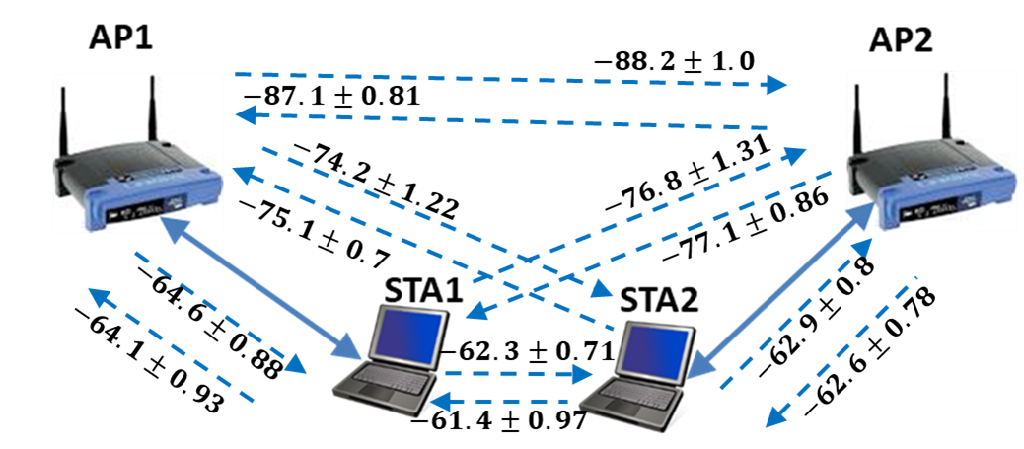
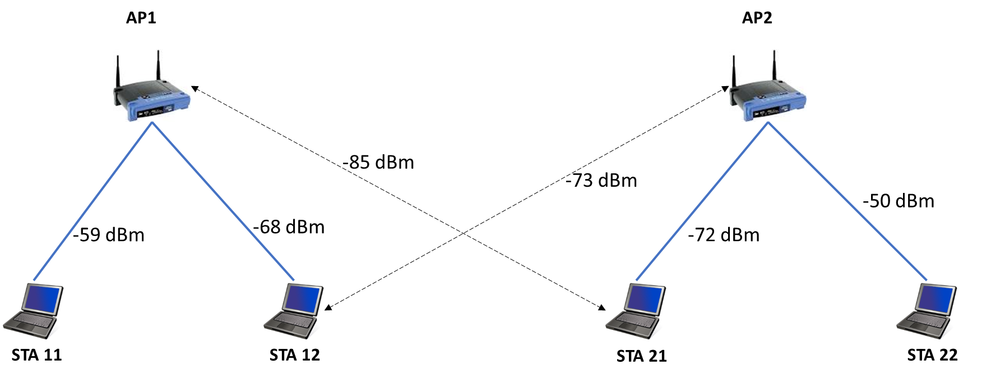
We Have Experimented with Two Scenarios of Dense AP Placement
Cochannel APs
About 30 m apart, with thick walls and heavy teak doors in between
We have experimented with APs in the 11ac mode at 20 MHz
For anonymity, we will not provide the model and manufacturer
We have found differences between APs, in the implementation of non-standardised aspects, such as
When RTS-CTS is used
How an AP schedules STAs associated with it
The AMPDU aggregation policy
2AP-2STA case
Each STA gets interference from the other AP
2AP-4STA case
STA11 and STA22 are close to their APs
STA12 and STA21 are “cell-edge” STAs
Each gets interference from the other AP
E.g., STA12 gets 78-104 Mbps PHY rate when only AP1-STA12 are active
But gets 26-39 Mbps PHY rate when AP2 is active along with AP1
With interference, aggregation also reduces, causing a steep drop in the user throughput

Slide 4
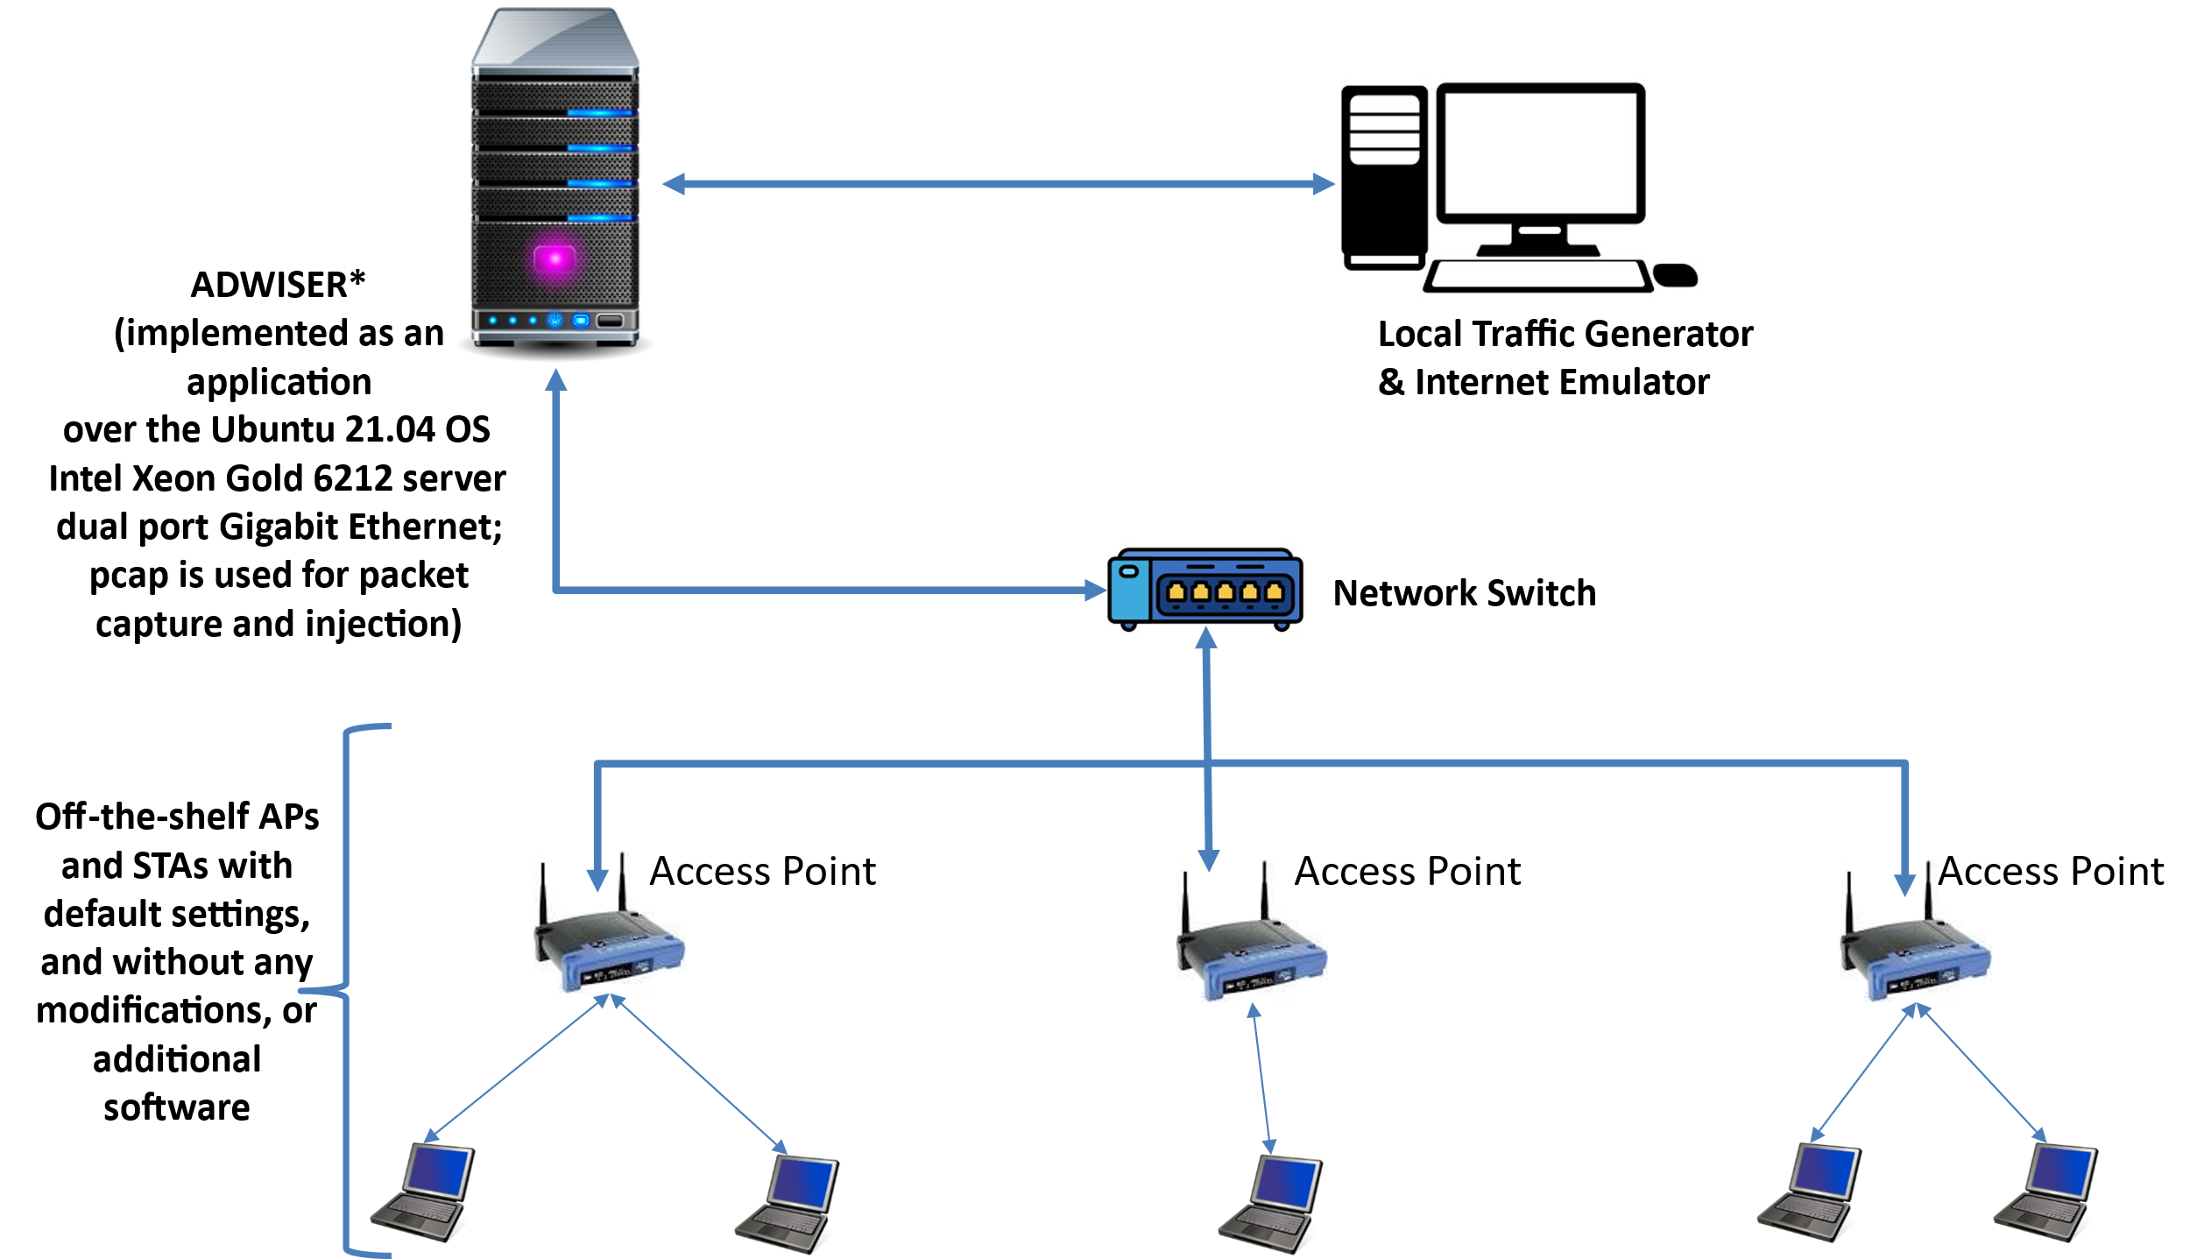
The Complete Testbed for Evaluating ADWISER
* ADvanced WIfi Service EnhanceR

Slide 5
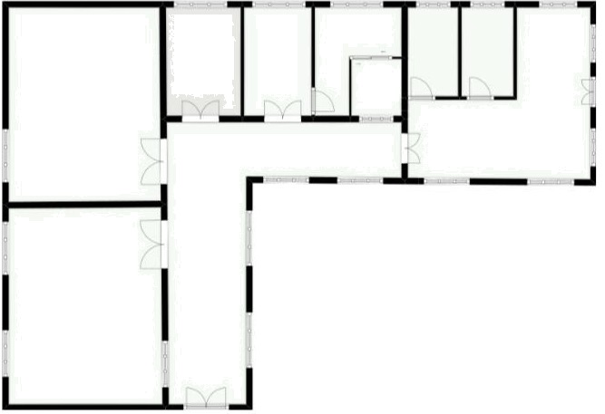
Physical Locations of the APs and the STAs in Network Labs, ECE, IISc
STA22
AP2
STA21
STA12
Access Point
AP1
Laptops: HP or Lenovo running Ubuntu OS
STA11
STA 12 and STA 21 are “cell-edge” stations, whereas STA 11 and STA 22 are “cell-interior” stations

Slide 6
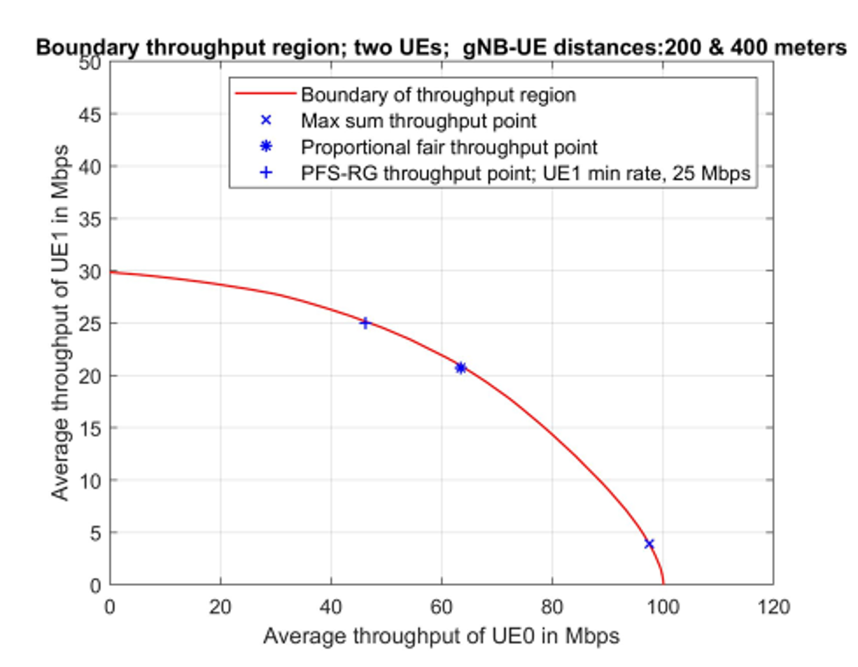
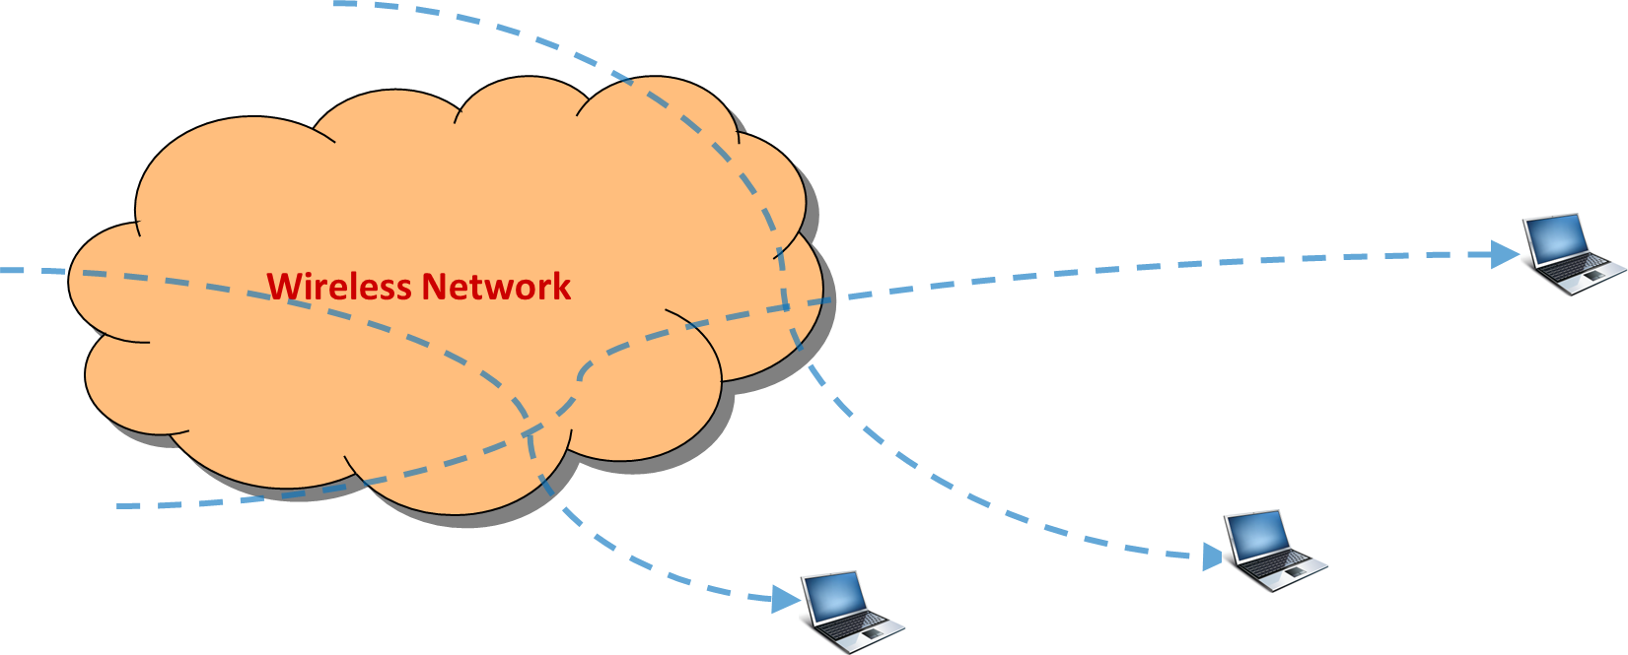
Throughput Region, Network Utility, and Operating Points
Throughputs of flows through a wireless network must lie in its throughput region
Efficiency requires that the operating point of the network lies on the boundary of the throughput region
The red curve in the plot
If flow $i$has throughput $θ_{i},$ we evaluate its utility as $U(θ_{i})$ for an appropriate function $U\left(⋅\right)$
The optimal operating point is obtained by $\max{\sum_{i=1}^{N}{U(θ_{i})} }$over the operating region
The commonly used Proportional Fairness has $U\left(θ\right)=log_{e}{θ}$ (e.g., cellular systems)
This is the utility we use in ADWISER scheduling

Slide 7
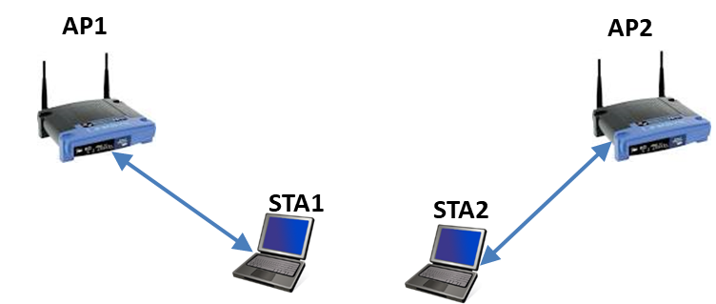
Downlink Bulk TCP Transfers (11n, 2.4 GHz, 20 MHz)
Bulk TCP
Bulk TCP
 | Scenario (250s experiments) | STA 1 (Mbps) Mean ± 95% CI* | STA 2 (Mbps) Mean ± 95% CI* | Network Utility
1 | Isolated | 79.6 ± 0.99 | 103.5 ± 1.03 | Bound on utility: 7.63
2 | Together | 21.7 ± 0.62 | 25.7 ± 0.56 | 6.32
3 | ADWISER, Time Slice = 100ms | 38.8 ± 0.38 | 50.9 ± 0.33 | 7.59
4 | ADWISER, Time Slice = 40ms | 37.9 ± 0.58 | 49.2 ± 0.43 | 7.53
5 | ADWISER, Time Slice = 20ms | 36.6 ± 0.35 | 47.5 ± 0.15 | 7.46
6 | ADWISER, Time Slice = 100ms, WAN | 38.7 ± 0.86 | 49.8 ± 0.53 | 7.56
7 | ADWISER, Time Slice = 40ms, WAN | 36.4 ± 0.28 | 48.9 ± 0.15 | 7.48
8 | ADWISER, Time Slice = 20ms, WAN | 34.9 ± 0.63 | 46.7 ± 0.11 | 7.4
* 25 throughput readings of 10 sec each were taken to calculate CI
WAN: emulated in Linux netem, 75 ms delay each way, 200 Mbps bottleneck rate
Date: 08/06/2022

Slide 8
Bulk TCP and HTTP Transfers: (11n, 2.4 GHz, 20 MHz)
Each HTTP download involved 10 HTTP requests:
1 of size 1MB, 3 of size 10KB, 3 of size 100KB, and 3 of size 500KB, a total of 22.640 Megabits
All these objects were downloaded by several parallel TCP connections
The think time was uniformly distributed between 100 and 500ms
Bulk TCP
HTTP
ADWISER provides higher throughput to the HTTP transfers, reducing their response time
Think times provide an opportunity for AP1-STA1 to steal the unused AP2-STA2 TxOPs .
Dynamic Time-Slicing
 | Scenario (3min experiments) | AP2-STA2 Avg. HTTP Response Time (ms) | AP1-STA1 TCP Throughput (Mbps)
1 | HTTP Expts - No ADWISER – AP2-STA2 HTTP – AP1-STA1 TCP | 1000 | 37.2 ± 0.9
2 | HTTP Expts - ADWISER 20ms – AP2-STA2 HTTP – AP1-STA1 TCP | 549 | 43.8 ± 0.71
Date: 08/06/2022

Slide 9
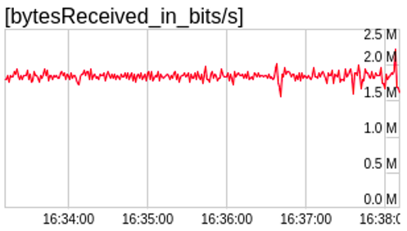
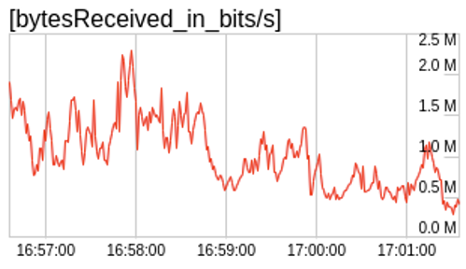
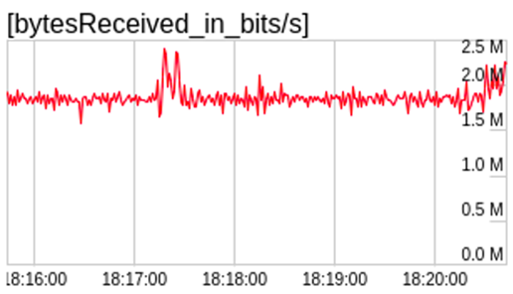
Downlink WebRTC Video over a Teams Call (11n, 2.4 GHz, 20 MHz)
Best case for video: nominal bit rate is 1.75 Mbps, average jitter 20 ms
Bulk TCP
Bulk TCP
and Video
Without ADWISER
Only downlink video, no TCP Downloads
AP-STA interference causes video packet loss; jitter goes up to 100-200 ms
Time Sliced, Index Based scheduling provides good video quality, with lower scheduling delays;
jitter 25-35 ms
Without ADWISER
ADWISER TS-PFS-IB-ABR-QD
Video over PFS: low bit rate video is scheduled
before releasing TCP packets
Downlink video, with TCP downloads at both STAs

Slide 10
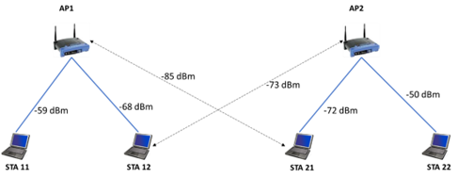
2AP 4STA Test-Bed, ADWISER Controlled
Downlink TCP Throughputs for Four Active Links (11ac, 5 GHz, 20 MHz)
11 May 2023
 |  | Experiment Details | STA 11 (Mbps) Mean ± 95% CI | STA 12 (Mbps) Mean ± 95% CI | STA 21 (Mbps) Mean ± 95% CI | STA 22 (Mbps) Mean ± 95% CI | Utility | Utility Bound
1 | No ADWISER | Isolated | 108.63 ± 1.05 | 94.16 ± 0.93 | 97.39 ± 1.28 | 126.48 ± 0.98 | - | -
2 |  | STA 11, STA 12, STA 21 & STA 22 Active | 61.47 ± 1.28 | 2.91 ± 2.04 | 7.45 ± 1.42 | 69.72 ± 0.97 | 11.46 | 14.42
3 | With ADWISER TS-PF-IB-ABR-OT S=20ms α=1 (with reserved slots for unserved set of STAs every 1 seconds) | STA 11, STA 12, STA 21 & STA 22 Active | 49.78 ± 2.05 | 21.90 ± 1.76 | 21.91 ± 2.57 | 56.01 ± 1.69 | 14.10 | 14.42
Schedulable set of AP-STA links $→$ | {11} | {12} | {21} | {22} | {11,21} | {11,22} | {12,21} | {12,22} | Utility Default | Utility Observed | Utility Bound
STA 11, STA 12 STA 21 & STA 22 Active | $$\frac{0}{0.0}$$ | $$\frac{0.25}{0.26}$$ | $$\frac{0.25}{0.24}$$ | $$\frac{0}{0.0}$$ | $$\frac{0}{0.03}$$ | $$\frac{0.50}{0.48}$$ | $$\frac{0}{0.0}$$ | $$\frac{0}{0.0}$$ | 11.46 | 14.10 | 14.42

Slide 11
9 May 2023
2AP 4STA Test-Bed, ADWISER Controlled
Downlink TCP Throughputs for Pairs of Active Links
 |  | Experiment Details | STA 11 (Mbps) Mean ± 95% CI | STA 12 (Mbps) Mean ± 95% CI | STA 21 (Mbps) Mean ± 95% CI | STA 22 (Mbps) Mean ± 95% CI | Utility | Utility Bound
1 | No ADWISER | Isolated | 108.63 ± 1.05 | 94.16 ± 0.93 | 97.39 ± 1.28 | 126.48 ± 0.98 | - | -
2 |  | STA 11 & STA 12 Active | 52.93 ± 2.19 | 46.92 ± 1.78 | - | - | 7.81 | 7.84
3 |  | STA 11 & STA 21 Active | 91.49 ± 0.77 | - | 34.71± 1.15 | - | 8.06 | 8.15
4 |  | STA 11 & STA 22 Active | 108.4 ± 1.07 | - | - | 125.87 ± 1.02 | 9.52 | 9.52
5 |  | STA 12 & STA 21 Active | - | 16.72 ± 2.91 | 29.07 ± 1.03 | - | 6.19 | 7.74
6 |  | STA 12 & STA 22 Active | - | 19.29 ± 2.06 | - | 89.74 ± 1.91 | 7.46 | 7.99
7 |  | STA 21 & STA 22 Active | - | - | 34.42 ± 2.19 | 78.36 ± 1.03 | 7.90 | 8.03
8 | With ADWISER TS-PF-IB-ABR-OT S=20ms a=1 (with reserved slots for unserved set of STAs every 1 second) | STA 11 & STA 12 Active | 48.26 ± 1.72 | 42.45 ± 1.66 | - | - | 7.64 | 7.84
9 |  | STA 11 & STA 21 Active | 63.38 ± 1.53 | - | 43.67 ± 2.01 | - | 7.93 | 8.15
10 |  | STA 11 & STA 22 Active | 98.64 ± 0.23 | - | - | 115.29 ± 0.76 | 9.34 | 9.52
11 |  | STA 12 & STA 21 Active | - | 41.44 ± 2.57 | 43.69 ± 1.99 | - | 7.50 | 7.74
12 |  | STA 12 & STA 22 Active | - | 41.97 ± 2.18 | - | 56.75 ± 1.02 | 7.77 | 7.99
13 |  | STA 21 & STA 22 Active | - | - | 43.69 ± 1.45 | 56.98 ± 1.73 | 7.82 | 8.03

Slide 12
11 May 2023
2AP 4STA Test-Bed, ADWISER Controlled Downlink
TCP Throughputs for Three Active Links
 |  | Experiment Details | STA 11 (Mbps) Mean ± 95% CI | STA 12 (Mbps) Mean ± 95% CI | STA 21 (Mbps) Mean ± 95% CI | STA 22 (Mbps) Mean ± 95% CI | Utility | Utility Bound
1 | No ADWISER | Isolated | 108.63 ± 1.05 | 94.16 ± 0.93 | 97.39 ± 1.28 | 126.48 ± 0.98 | - | -
2 |  | STA 11, STA 12 & STA 21 Active | 53.44 ± 2.17 | 2.93 ± 1.76 | 39.67 ± 2.07 | - | 8.73 | 10.78
3 |  | STA 11, STA 12 & STA 22 Active | 59.42 ± 2.5 | 12.25 ± 0.94 | - | 115.08 ± 0.62 | 11.33 | 12.16
4 |  | STA 11, STA 21 & STA 22 Active | 101.05 ± 3.25 | - | 18.58 ± 1.92 | 81.54 ± 1.07 | 11.94 | 12.19
5 |  | STA 12, STA 21 & STA 22 Active | - | 7.94 ± 2.58 | 14.29 ± 1.44 | 86.76 ± 1.86 | 9.19 | 10.67
6 | With ADWISER TS-PF-IB-ABR-OT S=20ms α=1 (with reserved slots for unserved set of STAs every 1 seconds) | STA 11, STA 12 & STA 21 Active | 43.25 ± 1.44 | 27.2 ± 2.93 | 29.07 ± 2.72 | - | 10.43 | 10.78
7 |  | STA 11, STA 12 & STA 22 Active | 65.13 ± 1.72 | 27.94 ± 2.16 | - | 75.06 ± 0.72 | 11.82 | 12.16
8 |  | STA 11, STA 21 & STA 22 Active | 64.71 ± 1.02 | - | 28.59 ± 1.57 | 75.15 ± 1.16 | 11.84 | 12.19
9 |  | STA 12, STA 21 & STA 22 Active | - | 28.62 ± 1.63 | 28.96 ± 2.92 | 37.56 ± 1.85 | 10.34 | 10.67

Slide 13
Network Slicing for WiFi: PF with Rate Guarantee
8 Feb 2023
Use cases
Indoor high-resolution, rapid download of images and videos
A senior doctor visiting patients at their hospital beds
Inspection and process monitoring in factories
Can we provide a guaranteed bit rate
to a particular device
or a group of devices, with admission control?
We have implemented PF-RG in ADWISER
In 5G they call this “network slicing”
The plot at left shows
The ideal max-sum-throughput and proportional-fair-throughput points
Also, the PF-RG point with rate guarantee of 25 Mbps to UE1

Slide 14
Enforcing a 75 Mbps Rate Guarantee for STA21 with ADWISER (TS-PF-IB(RG)-ABR-OT)
22 May 2023
Access Point
STA22
Laptops: HP & MSI
with the Ubuntu OS
STA21 is placed at different locations
AP2
STA21
(L3)
STA21
(L2)
STA21
(L1)
STA21 $43.95±2.01$ Mbps
STA 22 $65.84±2.15$ Mbps
STA21$57.89±2.02$ Mbps
STA 22 $63.16±2.18$ Mbps
STA21 $58.05±1.57$ Mbps
STA 22 $62.72±1.20$ Mbps
STA21 $74.45±3.31$ Mbps
STA 22 $14.05±2.68$ Mbps
STA21 $75.77±1.71$ Mbps
STA 22 $28.29±1.52$ Mbps
STA21 $74.91±1.65$ Mbps
STA 22 $27.30±2.67$ Mbps
Default Throughputs
Throughputs with ADWISER

Slide 15
How ADWISER Works

Slide 16
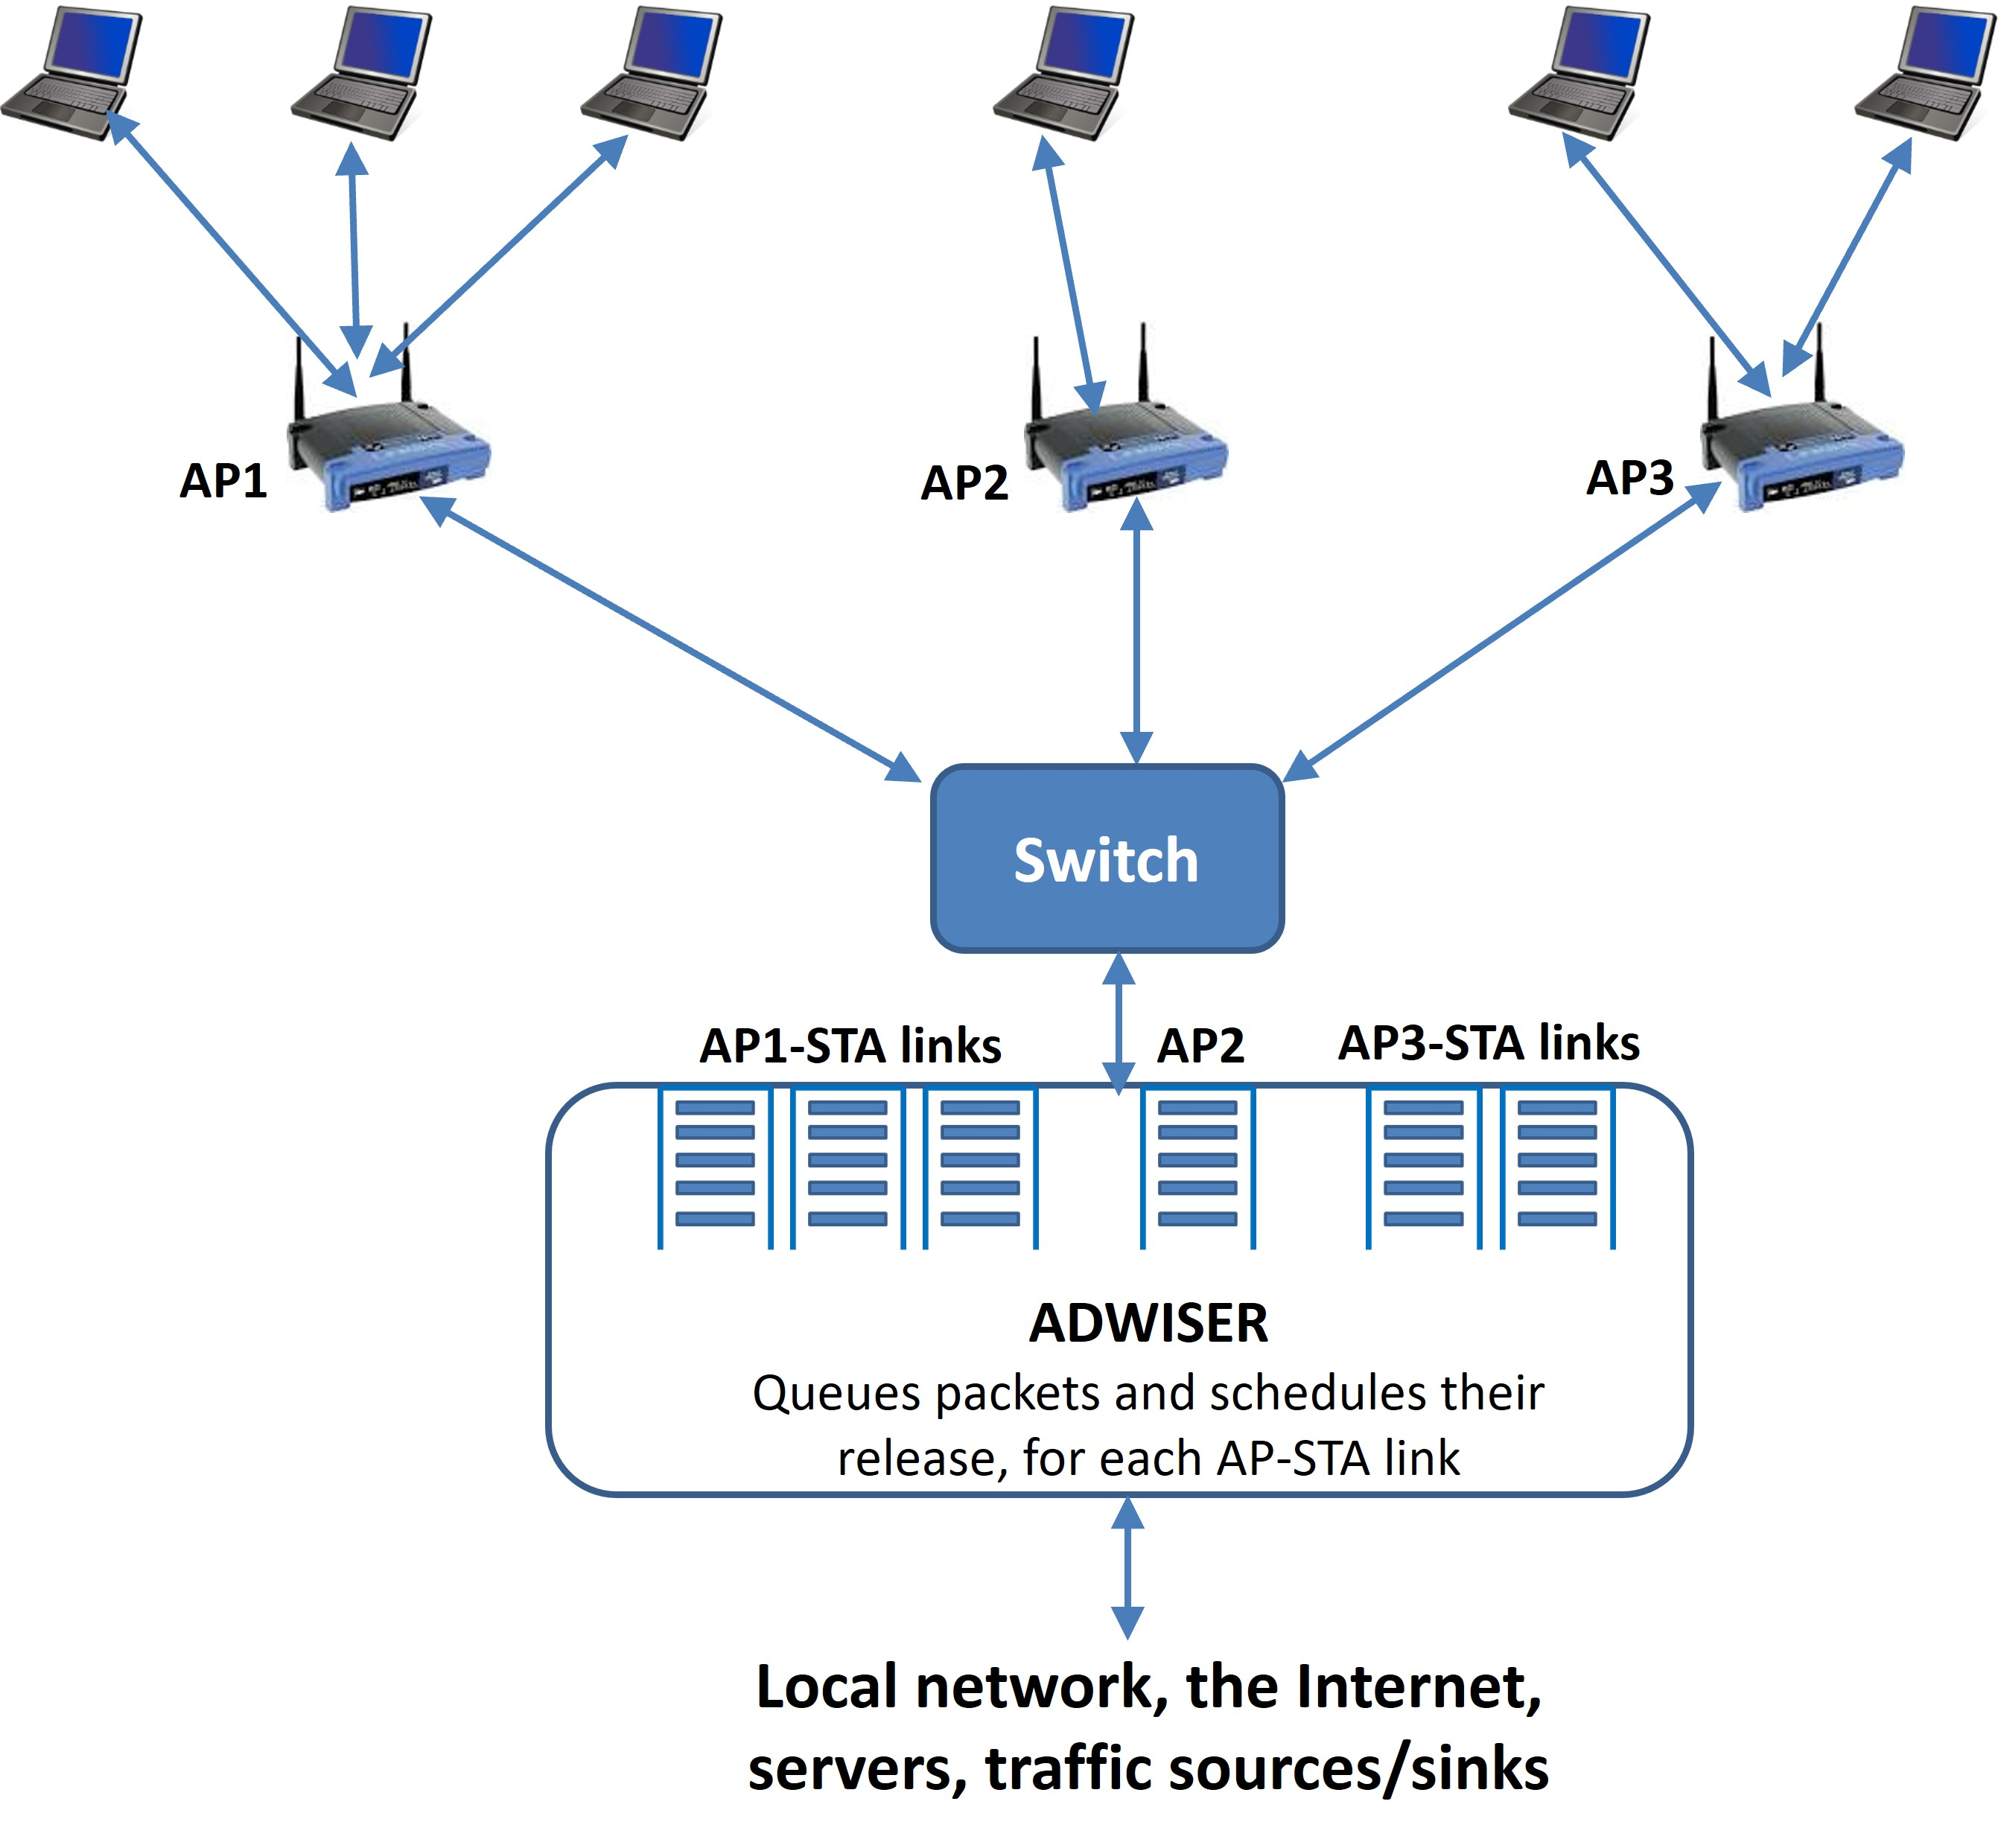
ADWISER: Internal Architecture
ADWISER controls link activation by controlling the release of packets into the AP queues
This permits the control of uplink and downlink TCP flows
Downlink UDP flows
Uplink UDP flows are not controlled

Slide 17
Measurement and Control in ADWISER
ADWISER uses past measurements to determine the set of AP-STA links to be scheduled in TS $k+1$ (for example: AP1-STA12 and AP2-STA22)
Scheduled APs and STAs use standard IEEE 802.11 mechanisms to send packets to each other
ADWISER updates measurements and determines the next set of AP-STA links to schedule
At each TS boundary, ADWISER determines and releases a burst of packets to each scheduled AP-STA pair
In each TS, ADWISER schedules sets of AP-STA links and collects measurements
Over successive Time Slices, ADWISER learns which sets of AP-STA links to schedule and how often
Time Slice $k$
Time Slice $k+1$
We have experimented with 20 ms, 40 ms, 80 ms, 100 ms slices
Smaller time slices are better for real-time interactive traffic QoS
The approach is similar to 4G and 5G Cellular Networks
Hence, the ADWISER approach can be viewed as Cellularising a WiFi Network

Slide 18
10 May 2023
2AP 4STA Test-Bed, ADWISER TS-PF-IB-ABR-OT (SACK Aware)
Optimal (upper) & Achieved (lower) Scheduling Frequencies
 | Experiment Details | {11} | {12} | {21} | {22} | {11,21} | {11,22} | {12,21} | {12,22} | Utility Default | Utility Observed | Utility Bound
1 | STA 11 & STA 12 Active | $$\frac{0.50}{0.50}$$ | $$\frac{0.50}{0.50}$$ | - | - | - | - | - | - | 7.81 | 7.64 | 7.84
2 | STA 11 & STA 21 Active | $$\frac{0}{0.01}$$ | - | $$\frac{0.22}{0.23}$$ | $$\frac{0}{0}$$ | $$\frac{0.78}{0.76}$$ | - | - | - | 8.06 | 7.93 | 8.15
3 | STA 11 & STA 22 Active | $$\frac{0}{0.01}$$ | - | - | $$\frac{0}{0}$$ | - | $$\frac{1.00}{0.99}$$ | - | - | 9.52 | 9.34 | 9.52
4 | STA 12 & STA 21 Active | - | $$\frac{0.50}{0.50}$$ | $$\frac{0.50}{0.50}$$ | - | - | - | $$\frac{0}{0.0}$$ | - | 6.19 | 7.50 | 7.74
5 | STA 12 & STA 22 Active | - | $$\frac{0.50}{0.24}$$ | - | $$\frac{0.50}{0.24}$$ | - | - | - | $$\frac{0}{0.24}$$ | 7.46 | 7.77 | 7.99
6 | STA 21 & STA 22 Active | - | - | $$\frac{0.50}{0.50}$$ | $$\frac{0.50}{0.50}$$ | - | - | - | - | 7.90 | 7.82 | 8.03

Slide 19
11 May 2023
2AP 4STA Test-Bed, ADWISER TS-PF-IB-ABR-OT (SACK Aware)
Optimal (upper) & Achieved (lower) Scheduling Frequencies
 | Experiment Details | {11} | {12} | {21} | {22} | {11,21} | {11,22} | {12,21} | {12,22} | Utility Default | Utility Observed | Utility Bound
1 | STA 11, STA 12 & STA 21 Active | $$\frac{0}{0.02}$$ | $$\frac{0.33}{0.37}$$ | $$\frac{0.15}{0.09}$$ | - | $$\frac{0.52}{0.52}$$ | - | $$\frac{0}{0.0}$$ | - | 8.73 | 10.43 | 10.78
2 | STA 11, STA 12 & STA 22 Active | $$\frac{0}{0.01}$$ | $$\frac{0.33}{0.36}$$ | - | $$\frac{0}{0}$$ | - | $$\frac{0.67}{0.61}$$ | - | $$\frac{0}{0.02}$$ | 11.33 | 11.82 | 12.16
3 | STA 11, STA 21 & STA 22 Active | $$\frac{0}{0}$$ | - | $$\frac{0.33}{0.34}$$ | $$\frac{0}{0}$$ | $$\frac{0}{0.02}$$ | $$\frac{0.67}{0.66}$$ | - | - | 11.94 | 11.84 | 12.19
4 | STA 12, STA 21 & STA 22 Active | - | $$\frac{0.33}{0.34}$$ | $$\frac{0.33}{0.33}$$ | $$\frac{0.33}{0.30}$$ | - | - | $$\frac{0}{0.0}$$ | $$\frac{0}{0.03}$$ | 9.19 | 10.34 | 10.67

Slide 20
ADWISER Queues: Activity Detection and Real-Time Packets
The STA queue in ADWISER indicates activity at the STA
Used by ADWISER to decide which sets of links to include in the scheduling index calculation
Voice and video packets are handled by releasing them at the beginning of each slice
This suffices for the commonly used voice and video formats

Slide 21
How the ADWISER Approach Can Enhance WiFi 6 & WiFi 7
 | Aspects | WiFi 6 & WiFi 7 | ADWISER
1 | Synchronous Scheduling | Asynchronous scheduling AP must win a TxOP to incorporate scheduling for that TxOP. | Synchronous scheduling ADWISER schedules AP-STA pairs in synchronous time-slices, based on a stateful algorithm.
2 | Globally Optimal Scheduling | Each AP has a view of only its own STAs, and can do OFDMA scheduling only over them. | ADWISER does globally optimal scheduling
3 | Distributed vs. Centralised | Distributed scheduling using interAP coordination: a lot of information exchange about link qualities must take place between the APs and a Master AP | ADWISER computes the schedule using the performance in previous slices for each AP-STA pair
4 | STA Power Management | Power Save takes priority over QoS | Time-sliced scheduling provides a sleep schedule that will be Optimal for Power Save and for QoS
4 | Information Availability | Some crucial information is available at the APs: Which STAs are associated? The state of its MAC queues? The AP’s own aggregation policy. | Some of this crucial information has to be either probed for by ADWISER, or has to be assumed or estimated, leading to overheads.
The future might be to provide a new well-thought-out Control Plane to (a) permit a central QoS controller to obtain the information it needs from the APs, or (b) embed ADWISER-like functionality in a centralized or distributed way in the APs

Slide 22
Acknowledgements, Publications, and Patents
During 2021-2023, our work was supported by CSR grants from Arista Networks and Cisco
Publications and Patents:
Recent (Emphasis on HT WiFi and fine-grained time-slicing):
Vishal Sevani, Purushothaman Saravanan, S.V.R. Anand, Joy Kuri, and Anurag Kumar, “Time-Slicing High Throughput WiFi Networks Using Centralized Queueing and Scheduling,” WiNTECH workshop in Mobicom 2022, Sydney, Australia October 2022.
Earlier:
Albert Sunny, Sumankumar Panchal, Nikhil Vidhani, Subhashini Krishnasamy, S.V.R. Anand, Malati Hegde, Joy Kuri, Anurag Kumar, “A generic controller for managing TCP transfers in IEEE 802.11 infrastructure WLANs," Journal of Network and Computer Applications (Elsevier), vol. 93, pages 13-26, 2017.
Malati Hegde, Pavan Kumar, K. R. Vasudev, N. N. Sowmya, S. V. R. Anand, Anurag Kumar, and Joy Kuri, “Experiences with a Centralised Scheduling Approach for Performance Management of IEEE 802.11 Wireless LANs," IEEE/ACM Transactions on Networking, vol. 20, no. 2, pages 648-662, April 2013.
Malati Hegde, S.V.R. Anand, Anurag Kumar, and Joy Kuri, “WLAN Manager (WM): a Device for Performance Management of a WLAN," International Journal of Network Management, (a Wiley Interscience journal), vol. 17, pages 155-170, January 2007.
Patents:
Malati Hegde, Pavan Kumar, K. R. Vasudev, S. V. R. Anand, Anurag Kumar, and Joy Kuri, “System and Method for Management of Throughput Between Internet and Heterogeneous Network and Qos Management,” Indian Patent No. 330594, granted 28 January 2020.
Malati Hegde, Pavan Kumar, K. R. Vasudev, S. V. R. Anand, Anurag Kumar, and Joy Kuri, “A Centralized Wireless Manager (WiM) for Performance Management of IEEE 802.11 and a Method thereof," Indian Patent No. 301414, granted 26 September 2018.

Slide 23
Thank You

Slide 24
Backup Slides

Slide 25
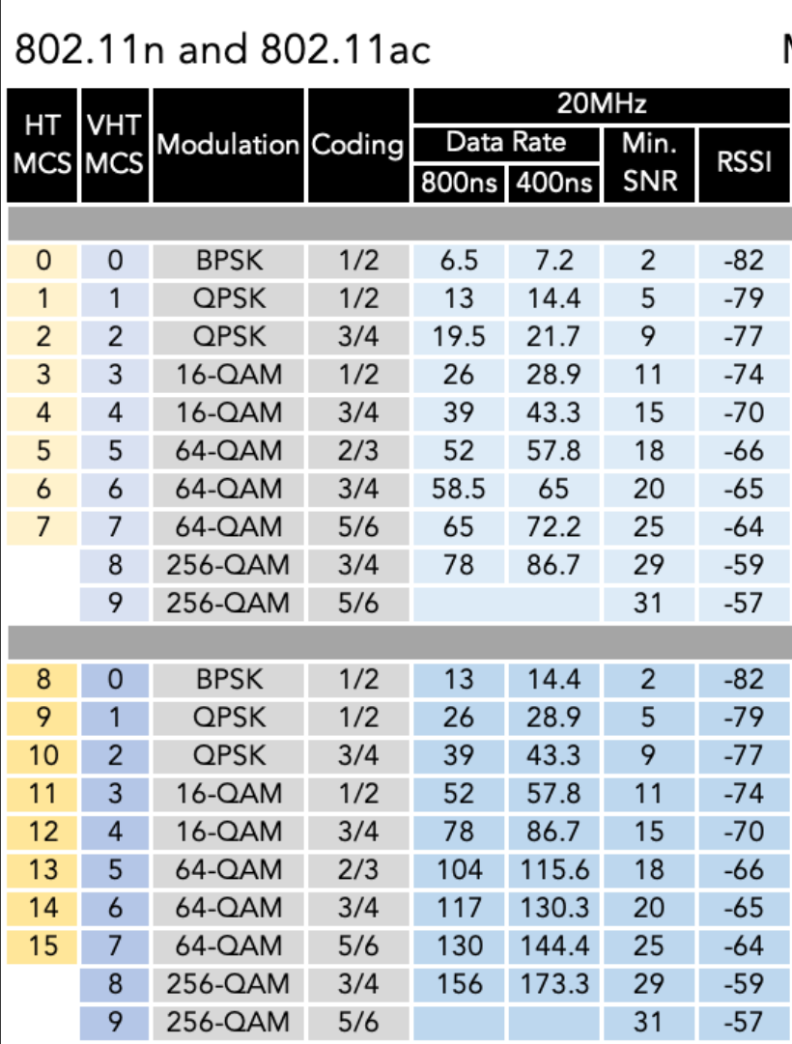
Received Signal Strength: Possible Interference Effects
AP1
AP2
Association
Data Packet Interference
-78 dBm
-75 dBm
-42 dBm
-51 dBm
-67 dBm
-63 dBm
STA 11
STA 12
STA 21
STA 22
Received Signal Strength (RSS) measurements were made using a utility in the Linux kernel
STA 12 and STA 21 are cell-edge stations
STA 21 can get 130 Mbps, if there was only noise
With interference its SNIR is 15 dB
As per the table, it will get about 78 Mbps if AP1 is active at the same time as AP2
Reduction in AMPDU aggregation will make the actual throughput much lower

Slide 26
Time Slicing with Adaptive Batch Release
Scheduler allots next slice to AP1-STA1.
Updated number of packets released to AP1-STA1
Suppose we release $r_{2}\left(k\right)$ packets to AP2-STA2
$$r_{2}(k)$$
The data released to AP2-STA2 is drained out in $V(r_{2}\left(k\right))$
$$r_{1}(k+1)$$
The scheduler could allot the next slice to AP1-STA1 or to AP2-STA2, and
ADWISER releases batch size $r_{i}\left(next\right)$
$$V\left(r_{2}\left(k\right)\right)$$
$$V\left(r_{1}\left(k+1\right)\right)$$
Time slice dynamically allotted to AP2-STA2
Time slice dynamically allotted to
AP1-STA1
Batch release promotes aggregation right from the beginning of the time slice
Simple Robbins-Monro control algorithm
$$r_{i}\left(next\right)=r_{i}\left(k\right)+a(S −V_{i}(r_{i}\left(k\right))$$
where $V_{i}\left(r\right)$ is the queue drain time at APi-STAi for a batch input of $r$ packets
$S$is the nominal slice time, e.g., 100 ms, 80 ms, 40 ms, 20 ms; the smaller the better
We call this algorithm: TS-PFS-IB-ABR-QD
Because the decision to allot a slice to an AP-STA pair is obtained via the Proportional Fair Sharing Algorithm
In general networks, we need to schedule more than one AP-STA link in a slice
For example: $ℳ=\{STA11, STA22\}$ or $ℳ=\{STA12, STA22\}$ in the 2AP 4STA case

Slide 27
ADWISER TS-PF-IB-ABR-OT
8 Feb 2023
At the end of slice $k,$we obtain burst sizes for all the stations $i$ in $ℳ$ using RM
$$r_{i}^{ℳ}\left(k+1\right)=r_{i}^{ℳ}\left(k\right)+a ∗(S −v_{i}^{ℳ}(k))$$
Time slice $k$
Time slice $k+1$
ABR-OT: Start a new slice at the slice boundary, and use a simple estimate for the drain time
We use following expression to estimate the value of $v_{i}^{m}$ in slice $k$
$$v_{i}^{ℳ}\left(k\right)←\left\{\begin{aligned}v_{i}^{ℳ}\left(k\right) ; v_{i}^{ℳ}(k)≤S \\ \frac{r_{i}^{ℳ}(k)}{\frac{r_{i}^{ℳ}(k)−ε_{i}^{ℳ}(k)}{S} } ; otherwise\end{aligned}\right.$$
where $ε_{i}^{ℳ}(k)$is the ‘unacked’ bytes out of the burst $r_{i}^{ℳ}\left(k\right)$ at STA$i$ when STAs in set $ℳ$ are scheduled in slice $k$
$0≤ε_{i}^{ℳ}(k)≤r_{i}^{m}\left(k\right)$
To determine the set of links $ℳ$to schedule in the next slice, we calculate the indices
$$Γ^{ℳ}\left(k\right)=\sum_{∀ i ∈ ℳ}{\frac{\frac{r_{i}^{ℳ}\left(l^{ℳ}\left(k\right)\right)}{{\overline{v}}_{i}^{ℳ}}}{\overline{θ_{i}}}}$$
Where $r_{i}^{ℳ}\left(l^{ℳ}\left(k\right)\right)$is burst size of STA $i$ when set $ℳ$ was scheduled last before the k^{th} slice
${\overline{v}}_{i}^{ℳ}:$ EWMA drain time, and $\overline{θ_{i}}$ : is EWMA throughput for STA $i$
Schedule the set of links $ℳ$ with the largest index
This is Proportional Fair Scheduling

Slide 28
ADWISER Takes Full Control of Scheduling; APs only Queue and Transmit
Consider AP3
ADWISER can release a burst of packets for both the STAs
But AP3 will schedule these packets using its own policy
Thereby, possibly, upsetting ADWISER’s global calculations
Our observation is that the APs tend to favour an STA with better throughput
Therefore, ADWISER only schedules sets of AP-STA links with at most a single STA associated with each AP
This also reduces the number of scheduling options,
thereby reducing the complexity of scheduling
We call this approach TS-PF-IB-ABR-OT
Since we have true proportional fair sharing over the network
What about interAP coordinated OFDMA?
In the future, ADWISER could itself instruct the AP to optimally allocate OFDMA RUs to the associated STAs

