Slide 1
Kiran Avva, DoE, cnWave
Prabhash Dhyani, DoE, Enterprise Wi-Fi
Multi-Gigabit Wireless Fabric for Smart Cities, Logistics, and Public Access
Wi-Fi Knowledge Summit, 2023

Slide 2
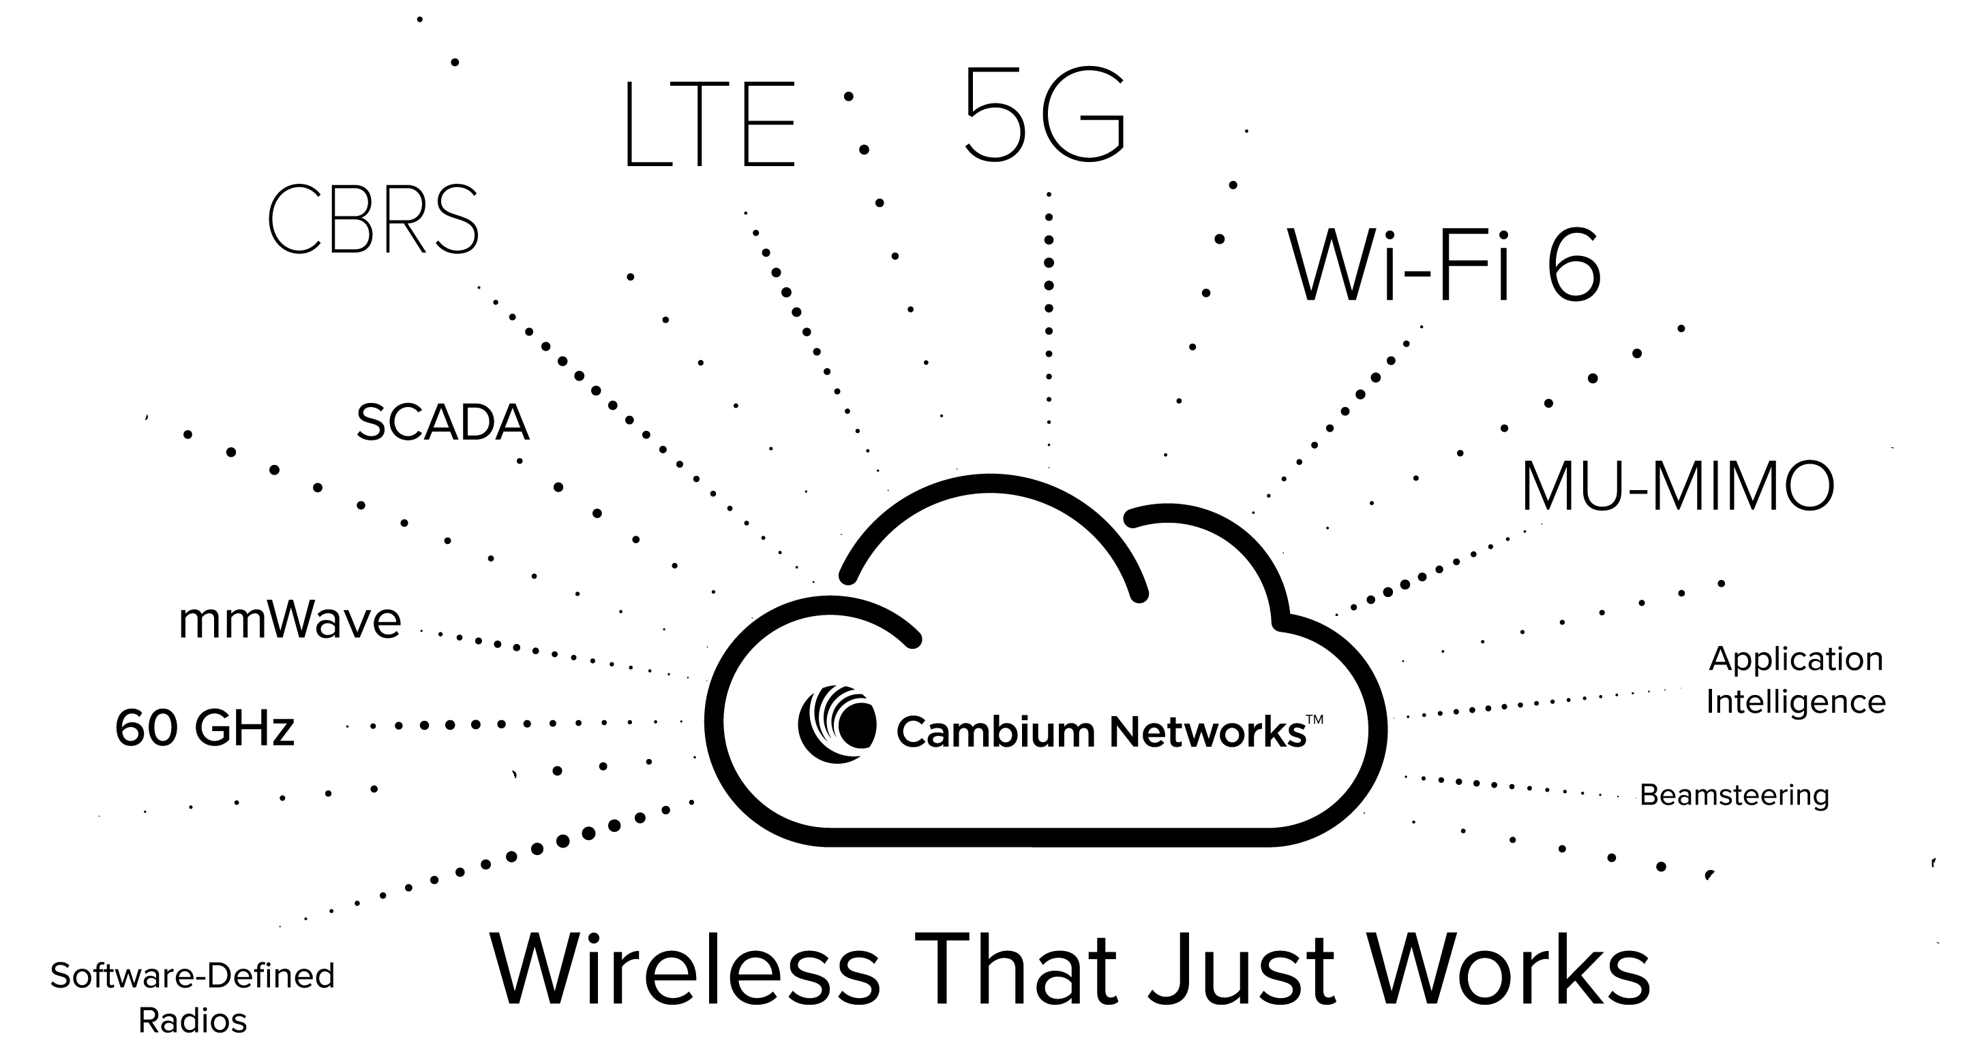

Cambium Networks - Connectivity That Just Works
Wireless fabric around the world,
  Powers reliable Connections from 2 meters to 200 Kms.
  Point-to-point, point-to-multipoint and WLAN
What can be wireless, will be wireless!
CMBM
Mission: Connect the Unconnected

Slide 3
Smart Cities, Logistics and Public Wi-Fi Challenges
To give a seamless end-to-end connectivity to end users, backhaul should be as reliable as Wi-Fi. Backhaul should have following properties:
Cost-Effective
Flexible
Resilient
Fast
Recoverable
Fiber is expensive
Difficult Terrains
Hard to reach locations
Permissions required
Takes time
Easily deployable
Temporary Installations
Rapid Deployments Scenarios
Meet growing demands
Not easily susceptible to damage
Weather, construction work damage fiber networks.
HA is difficult with Fiber.
Comparable throughput as Fiber
Suitable for applications as video surveillance, calls
Faster recovery
Without end-user’s notice

Slide 4
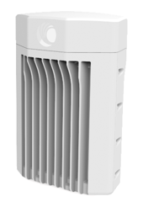
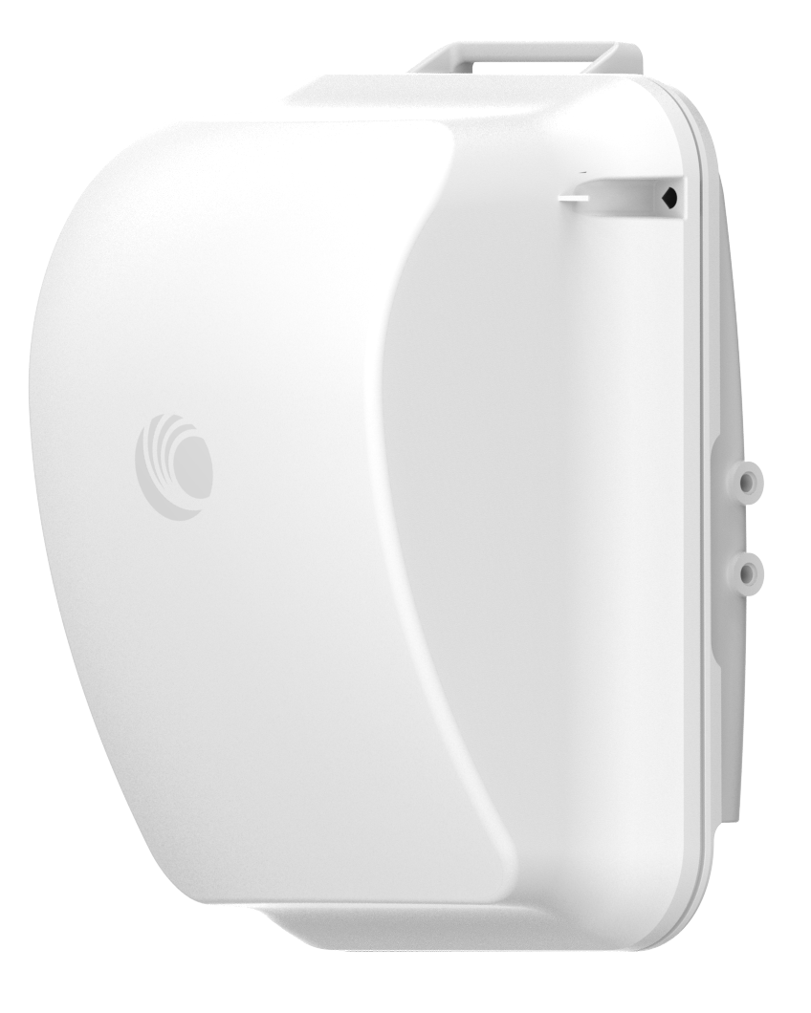
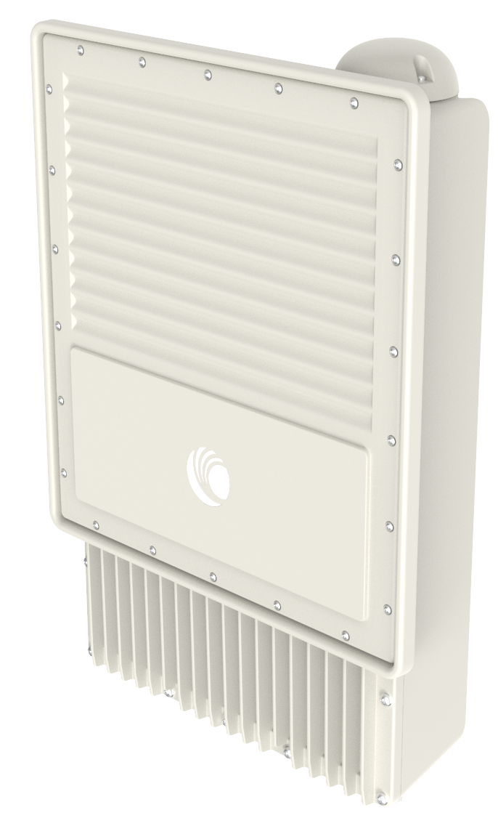
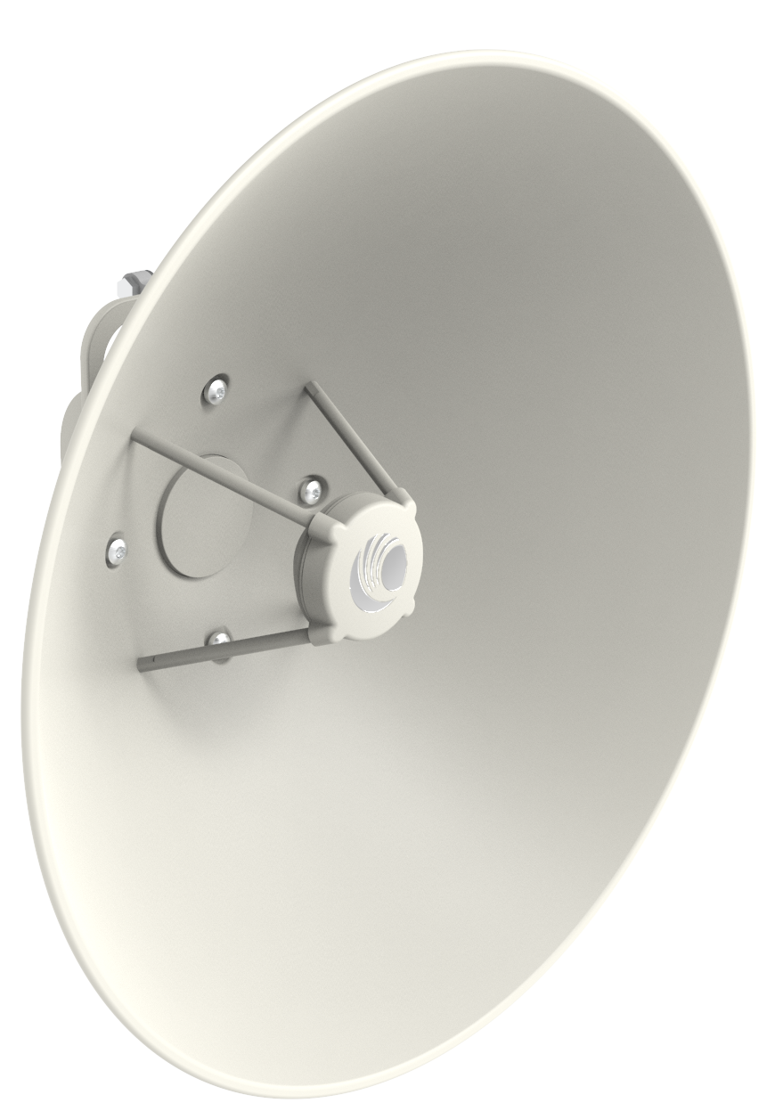
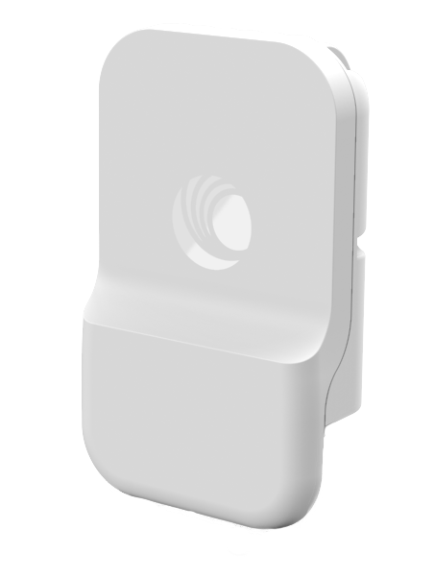
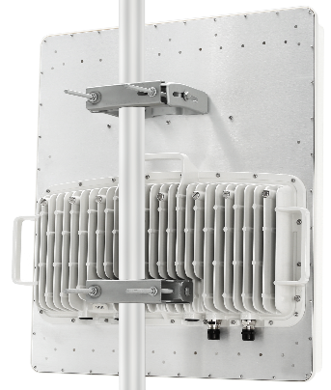
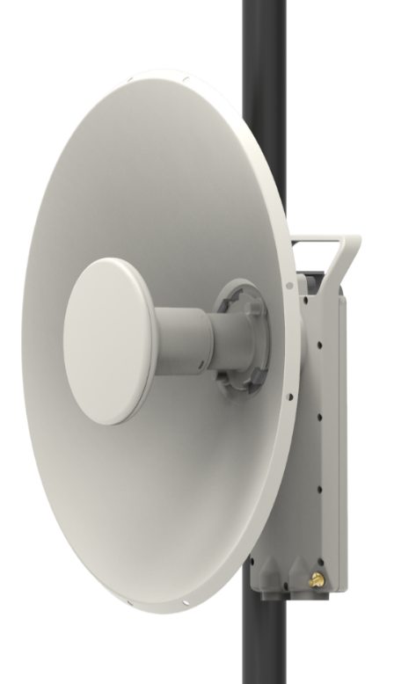


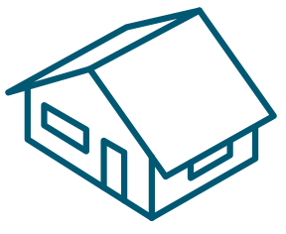


Fixed Wireless Access (FWA) Networks
60 GHz cnWave
cnWave 5G Fixed
3 GHz PMP 450
ePMP 4000 & Force 4xx
>1 Gbps
Subscriber Bandwidth
400 Mbps
200 Mbps
Tower Location
Subscriber Density
300 m
5 km
10 km
KPI
Technology | 802.11ay Terragraph | 5G NR | cnMedusa MU-MIMO → 5G NR
Sector Capacity | > 15 Gbps | > 3 Gbps | > 1 Gbps
Subscribers per Sector | 30 | 240 | 238

Slide 5


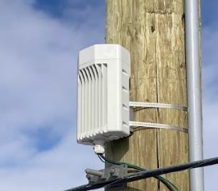
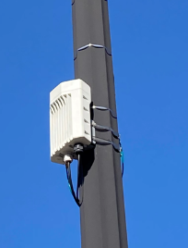
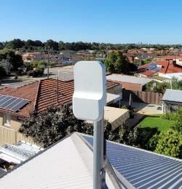
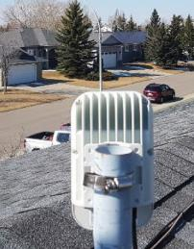
60 GHz Networks Are Popping Up Everywhere

Slide 6
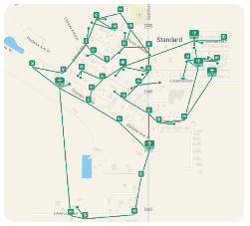
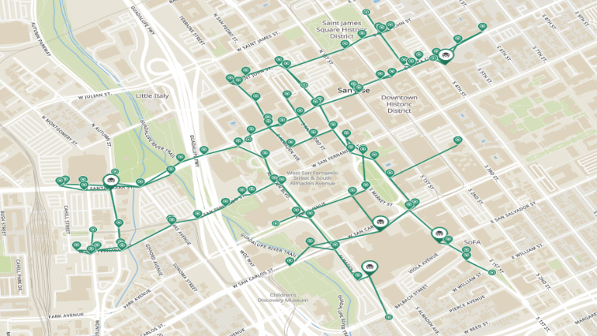

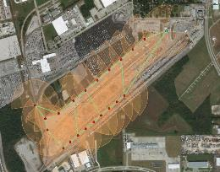
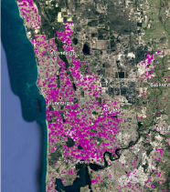
60 GHz is Proven Gbps Infrastructure
Verticals
Service Providers (WISP’s, Carriers, Fiber)
Enterprise (MDU’s, Logistics, Retail)
Industrial (Oil/Gas, Freight Rail)
Municipalities (Public Wi-Fi, City Services)
Solutions
CCTV/Video Surveillance Backhaul
Wi-Fi Backhaul
Campus Connectivity
Residential/Business Internet Access
Village of Standard,
Alberta, Canada
Public WiFi Back Haul
City of San Jose, USA
Freight Railyard
Montreal, Canada
Pentanet Service Provider
Perth, Australia

Slide 7
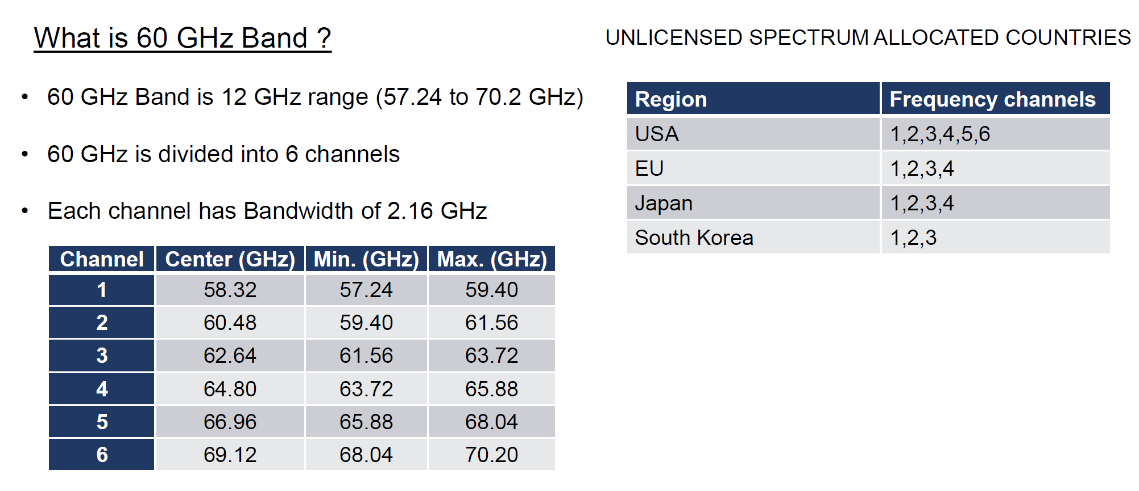
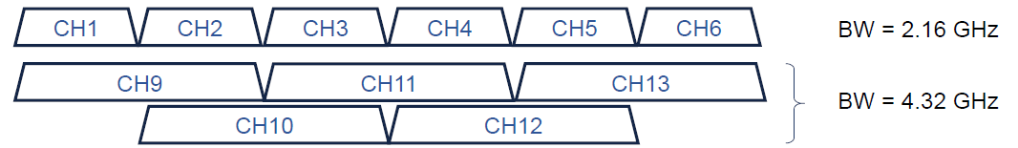
60 GHz frequency band

Slide 8
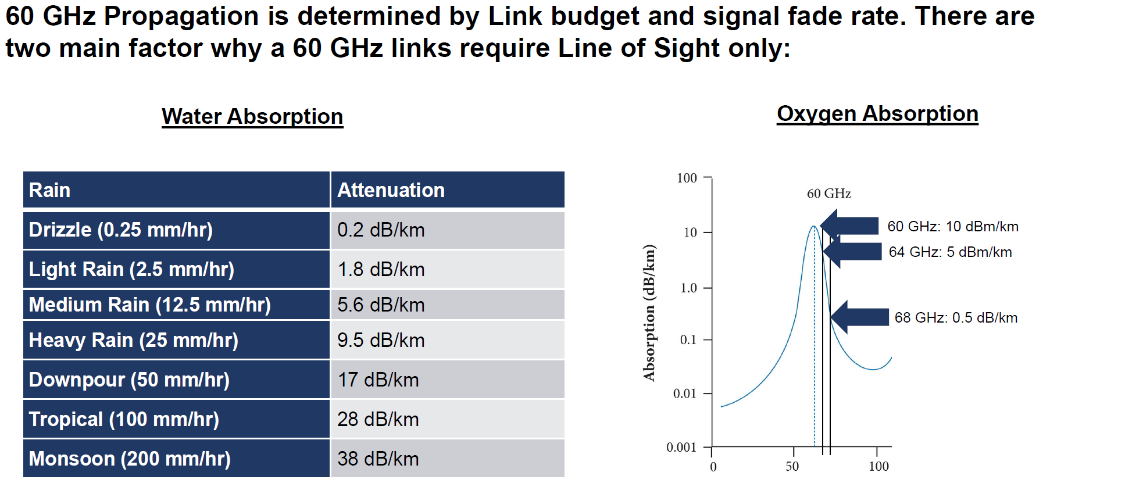
60 GHz Propagation

Slide 9
802.11ad → 802.11ay: What has Changed?
Cloud Management
High Availability
Network Efficiency
Endless Possibilities
Small Cell Backhaul
Campus Area Network
Fiber Extension
Urban Network
Enterprise Private Network
Gigabit Residential Service
Dense Deployment
Network
Capabilities
Scalability
Network Capacity
802.11ad Standard
802.11ay Standard + Terragraph
High Performance Over
Short Distances
2010
2020

Slide 10
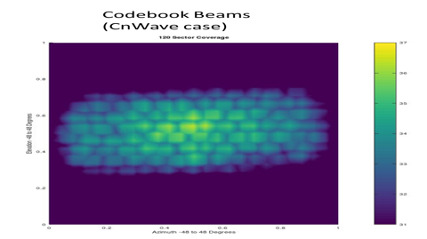
Beamforming and Directional Antennas
Due to the short wavelength of 60 GHz, antenna elements are very small in size.
This allows us to have a large phased array in a small form factor.
The technology we use is RF beamforming, and we utilize lookup tables to pre-program the phase and magnitude to define a beam direction.
The picture shows different beams we could select on the fly during the link-up process. Only one element in the phased array is illuminated.
This minimizes interference, which is quite useful in a mesh. Data is sent in a narrow beam specific to that link.

Slide 11
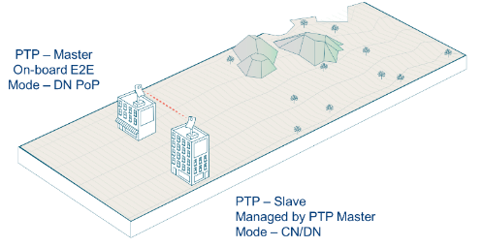
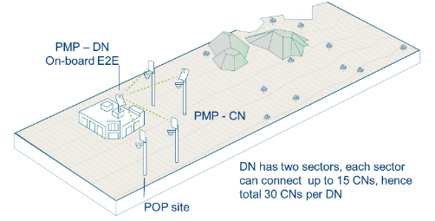

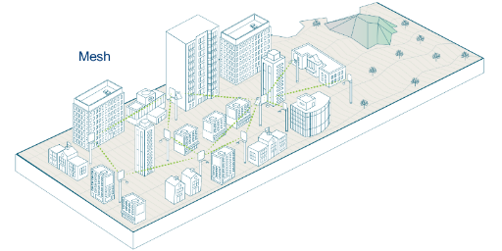

Flexible Deployment Options
Point-to-Point
Point-to-Multipoint
Distributed Network
Sector 1
Centralized Controller
Optimum Route Calculated at each DN
Total of 30 CN’s per DN
Sector 2
Management & Configuration Centralized, Reliability and Redundancy Distributed

Slide 12
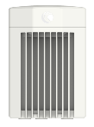


Deployment Example – Building a Distributed network
Endless Deployment Scenarios
V5000 DN
Sector 1
Sector 2
V1000 CN
Mesh (DN-DN)
– Auto healing
Gigabit PTP (V1000-V1000)
V3000 CN
Long range multi-Gigabit PTP (V3000-V3000)

Slide 13
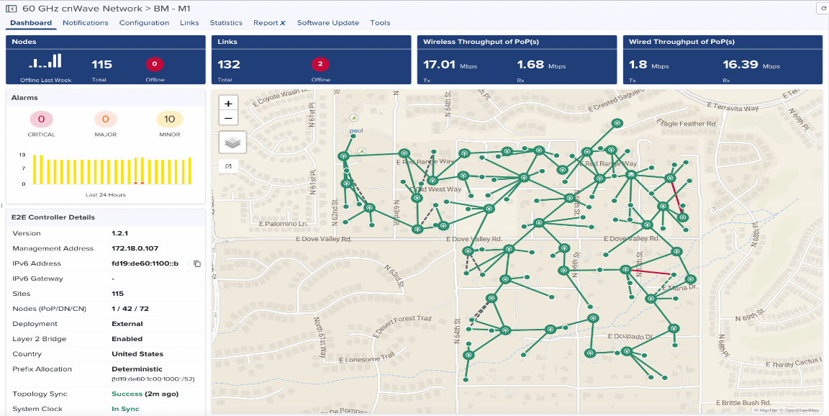
cnMaestro: V5000 Distributed Networks

Slide 14
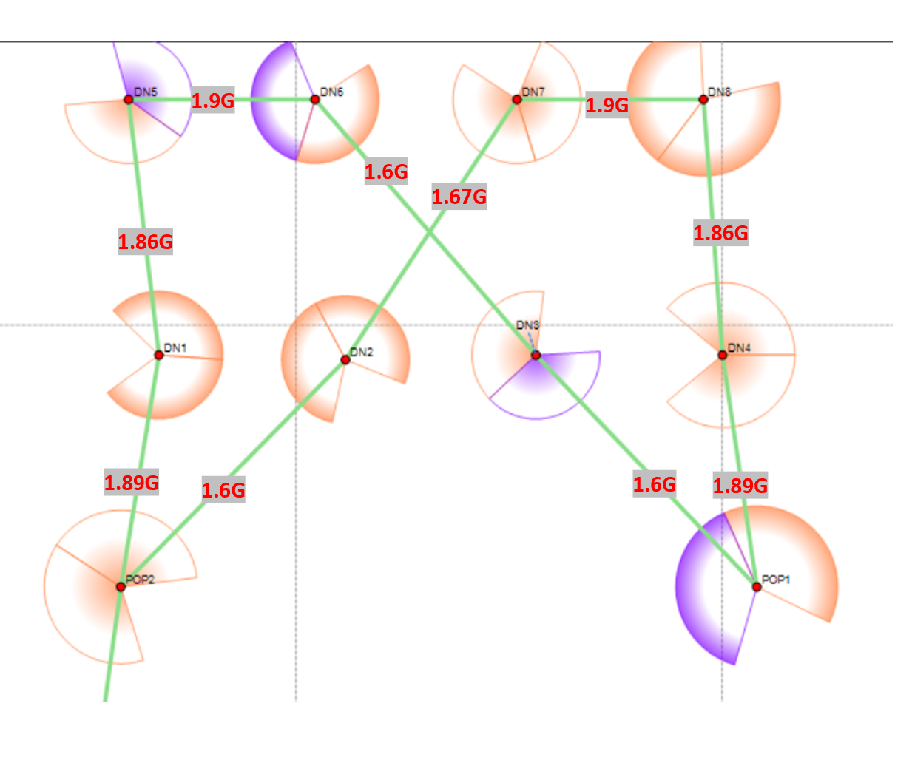
TDD Synchronization
Synchronization is used to control the transmit and receive of signal to prevent self-interference
Radios assigned with same polarity will be transmitting and receiving at the same time.
  Two types of Polarity
    Odd
    Even
  When Odd nodes are Tx
  Even nodes will be Rx

Slide 15
Layer 2 and Layer 3 Networking
Terragraph/QCA/Facebook/Cambium have studied the impact of layer 2 vs layer 3 mesh networks and settled on layer 3 for a reason.
  Layer 2 is transparent to all Ethernet traffic so can simplify deployments on a small scale
However:
  As the network grows, layer 2 broadcast traffic can overwhelm the network. Flooding can occur causing congestion and inefficiency
  Protection is required to avoid Client to Client communication, devices attached to CN’s can discover each other.
OPEN/R from Facebook provides the layer 3 routing between nodes in the mesh network.
cnWave has native layer 3 support and enables layer 2 tunnelling at the touch of a button.
Cambium cnWave aligns to the networking layer from Terragraph and differentiates with superior wireless performance and stability.
Notes:
You can imagine a broadcast storm occurring when a large number of customers come online at the same time e.g. after software upgrade or a backhaul link is re-established.
It’s easier to segment networks, restrict broadcast traffic to subnets

Slide 16
60 GHz cnWave Cost per node passed is 41% of Fiber
Wireless Coverage breakeven at 14 months
Fiber breakeven at 30 months
cnWave plan showing wireless DN and POP locations
FTTH Plan showing: Trenches, Closures, Cabinets, Splice Points, Underground Cable
Source: Facebook Connectivity OTE Gerakas-TG-BusinessCase

Slide 17
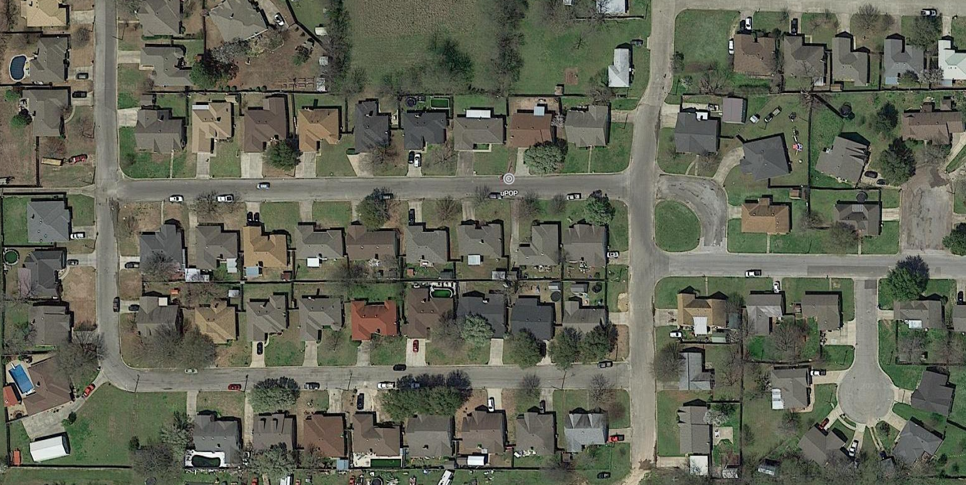
Example 1: Distributed Mesh vs. Hub-and-Spoke
Real-world design example
Service Provider goal is 100% coverage of 55 homes in this neighborhood
  500Mbps/1Gbps capacity
Design constraints
  Line of sight
  < 200 meter range for high modulation
  No more than 15 CN’s per sector
Option 1:Traditional Hub/Spoke
Option 2: Distributed Mesh

Slide 18
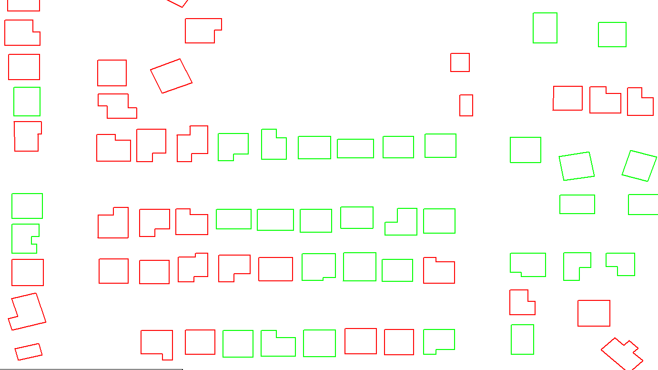
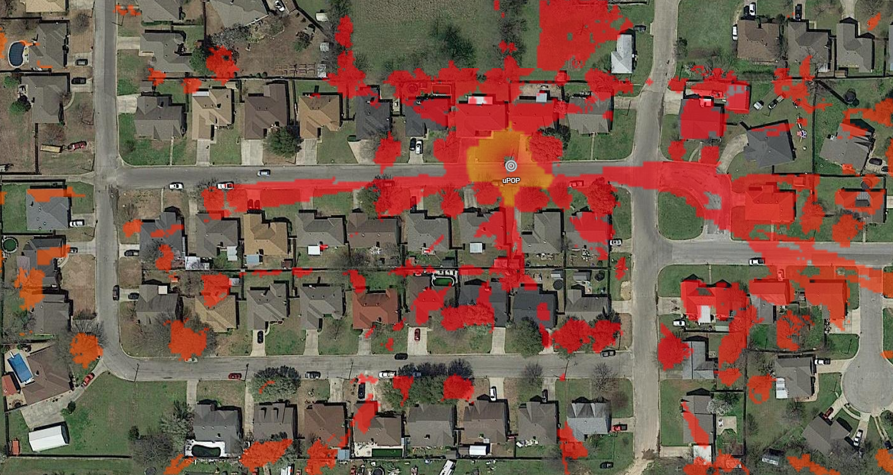
Example 1: Traditional Hub/Spoke
Pole Height | Covered | Total | Percent
10m | 31 | 55 | 56%
15m | 44 | 55 | 80%
20m | 50 | 55 | 91%
25m | 52 | 55 | 95%
30m | 53 | 55 | 96%
56% of buildings covered by uPOP with 10m pole
30m / 10-story tower required for 96% coverage
Southwest quadrant is already maxed out at more than 15 CN’s
Far West CN’s are at edge of range
Single tree can block several houses
No resiliency

Slide 19
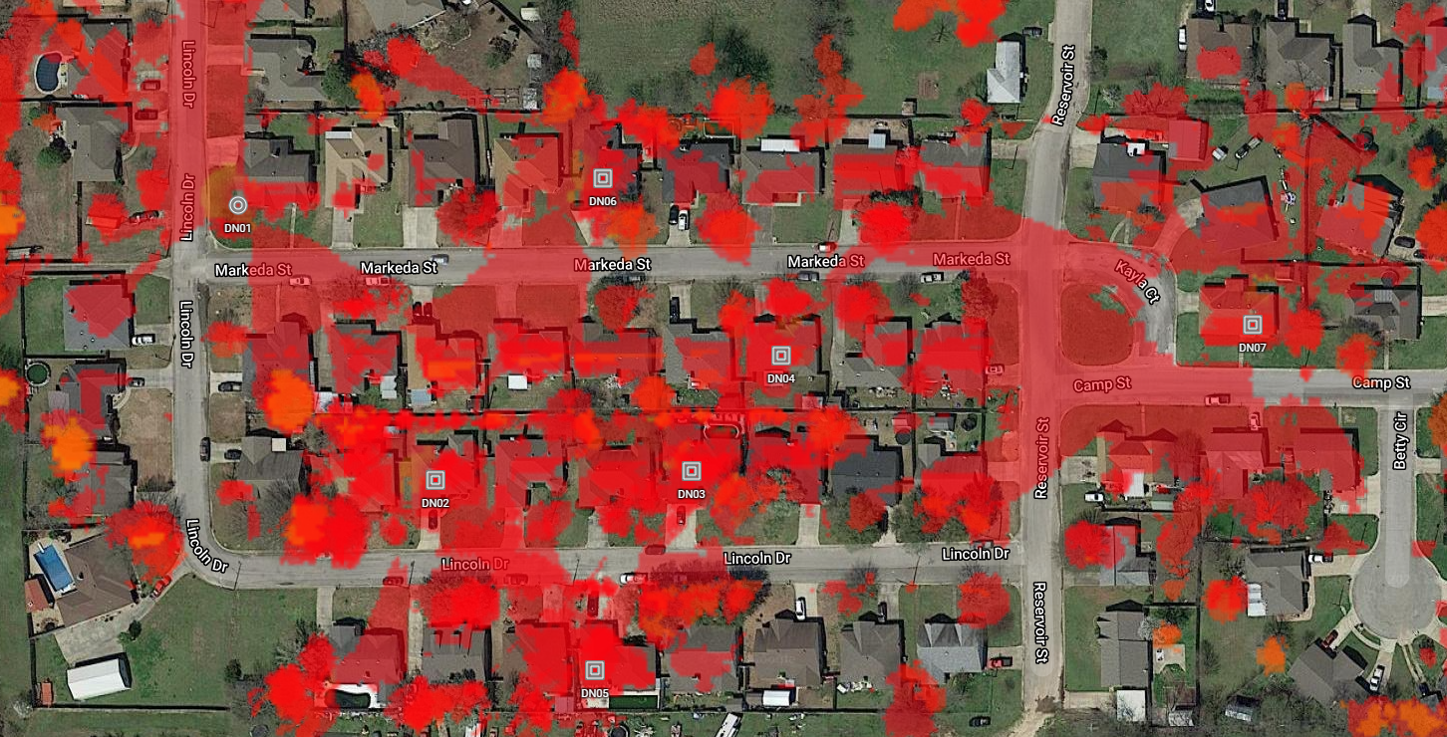
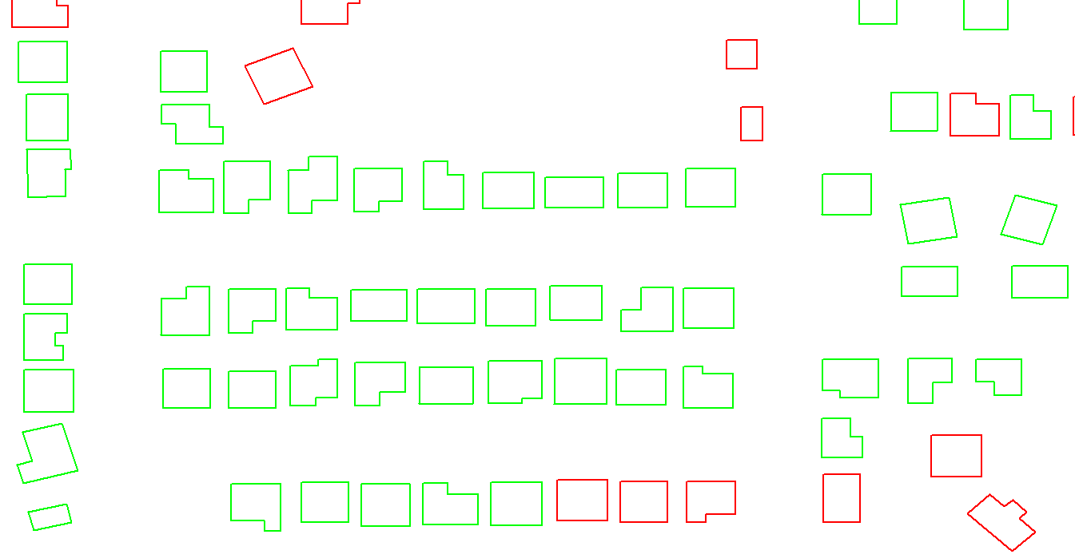
Example 1: Distributed Mesh
Mesh with 7 DNs covers 96% of homes
DN’s at 10m height
Benefits
  Reliable
    most homes covered by multiple DNs
  Performance
    links are shorter / higher modulation
    fewer CN’s per DN
  Scalable
    Room to add CN’s in each direction
    Easy to expand mesh beyond current boundaries
    Single obstructions less critical

Slide 20
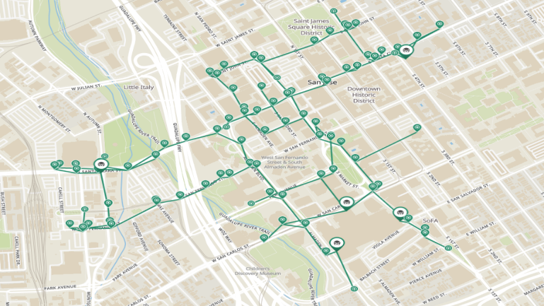
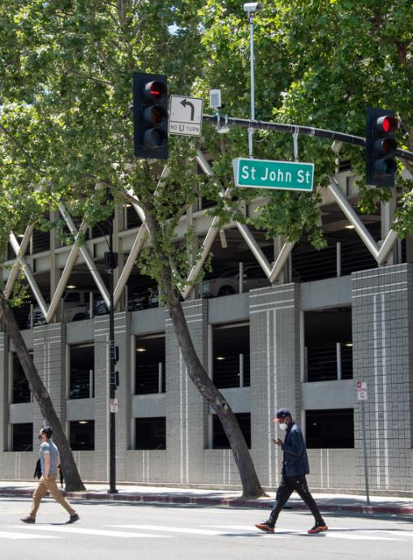


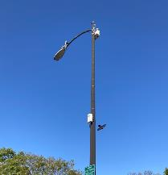
City of San Jose – Public WiFi Infrastructure

Slide 21
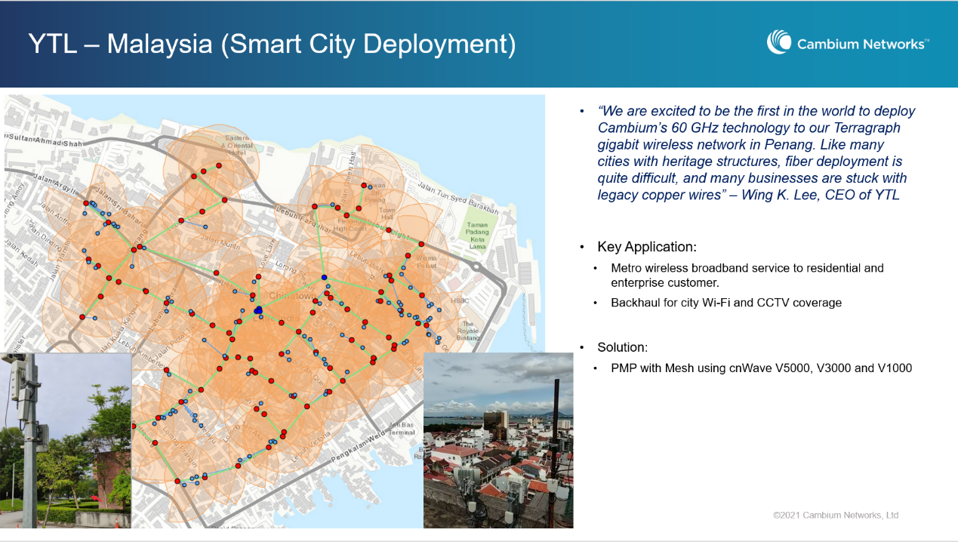

Slide 22
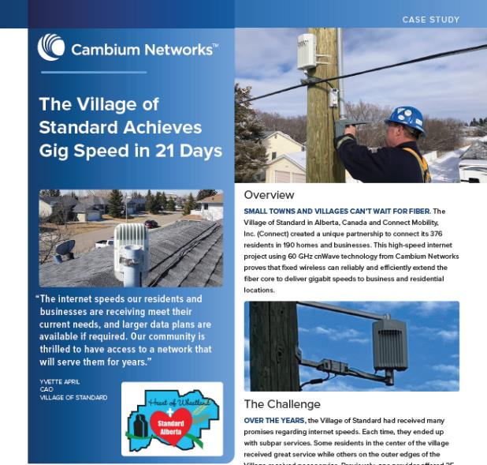
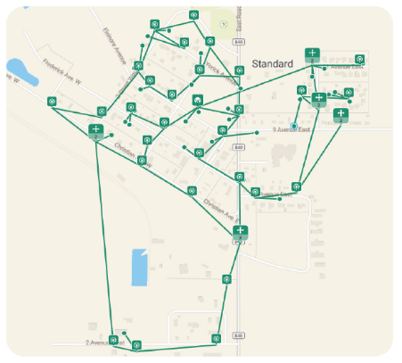
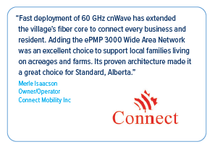
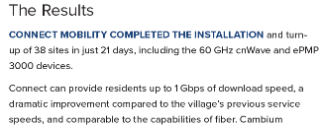
Canada – Towns and Villages

Slide 23

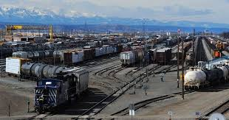
Private Network: Rail Yard Coverage
REQUIREMENTS
  Provide backhaul for Wi-Fi coverage and video surveillance network.
  Off load large telemetry and video data payloads (Gigabyte/Terabyte) from the train.
  SOLUTION
  Deploy 60 GHz cnWave V5000, V3000, and V1000 with Point-to-Point, Point-to-Multipoint, and Mesh configurations.

Slide 24
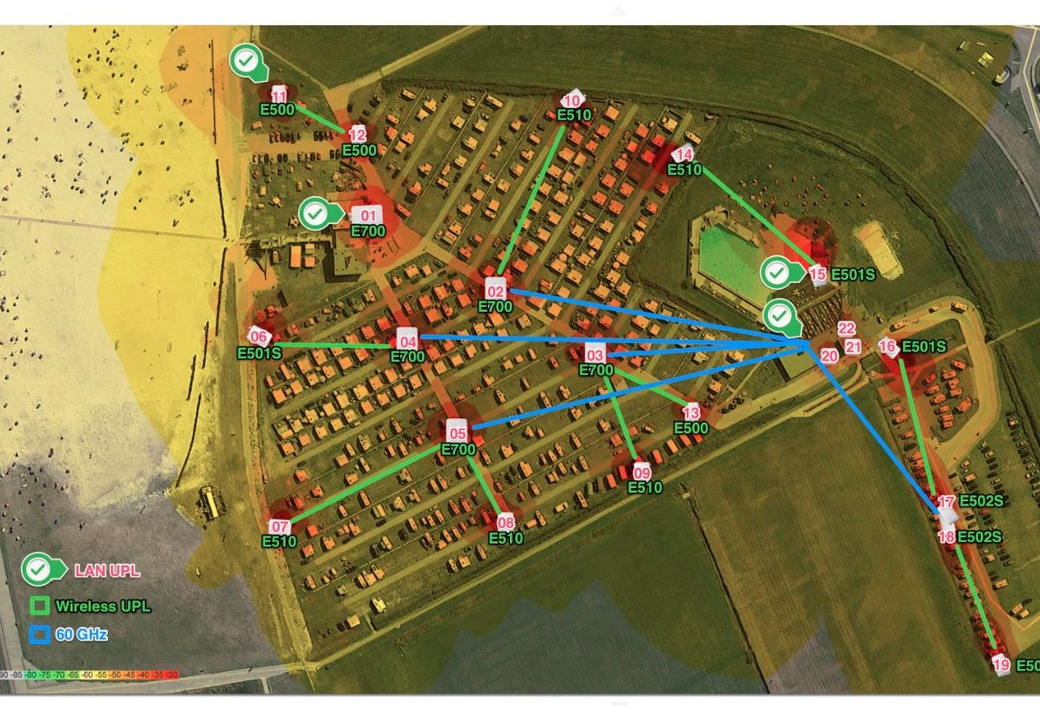

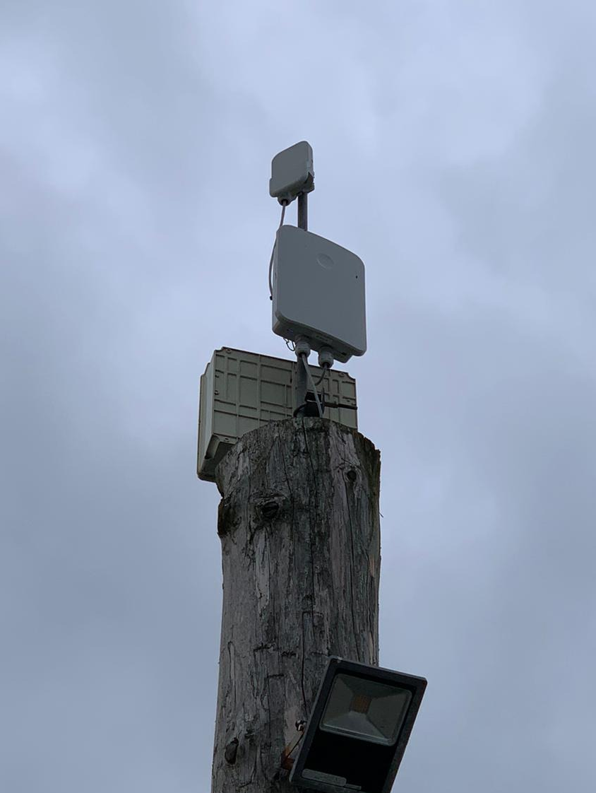
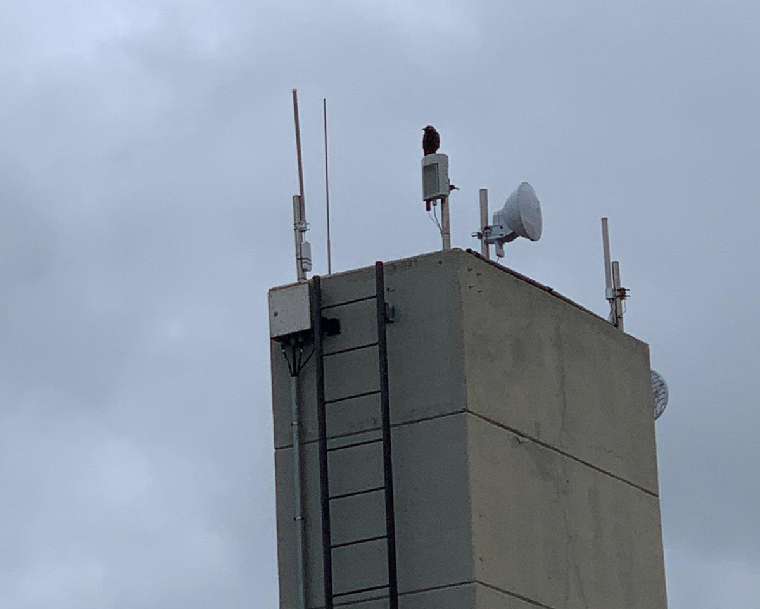
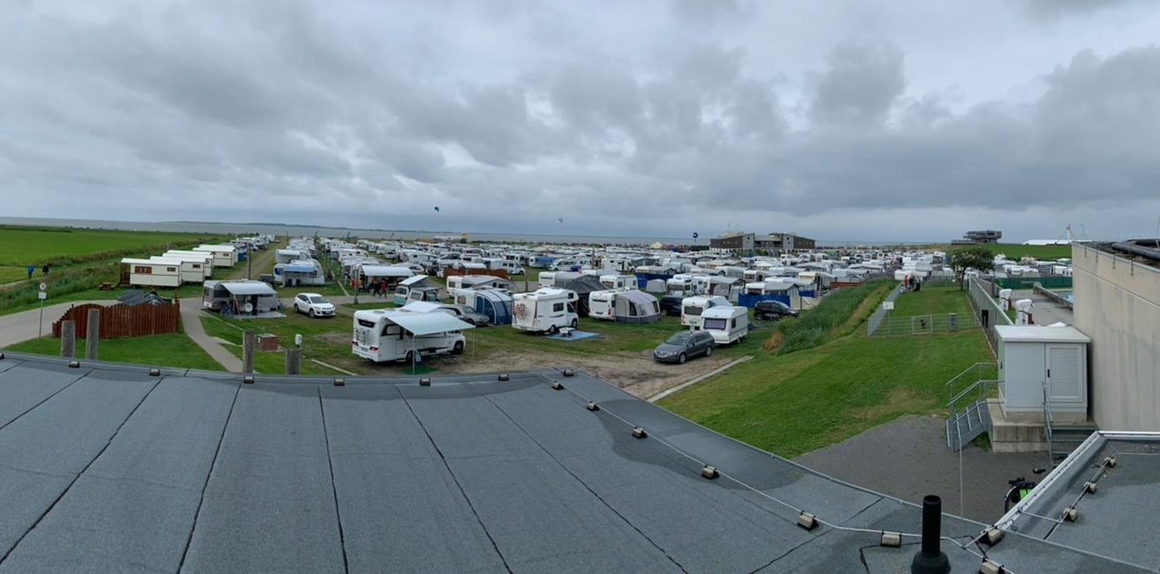
Popup Networks - Concerts
Campground
Reseller: 1TOP IT
List of Material and numbers sold
  2 x V5000
  19 x Outdoor APs (E700, E510, E501S & E502S)
  Installation date
    Spring 2022

Slide 25
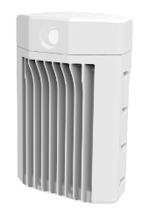
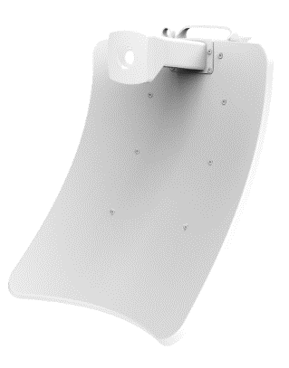
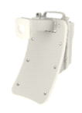
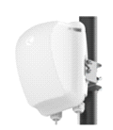
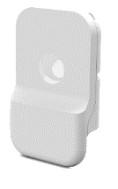
cnWave Platform
Distribution Node
Client Nodes (PMP or PTP)
V5000
V3000
V2000
V1000
Dual Sector
High Gain
Flexible
Mid-Range
Small
Form-Factor
44.5 dBi Dish
40.5 dBi Dish
All 60 GHz cnWave products include:
  Cloud or on-premises network management with cnMaestro™
  Optional advanced management features with cnMaestro X
  Network planning capabilities with cnHeat, LINKPlanner, and ANP
  On-board or Remote e2e Controller Software
  Layer 2 or layer 3 network connectivity
  IPv4 or IPv6 networking protocols
  Security with HTTPS interfaces and 128-bit AES encryption
  3-year warranty
  Options for extended warranty, Cambium Care Pro, and advanced replacement
25

Slide 26



Network Planning
LINKPlanner
  Support PTP/PMP configuration with BOM creation
cnHeat
  Using LiDAR data to create precise coverage plans
Distributed Network Planning
  Site identification and preparation
  LOS identification & optimization
  TCO/CAPEX calculations

Slide 27





Management with cnMaestro X
Single console for the wireless fabric – Wi-Fi, Switching, 60GHz, Fixed Wireless
Simple and easy-to-navigate for fast time-to-productivity
Powerful troubleshooting tools for rapid problem resolution
Flexible integration via standard APIs with 3rd party solutions and MSP customization

Slide 28








Cambium’s ONE Network
Cloud Management & Analytics
APIs
Integrated Network Security
Planning
Deployment
Operations
z
Indoor LAN
Outdoor Campus
Wi-Fi
Switching
Security &
SD-WAN
Outdoor Wi-Fi,
Multi-Gbps Wireless Backhaul
Ruggedized Switching

Slide 29



Application Intelligence for Predictable Performance
WAN
App Control at the WAN Edge
Wi-Fi
App Control at the Wi-Fi Edge

Slide 30




Policy Based Automation on the Wired Network
ID Camera
Profile & ID device using PBA Rule
Configure Switch Port based on user defined policy for a camera
Access Point
Identify AP
Configure switch port automatically
Policy
Rule
Action
=
+
Camera Policy
Identify Camera
Place Camera on VLAN 100

Slide 31





Cambium ONE Network Summary
ONE Network
Wi-Fi, switching, security & backhaul in one solution
Superior Performance
Application optimized
High density, long range
Simple to Operate
Cloud managed
Integrated automation
Economical
Less equipment
Lower TCO

