Slide 1

Wi-Fi8 Developments
Sudharshan Srinivasan,
Broadcom Ltd.

Slide 2
The thoughts expressed in this presentation are author’s own and do not represent Broadcom’s official position, future product roadmap and technical/strategic direction in Wi-Fi

Slide 3
Outline
Advancements from Wi-Fi 7 development
WiFi 8 stated objectives
WiFi8 features addressing each of the objectives
  Ultra High Reliability

Slide 4
WiFi7 or 802.11BE development
Extremely high Throughput (EHT)
  Increased peak data rate
  Addition of 320 MHz, 4096-QAM
  MUMIMO with 16-streams
Multi link operation (MLO)
  Simultaneous links in different bands
Spectrum efficiency - allocation of Multiple Resource Units (MRUs), preamble puncturing

Slide 5
WiFi8 objectives
UHR targets relative to EHT/802.11be:
  + 25% throughput at some SINR point (rate vs range)
  - 25% latency (95th-percentile worst-case latency)
  - 25% MPDU loss, especially during BSS transitions
  lower power consumption in STA devices
  improved peer-to-peer operation
  In general, prioritise reliability in more demanding scenarios over raw speed – stable performance under pressure.

Slide 6
High Efficiency, Ultra High Throughput and Reliability - Wi-Fi Phase 3
11AX
Wi-Fi 6
11AX
Wi-Fi 6e
11BE
Wi-Fi 7
11BN
Wi-Fi 8
HE: High Efficiency
EHT: Extremely High TPUT
UHR: Ultra High Reliability
1024QAM
2.4, 5 and 6G
320MHz
MultiAP Coordination
2.4 and 5GHz
6G VLP, LPI and SP regulatory classes
4096QAM
Seamless Roaming
New GI, LTF options
2.4, 5 and 6G
Dynamic Subband Operation (DSO)
6G Discovery Protocol
UL and DL OFDMA
MLO
Non-Primary Channel Access (NPCA)
UL and DL MUMIMO
eMLSR
Dynamic Power Save
Max 8 SS
STR-MLO
InDevice Coex
BSS Coloring
nSTR-MLO
New MCS, Unequal Mod
2x LDPC
Puncturing, MRUs
ELR, DRU
Max PHY rate 9606 Mbps
(8X8, 160MHz)
Max PHY rate 23 Gbps
(8X8, 320MHz)
Secure Control Frames
Max PHY rate 23 Gbps
(8X8, 320MHz)

Slide 7

Wi-Fi 8: Ultra High Reliability
Throughput
Enhanced MCS
Unequal Modulation
Longer LDPC codes
Reliability & QoS
Seamless Roaming
Enhanced In-Device Coexistence
QOS Enhancements
Low Latency Indication
Enhanced EDCA
Power Save
Dynamic Power Save
Multilink Power management
Range
Enhanced Long Range
Distributed Resource Units
Capacity
Inter-AP Coordination
Non-Primary Channel Access
Dynamic Subband Operation
Dynamic Bandwidth Expansion

Slide 8
WiFi8 features addressing the objectives
Enhanced Long Range (ELR)
  20 MHz only, mainly targeted to bring uplink range closer to downlink
  Increase the legacy preamble signal power,
  Unique pattern per BSS, repeated 4x in ELR mark symbol
  Payload also has 4x repetition
  Gives between 3 to 5dB (Rx) SNR gain - Improves range
Distributed Resource units (DRU)
  (Trigger based) Uplink
  Instead of continuous tones, user is allocated tones distribute across wider BW
  Helps meet PSD limits at higher Tx power - improves uplink range

Slide 9
ELR and DRU
Problem being addressed - In a typical WLAN network, the AP typically transmits higher power ( >= 6dB) than STA
  Uplink range shorter than Downlink range
Legacy DL Range
Desired UL Range
AP
DL
STA
Legacy UL Range
ELR increases effective Rx SNR, while DRU accommodates higher transmit power
Notes:
Need to add 2 points - 1) If AP is within regulatory limit, it can exploit its higher No of antennas to improve DL range, 2) AP can also use RE to extend DL range -in which case UL has more to catch up (add one slide)

Slide 10
WiFi8 features addressing the objectives
2x (longer CW) LDPC
  3888b codeword - 2x of the WiFi7 max codeword length
  Better PER, helps higher rates in higher bandwidth, fading channels
New MCS
  Fills gaps in existing MCS set - helps finer rate control
Unequal Modulation (UEQM)
  Applies different modulations (QAMs) for different (MIMO) streams
  Adapted to SNR per stream - optimises throughput in fading channels

Slide 11
WiFi8 features addressing the objectives
Intermediate FCS /post-FCS padding
  Helps UHR devices to stop packet processing earlier and do channel switching while packet is on air
  Provides the basis for supporting different features in WiFi8
Initial Control frame , Initial Control Response (ICF- ICR)
  Framework for initial handshaking for transmission opportunity (TxOP)
EMLSR - more formalised
  Uses ICF and ICR as described above , with I-FCS, padding
  Helps lower capability clients radios to benefit from two links
Dynamic Power Save (DPS)
  Allows a STA to go to low capability (low power) mode until there is a TxOP

Slide 12
WiFi8 features addressing the objectives
Dynamic Subband Operation (DSO)
  Applicable when there are clients with mixed BW (ex: some with 80 MHz, some with 160 or 320 MHz)
  The AP moves some lower BW clients to the secondary parts of the BSS to maximise BW utilisation
Non-Primary Channel Access (NPCA)
  Kicks in when primary 20 MHz is busy (due to OBSS traffic)
  use a different primary in the BSS BW as the anchor primary
  Schedule traffic using the NPCA-primary for the duration of the OBSS
  Come back to primary just prior to the end of OBSS traffic

Slide 13
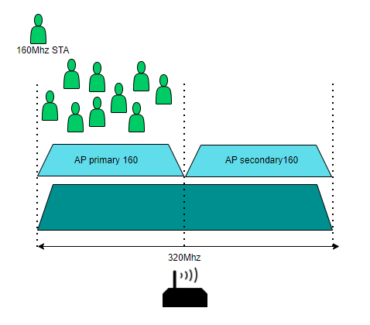
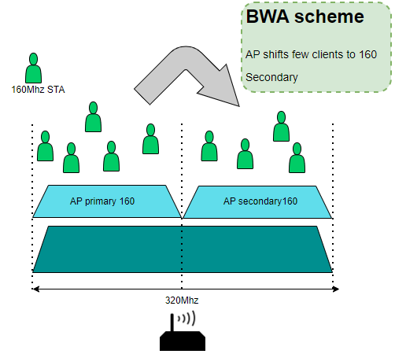
DSO and NPCA in Wi-Fi 8
DSO: AP moves DSO clients to secondary channels for each TXOP - to enhance network capacity
NPCA: STA or AP switches to secondary channels if primary is congested - with constraints

Slide 14
WiFi8 features addressing the objectives
Seamless roaming across APs
  Reduces packet loss during BSS transitions
Dynamic bandwidth expansion (DBE)
Improved Coexistence with BT, UWB and others
  Dynamic Unavailability Operation (DUO)
    Indicate unavailability periods to AP to help efficient scheduling
Low latency indication
Multi-AP coordination
  Coordinated - Beamforming (CBF), TDMA (C-TDMA), Spatial Reuse (CSR)
Multi link Power management (MLPM)
  The power saving modes of multiple links are managed in a coordinated manner in MLO operation

Slide 15

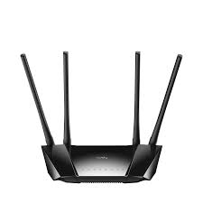
Multi AP Coordination
Coordinated TDMA
Both the APs can transmit in the same channel and subchannels, but the time-share in a coordinated manner, rather than relying on CSMA-CA
Coordinated Spatial Reuse
Both the APs TX can overlap in frequency and time, but coordinated to not cause interference. Overlapped TX allowed only if known to cause weak interference
Sharing AP allows shared AP to transmit in its TXOP
1A
1B
Sharing AP
TXOP Owner
2
Shared AP
Coordinated Beamforming
Each AP sounds channels from STAs in their peer AP’s network - steers data frame to null the interference at peer AP’s STAs.

Slide 16
Implementation Challenges
Higher digital complexity
  higher max BW -=> more complex algorithms
  SIFS requirement for some response frames imposes a hard limit on Rx processing - tighter processing latency requirements
Performance impact constraints
  While digital complexity favours process node advancement, analog design has to change accordingly
  still meeting better SNR requirements (support 4096 QAM in BW 160/320)
  Challenges due to constant mobility of STAs - performance robustness
Power consumption constraints
  meeting the performance constraints with ever tightening power consumption limits

Slide 17
Q & A

Slide 18
Backup Slides

Slide 19
Diving into MLO - STR
AP PHY1 (2.4G)
AP MAC-1
MLD
entity
HOST
2.4G
HOST
MLD
entity
STA MAC-1
STA PHY1 (2.4G)
AP PHY2
(5G)
AP MAC-2
STA MAC-2
STA PHY2 (5/6G)
AP PHY3
(6G-Low band)
AP MAC-3
5G/6G
AP PHY4
(6G-High band)
AP MAC-4
Simultaneous transmit-receive MLO
Host “sees” only one MAC device, and needs to assign only one IP address, despite having multiple RF links underneath
A Multi-Link Device (MLD) is STR over a pair of links, if it can transmit, receive and perform channel sensing (CCA) on any link regardless of the nature of activity on the other link.
Throughput aggregation and latency advantage.
Disadvantages
  Note: 2G is only 20MHz link, and congested
  STA unable to use multiple 5G/6G links due to cost

Slide 20
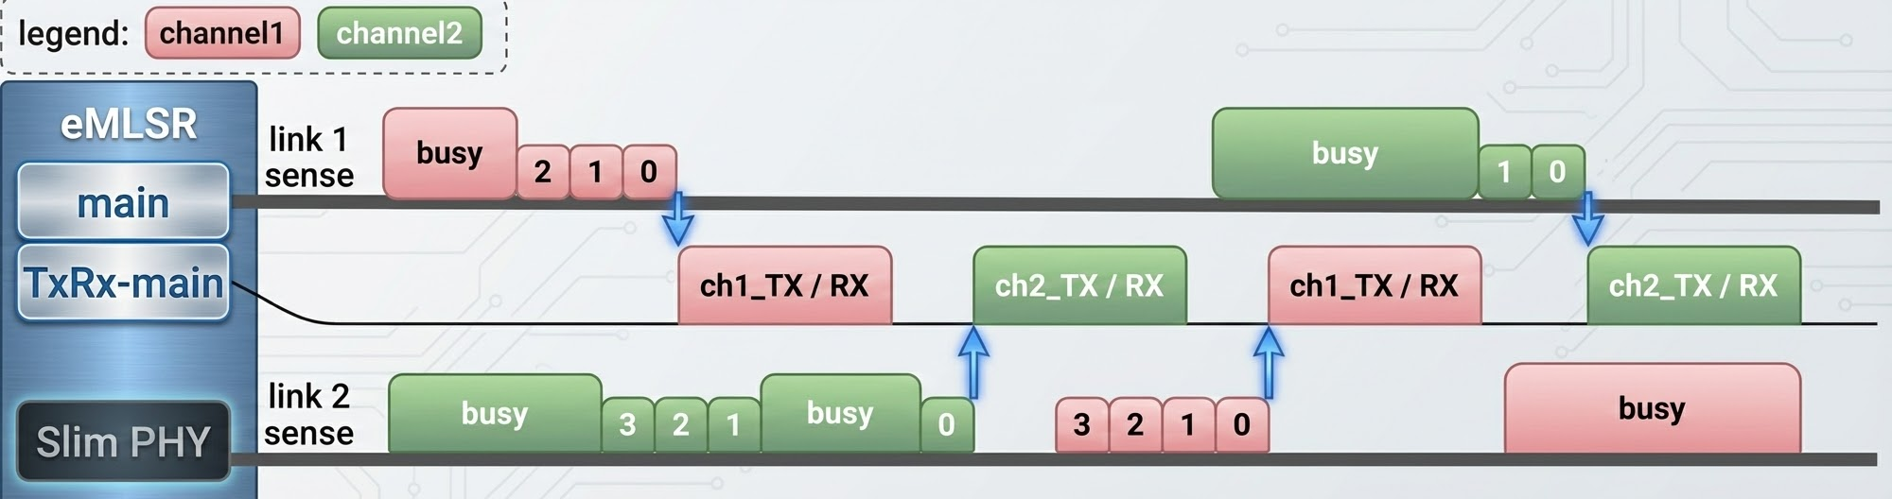
Diving into MLO - eMLSR
AP PHY1 (2.4G)
AP MAC-1
MLD
entity
HOST
2.4G
HOST
MLD
entity
STA MAC-1
STA PHY1 (2.4G)
AP PHY2
(5G)
AP MAC-2
STA MAC-2
STA PHY2 (5/6G)
AP PHY3
(6G-Low band)
AP MAC-3
5G/6G
slim PHY
AP PHY4
(6G-High band)
AP MAC-4
Enhanced Multi-link Single Radio (eMLSR)
An MLD is eMLSR over a set of links, if it can receive certain basic control frames (MU-RTS/BSRP) and perform CCA simultaneously on the set of links.
However, it can transmit or receive data on only one link at a time, the link being chosen dynamically in each TXOP period.
Sensing two links at the same time, and using only one at a time for data transmission.
  Significant gain in throughput and latency due to “access diversity”
  At very reasonable additional hardware.

