Slide 1
Enabling Open Wi-Fi Business and Technology Playground using Blockchains
Himanshu Tyagi

Slide 2
Open Networking Technology
Internet started as an open network
Many small servers hosted in the 90s
TCP/IP for decentralized routing and congestion control
Software defined networks and programmability
Two decades of research on programmable networking components
SD-WANs in enterprise networks, NFV excitement in 5G

Slide 3
Open Network Business?
Centralization of infrastructure ownership
Most internet services moved to a few cloud services
Mobile carriers have reduced from 6-7 to …
Internet Service Providers
This is perhaps the business model with the lowest entry bar

Slide 4
Impact of Centralized Network Business
The Good
High quality of service provided
Maintains compliance and reputation
The Bad
Focus remains (largely) on high bandwidth consumers
Business innovation remains limited

Slide 5
Indian Need
Mobile data is cheap (INR 14 per GB) but is becoming increasingly expensive
Carriers are now increasing minimum plans to increase their ARPU
Broadband connections are not available easily beyond cities
There are no cheaper options for lower income groups

Slide 6
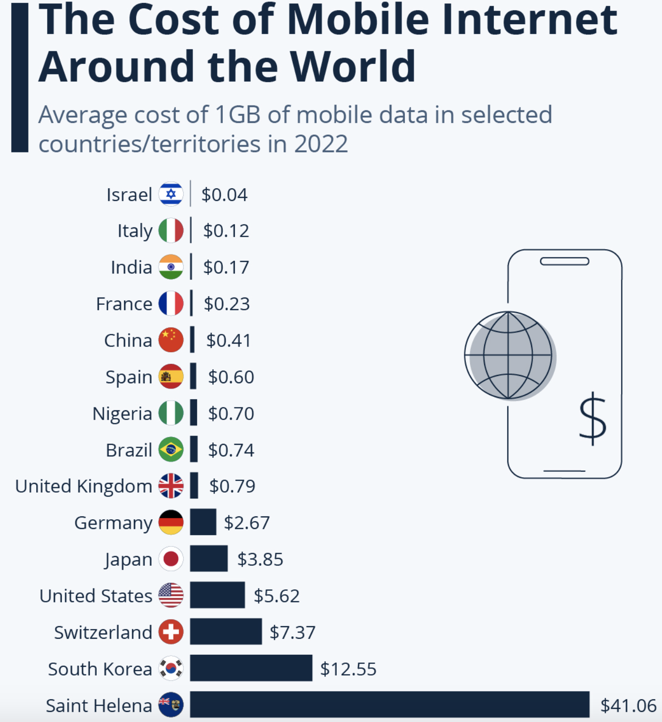
Global Need
Data is very expensive in developed countries
Sparsely populated rural areas are not covered by larger carriers and ISPs
Source of data: cable.co.uk; Source of picture: statista.com

Slide 7
An Open Network Business Ecosystem can enable innovative solutions for these problems

Slide 8
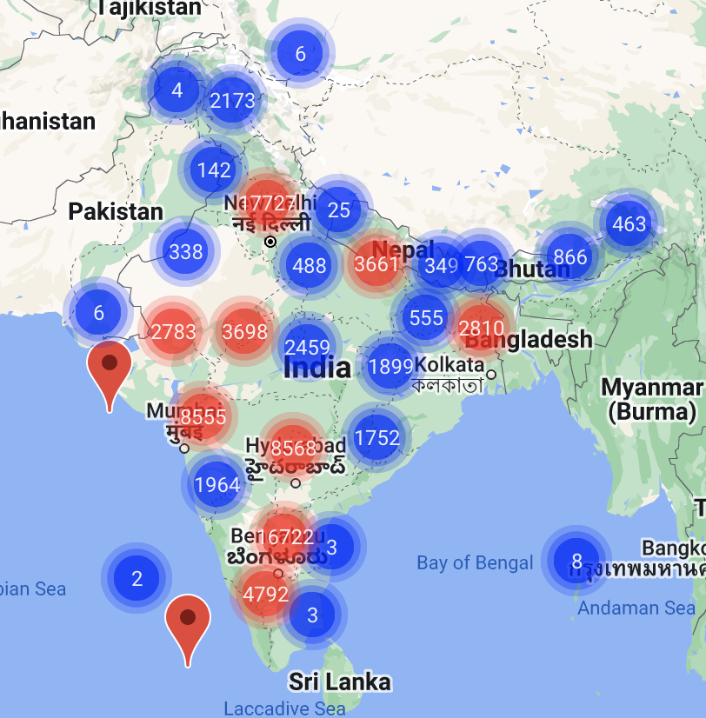
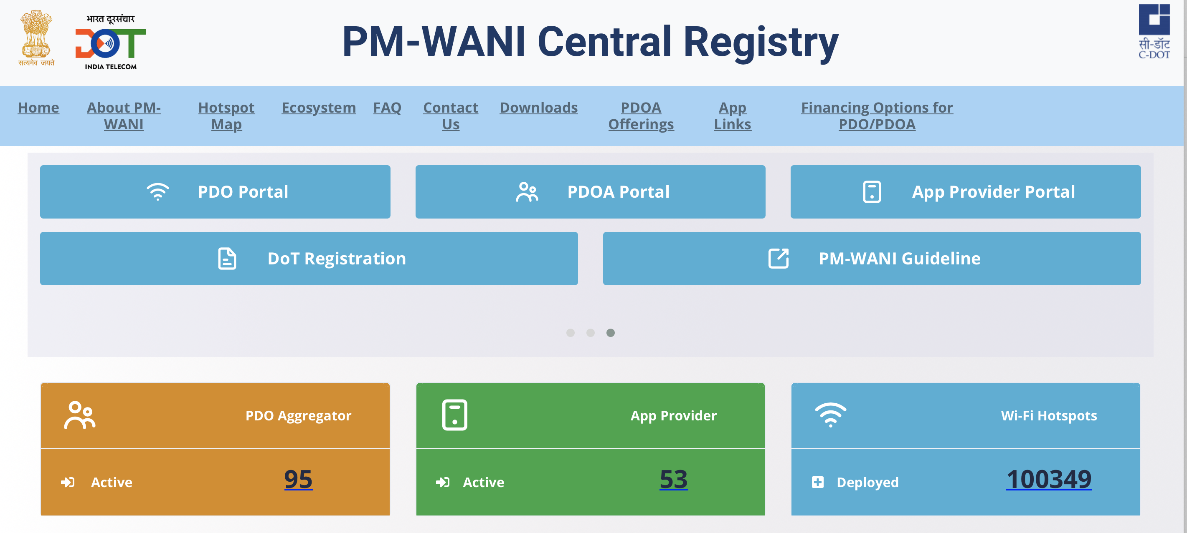
The Indian Solution: PM-WANI
Rapidly growing network
Wireless Network Access Interface (WANI)
Interfaces for individuals and small businesses to provide WiFi like an ISP
New WiFi Service brands powered by PM-WANI

Slide 9
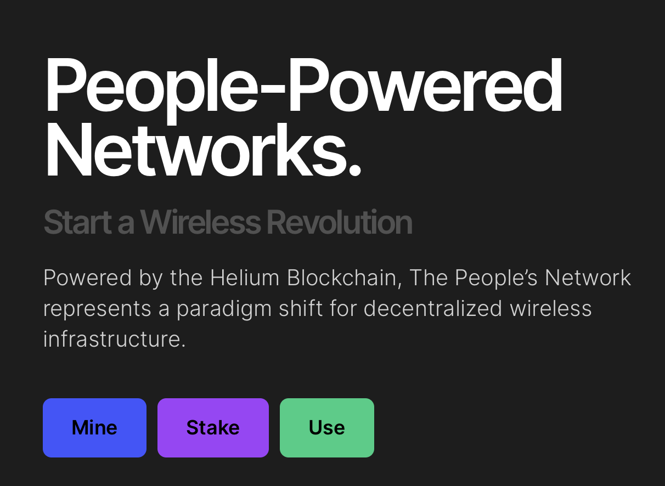
Global DeWi Startups (WiFi and Cellular)

Slide 10
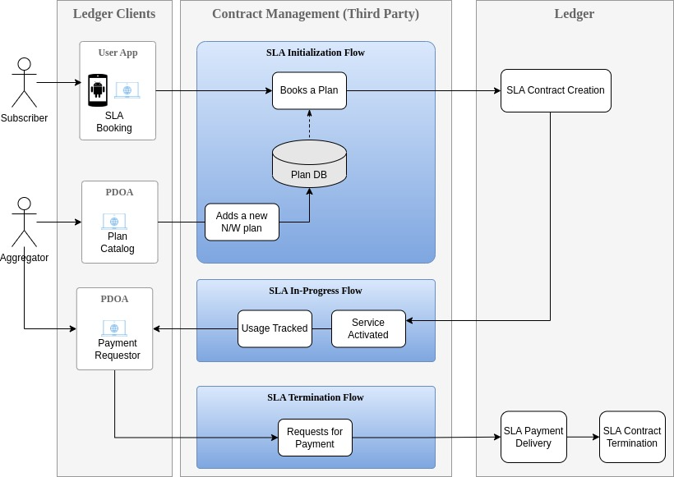
WANI 3.0 Proposal
An Open Business Ecosystem to connect the unconnected
A blockchain-based ecosystem for unbundling the roles of bandwidth supplier, payer, authentication, accounting and consumer
Can enable use cases such as open roaming, public WiFi etc
See details in the iSpirt whitepaper:
https://pn.ispirt.in/pm-wani-3-0/
Stay tuned for an open house session by iSpirt

Slide 11
Components of Open WiFi Ecosystem
Identity and authentication
Smart Contracts
Performance Audits
An easily verifiable identity which can be used for authorizing payments etc
Secure access without requiring bulky KYC
Escrows for payments
Service Level Agreement implemented as a smart contract
Compliance and certification to ensure implementation quality
Trustfree verification of SLA conditions and QoS

Slide 12
Proofs of Bandwidth
Proof of Service
Two-sided measurements and payment release only on verification of service
Proof of Backhaul
Decentralized speed tests for trustfree bandwidth verification
Proof of Location
Trustfree location verification of devices
This research is carried out as a part of a blockchain startup Witness Chain. We are building a proof system for decentralized infrastructure.
www.witnesschain.com

Slide 13
Concluding Remarks
A new era of open wireless business is on the horizon
Blockchains will play a central role in it
A lot more research is needed to enable trustfree assurance
(Witness Chain’s Proofs of Bandwidth is work in this direction)
Need for open standards and pilots
(iSpirt is driving policy proposals and supporting adoption of WANI 3.0)

