Slide 1
WiFi Knowledge Summit - 2025 Matter and WiFi 22nd May 2025
Vijai Simha – Dean Academics & Director, CoE for Connected Intelligence

Slide 2
Matter is currently the primary candidate to address the issue of fragmentation in Smart Homes.
Matter is an application layer standard that aims to simplify and unify the connected home experience.

Slide 3
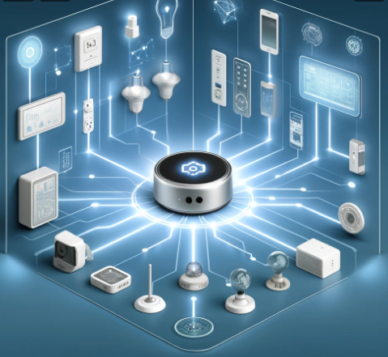
Key Differentiating Features
IP-Based Networking
Developer-friendly – Open Source & Community-driven
Simplified Setup and Commissioning – BLE, NFC & QR
Security – DCL (Distributed Compliance Ledger)
Multi-Admin
Local Communication
Federated – No single point of failure
Matter + Thread + 802.15.4 is an excellent stack for Low-power, Low-cost Sleepy End Devices
Support for Legacy devices via Matter Bridges

Slide 4
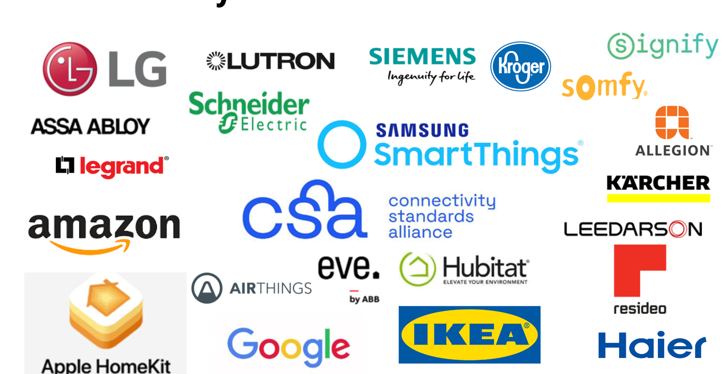
Strong and growing set of Products and Ecosystems
Wide support by IoT SoC players and other entities in the developer ecosystem

Slide 5
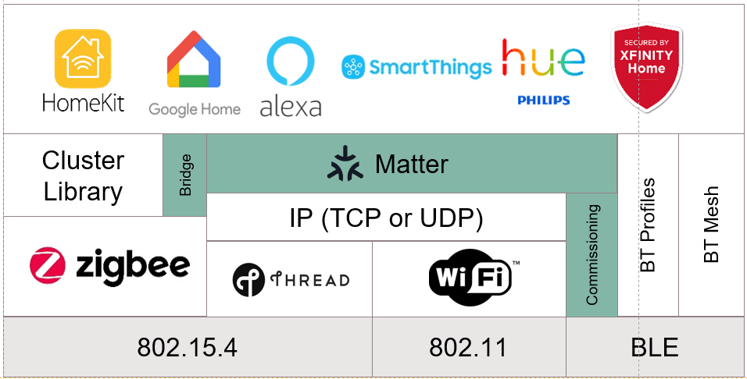

Slide 6
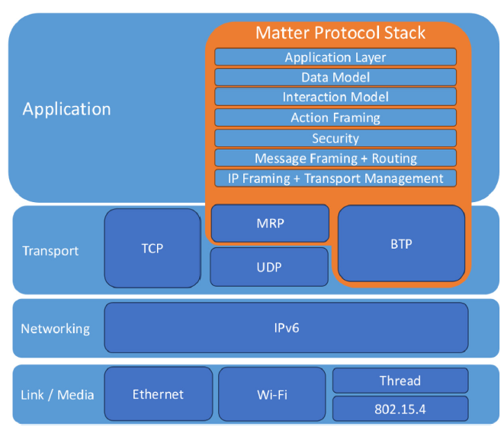

Slide 7
Matter Releases: Feature Progression
Matter 1.0 (Oct 2022) | Matter 1.1 (May 2023) | Matter 1.2 (Oct 2023) | Matter 1.3 (May 2024) | Matter 1.4 (Nov 2024) | Matter 1.4.1 (May 2025)
Initial release with core device support | Performance improvements | Device appearance and semantic tags | Energy and power reporting clusters | Enhanced Multi-Admin | Enhanced Setup Flow (ESF)
IPv6 networking over Wi-Fi, Thread, Ethernet | Improved support for battery-powered devices | Generic OTA support for all devices | Time synchronization improvements | Home Routers and Access Points (HRAP) | Multi-Device Setup QR Code
Multi-admin control | Device lifecycle management enhancements | Multiple fabrics per device | Standardized schedules and scenes | Expanded Energy Management (solar, batteries) | NFC Tap-to-Pair Onboarding
Secure onboarding with QR codes | Bug fixes and tooling enhancements | Structured data model improvements | Thread Border Router support | Device Energy Management and Modes
Over-the-air (OTA) updates | Commissioning retry improvements | Power source and quality reporting | Diagnostics and logging improvements | Long Idle Time (LIT) for better battery life
Certification and interoperability testing |  | Flexible scenes integration | Expanded commissioning flows

Slide 8
Matter Releases: Device Types Supported
Matter 1.0 (Oct 2022) | Matter 1.1 (May 2023) | Matter 1.2 (Oct 2023) | Matter 1.3 (May 2024) | Matter 1.4 (Nov 2024) | Matter 1.4.1 (May 2025)
Light bulbs and fixtures Smart plugs and outlets Smart switches Smart thermostats HVAC controllers Door locks Window coverings (blinds/shades) Garage door controllers Motion and contact sensors Media devices (TVs, streaming video players) Bridges | No new device types added; improvements to battery-powered devices and commissioning experience | - Refrigerators - Room air conditioners - Dishwashers - Laundry washers - Robotic vacuums - Smoke and CO alarms - Air quality sensors - Air purifiers - Fans | - Water heaters - Water softeners - EV chargers - Energy management systems (Energy reporting, load control) - Scenes and schedules - Thread Border Routers | - Solar panels - Batteries (Battery Energy Storage Systems) - Heat pumps - Mounted On/Off and Dimmable Load Controls - Home Routers and Access Points (HRAP) | No new device types; introduced Enhanced Setup Flow (ESF), Multi-Device Setup QR Code, and NFC onboarding for improved device

Slide 9
The Last Year – Matter Ecosystem
Enhanced Multi-admin Support
Expanded Device Support – Energy Management, Heat Pumps, Batteries, Solar panels
HRAP – Home Routers and Access Points
Optimizations for Battery Performance (Sleepy End Devices)
Matter 1.4
Matter 1.4.1
Enhanced Setup Flow (ESF)
Multi-Device Setup QR Code
NFC Tap-to-Pair Onboarding
Thread 1.4
Thread Border Router Interoperability
Enhanced Commissioning and Credential Sharing
Improved Network Diagnostics
Smartphone
Support
Android 15 – Supports Thread Support, Border router functionality (‘Use Thread’ toggle)
iOS 18 – Expands support for Matter, Thread accessories and Thread border routers.
Product
Launches
Expansion of Product Portfolios of Major Ecosystems (Amazon, Google, Samsung etc)
New Entrants: Nanoleaf, Wemo, Aqara, Yale.. Lots more

Slide 10
Matter & WiFi: A Powerful Combination
Integrates the fragmented Smart home – Connects WiFi clients & Low-power devices
Leverages existing WiFi ecosystem
Streamlined onboarding and device setup – BLE, QR, NFC
Widens the range with long-range device support
Security enhancements

Slide 11
HRAP – Home Router and Access Points
Home Routers can now act as WiFi Access Points & Thread Border Routers
Multi-protocol support without need for a separate OTBR or IoT Gateway
Co-commissioning of Thread and WiFi devices
Forms a backbone for future-proof smart home deployments
Easy onboarding – secure directory for storing and sharing Thread network credentials

Slide 12
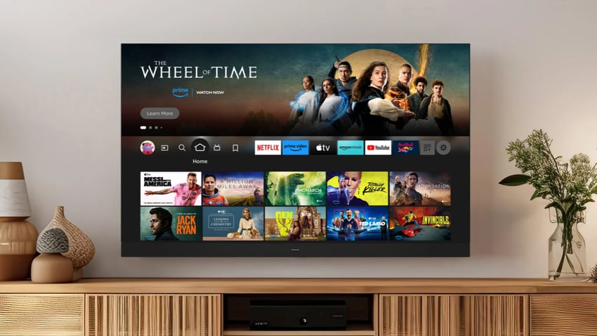
Matter Casting & Matter Streaming
Open, manufacturer-neutral protocol for casting of media (eg. Smartphone –to- TVs)
Amazon Fire TV and Echo Show support Matter Casting with Prime Video
Panasonic TV support
Limited support from other market players
Matter Release 1.5 (Dec 2025) is expected to provide support for cameras and live video streaming

Slide 13
India’s First Liberal STEM University
Interdisciplinary & Futuristic Majors
Digital Transformation
Energy Sciences
Life Sciences
eMobility
Sustainable
Entrepreneurship
Project-based Learning Pedagogy Aligned to Industry Needs.
Options to explore and experiment
before choosing Major stream (after Year 1)

Slide 14
Launch – Matter Meetup @ Atria University
CoE for Connected Intelligence shall host ‘Matter Meetups’ at Atria University Campus
Open Platform for interactions between Industry Practitioners, Academicians and Students
Kick-start with a One-day Workshop on Matter Protocol (
Reach out to simhav@gmail.com or vijai.simha@atriauniversity.edu.in
https://www.atriauniversity.edu.in/

Slide 15
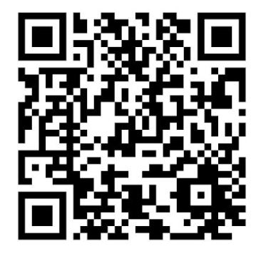
Thank You
Vijai Simha - 7702352020
Email: vijai.simha@atriauniversity.edu.in or simhav@gmail.com
LinkedIn: https://www.linkedin.com/in/vijaisimha/

Slide 16
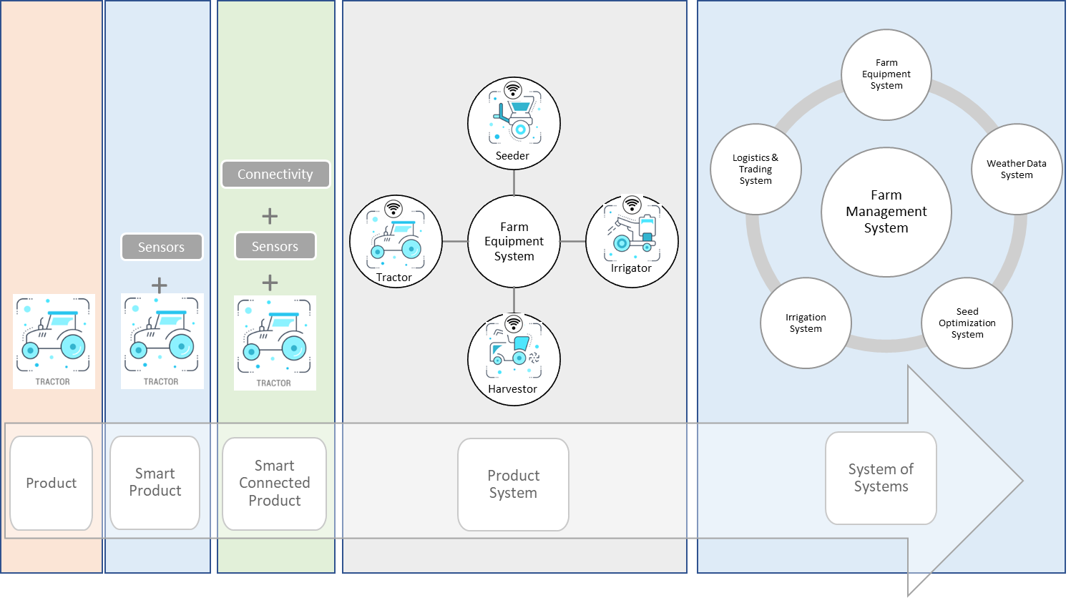
IoT Progression – From Thing to System-of-Systems

