Slide 1

Mastering Wi-Fi
PCAP Analysis
Packet Capture & Analysis Techniques
Every Wi‑Fi problem leaves a trace
Rasika Nayanajith (@mrncciew)
Notes:
Packet captures are incredibly powerful for Wi‑Fi troubleshooting.
But capturing is only half the battle—and analyzing frame by frame simply doesn’t scale.
Today, I’ll show you different ways to capture and analyze Wi‑Fi traffic, so you can quickly find issues without getting lost in the noise.”

Slide 2








Rasika Nayanajith (@mrncciew)
Wireless Instructor (Cisco, CWNP & Ekahau)
Content Developer for digital learning
Principal Consultant, MRN Networks
WLPC 2026 Best Content Contribution Award
Notes:
I’m Rasika Nayanajith—Wireless Instructor, Content Developer, and Principal Consultant at MRN Networks… and I spend a lot of my time working with Wi‑Fi troubleshooting and analysis.
I was lucky to receive the WLPC 2026 Best Content Contribution Award—so if you were one of the people who voted, thank you… it really means a lot.

Slide 3
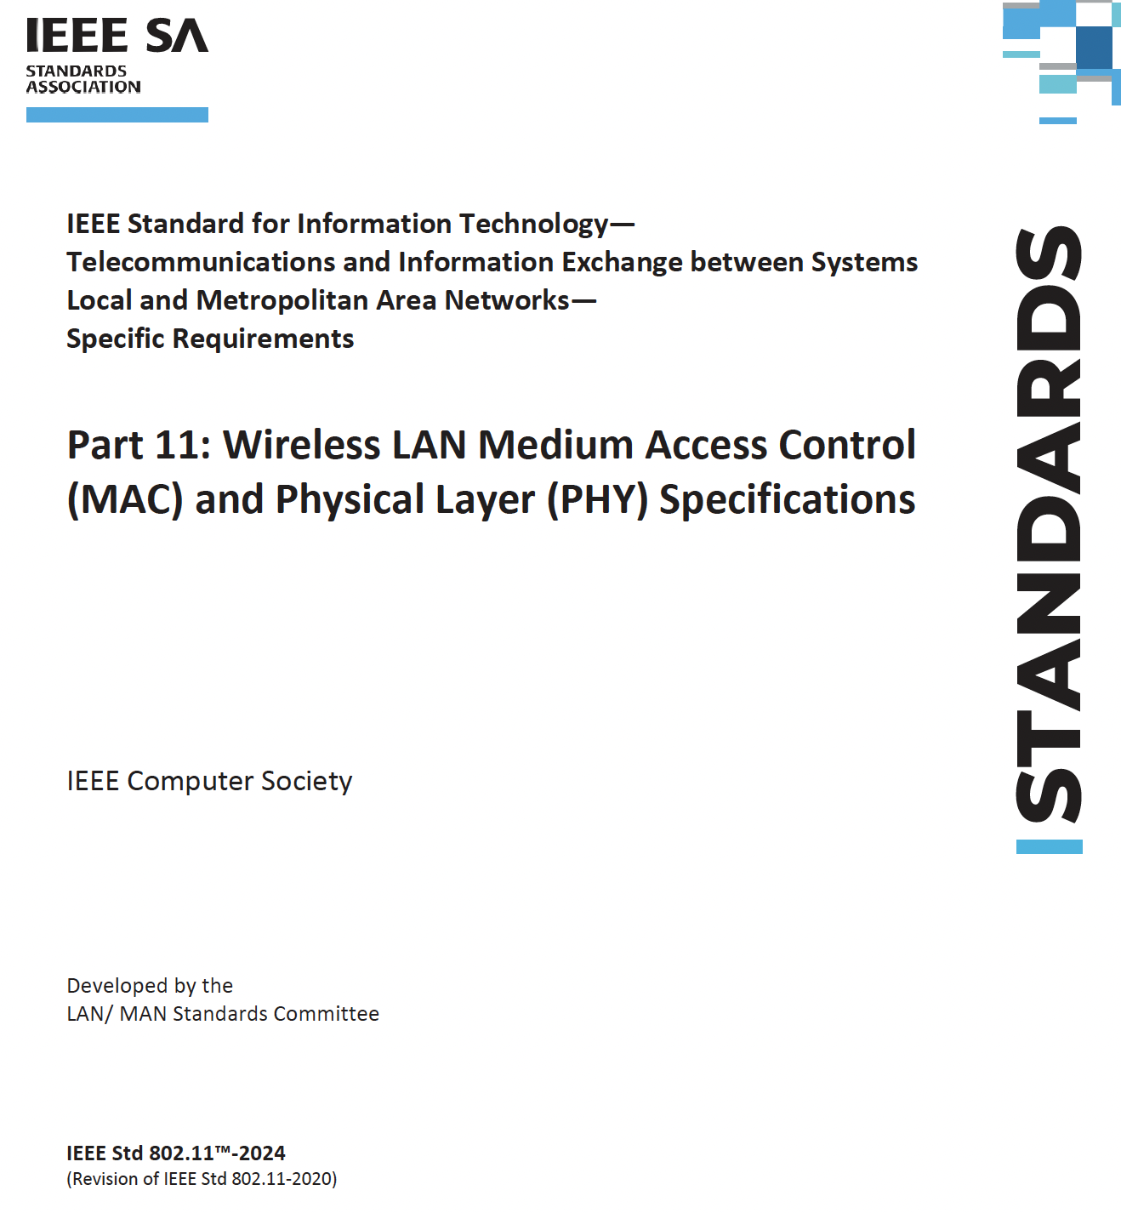

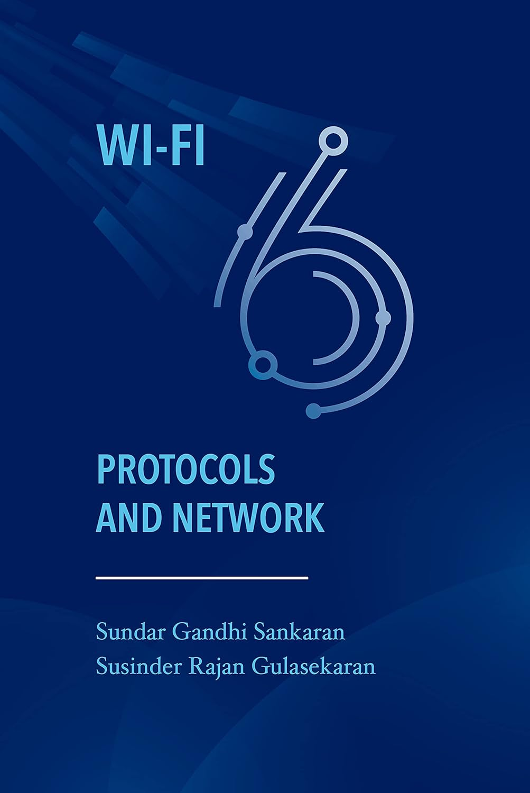


Wi-Fi Analysis References
https://ieeexplore.ieee.org/browse/standards/get-program/page/series?id=68
Notes:
https://ieeexplore.ieee.org/browse/standards/get-program/page/series?id=68

Slide 4


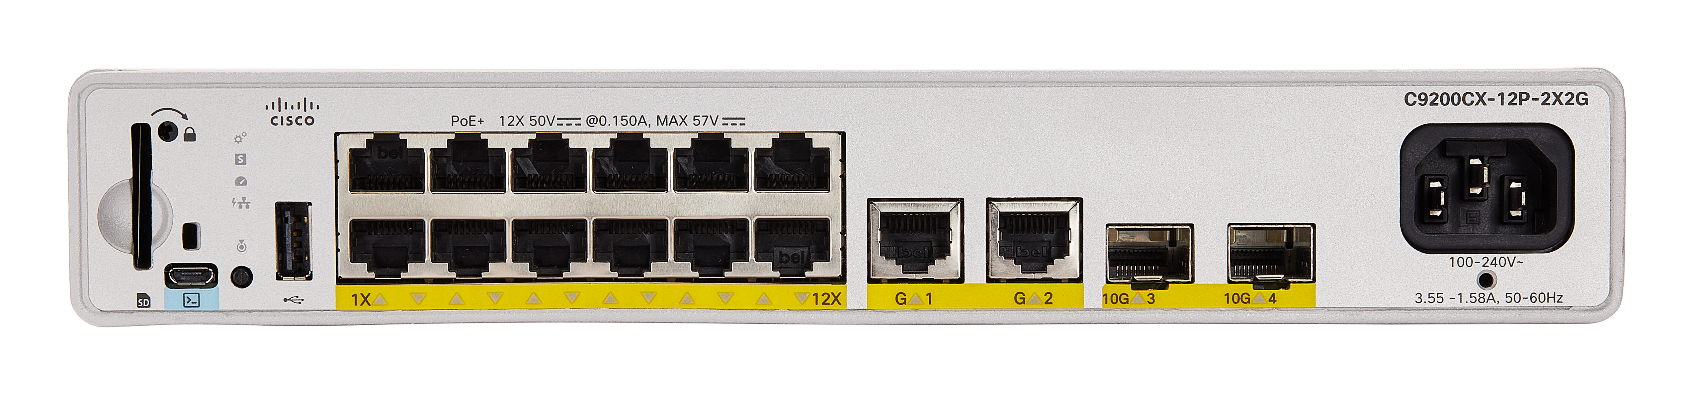
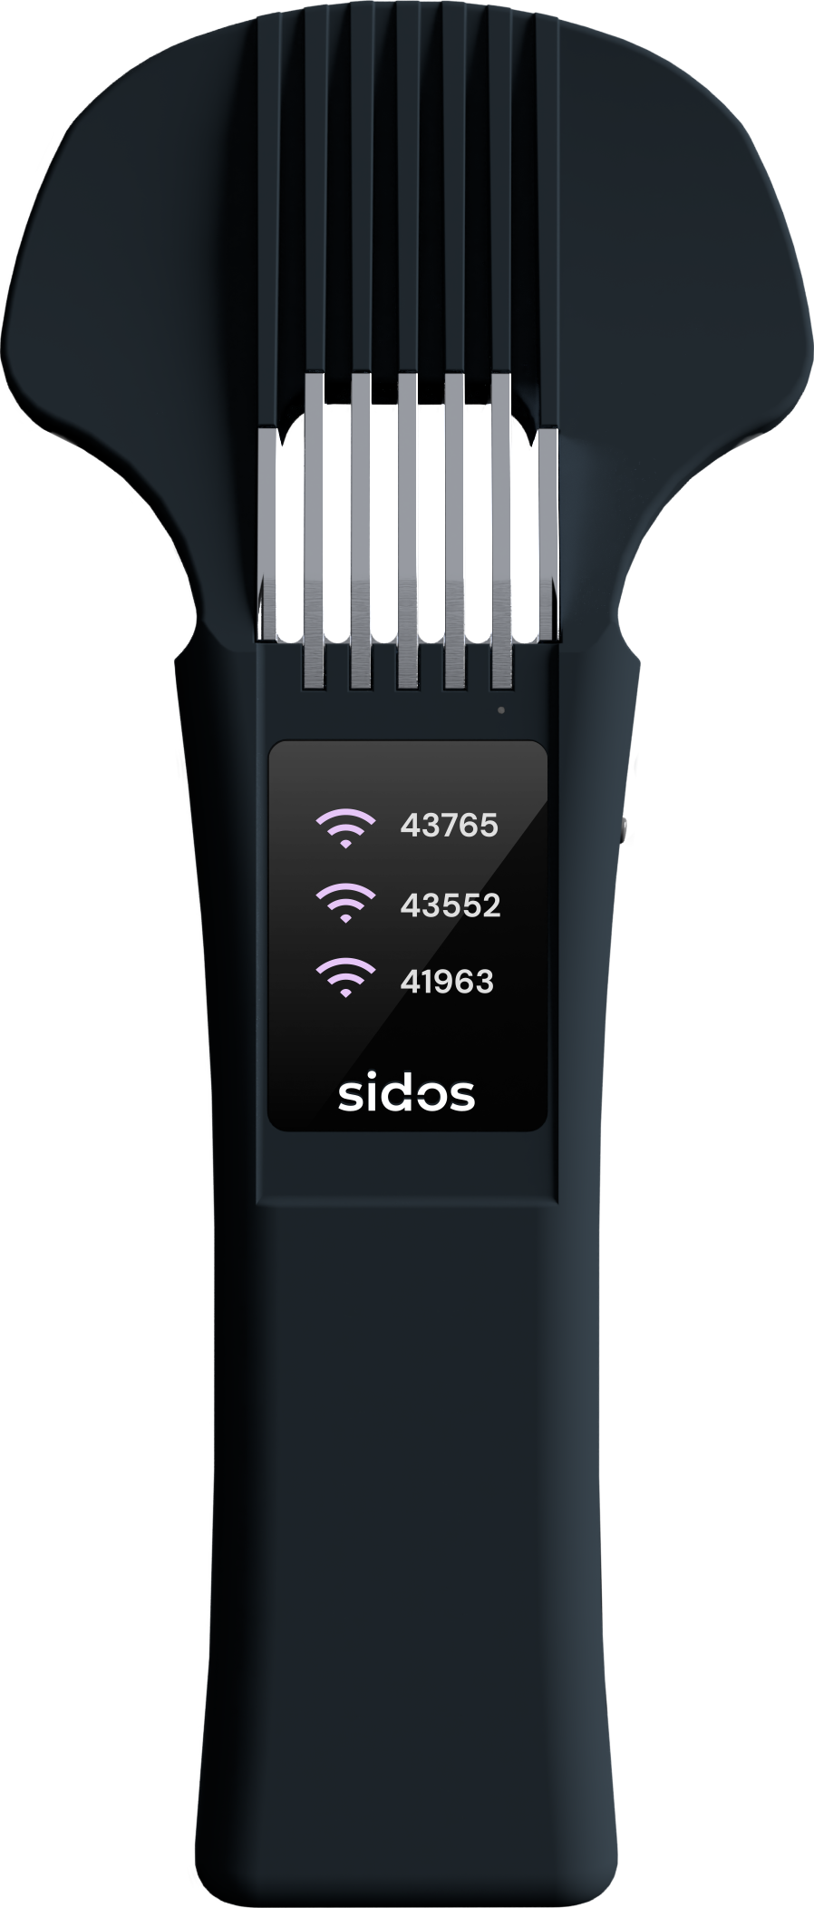
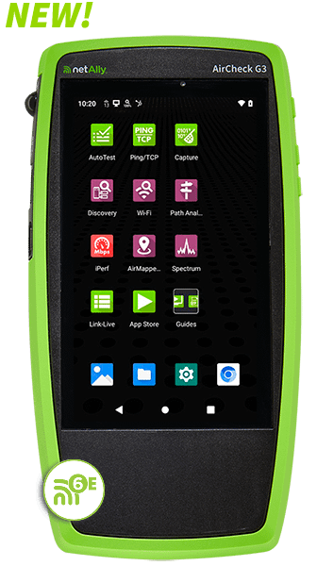
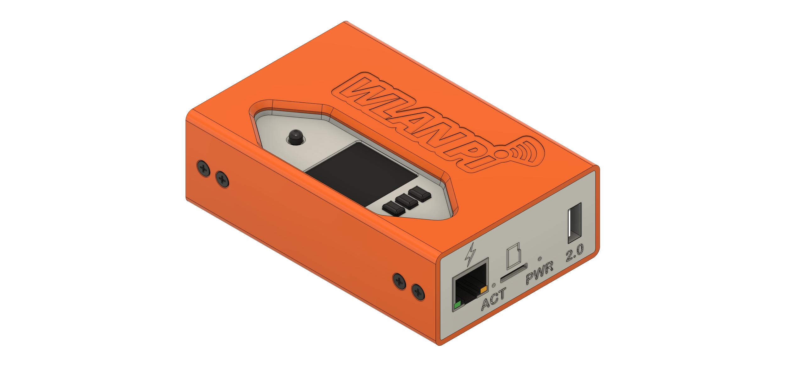
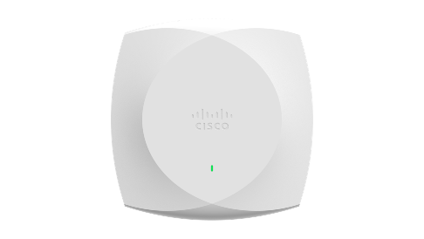
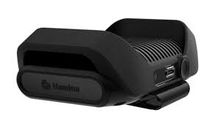



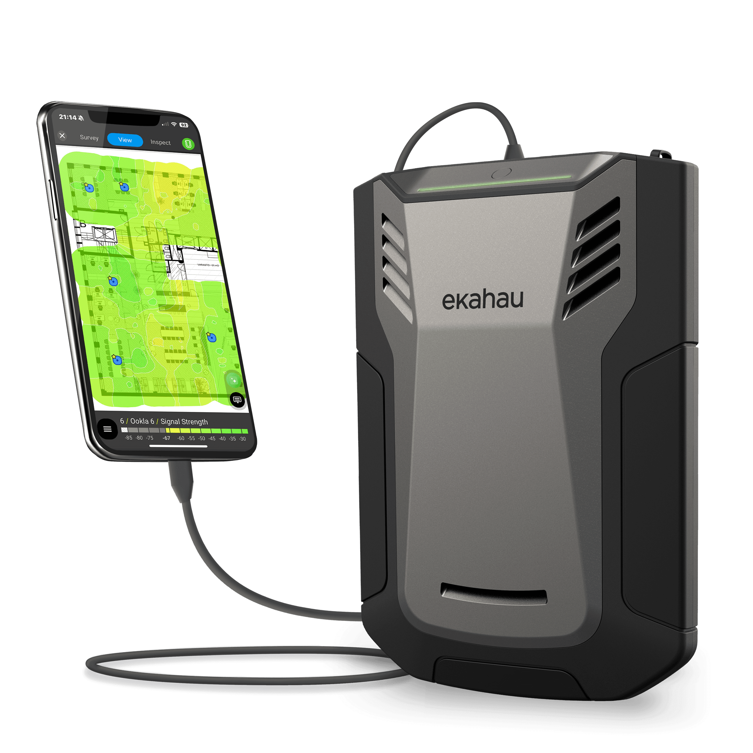








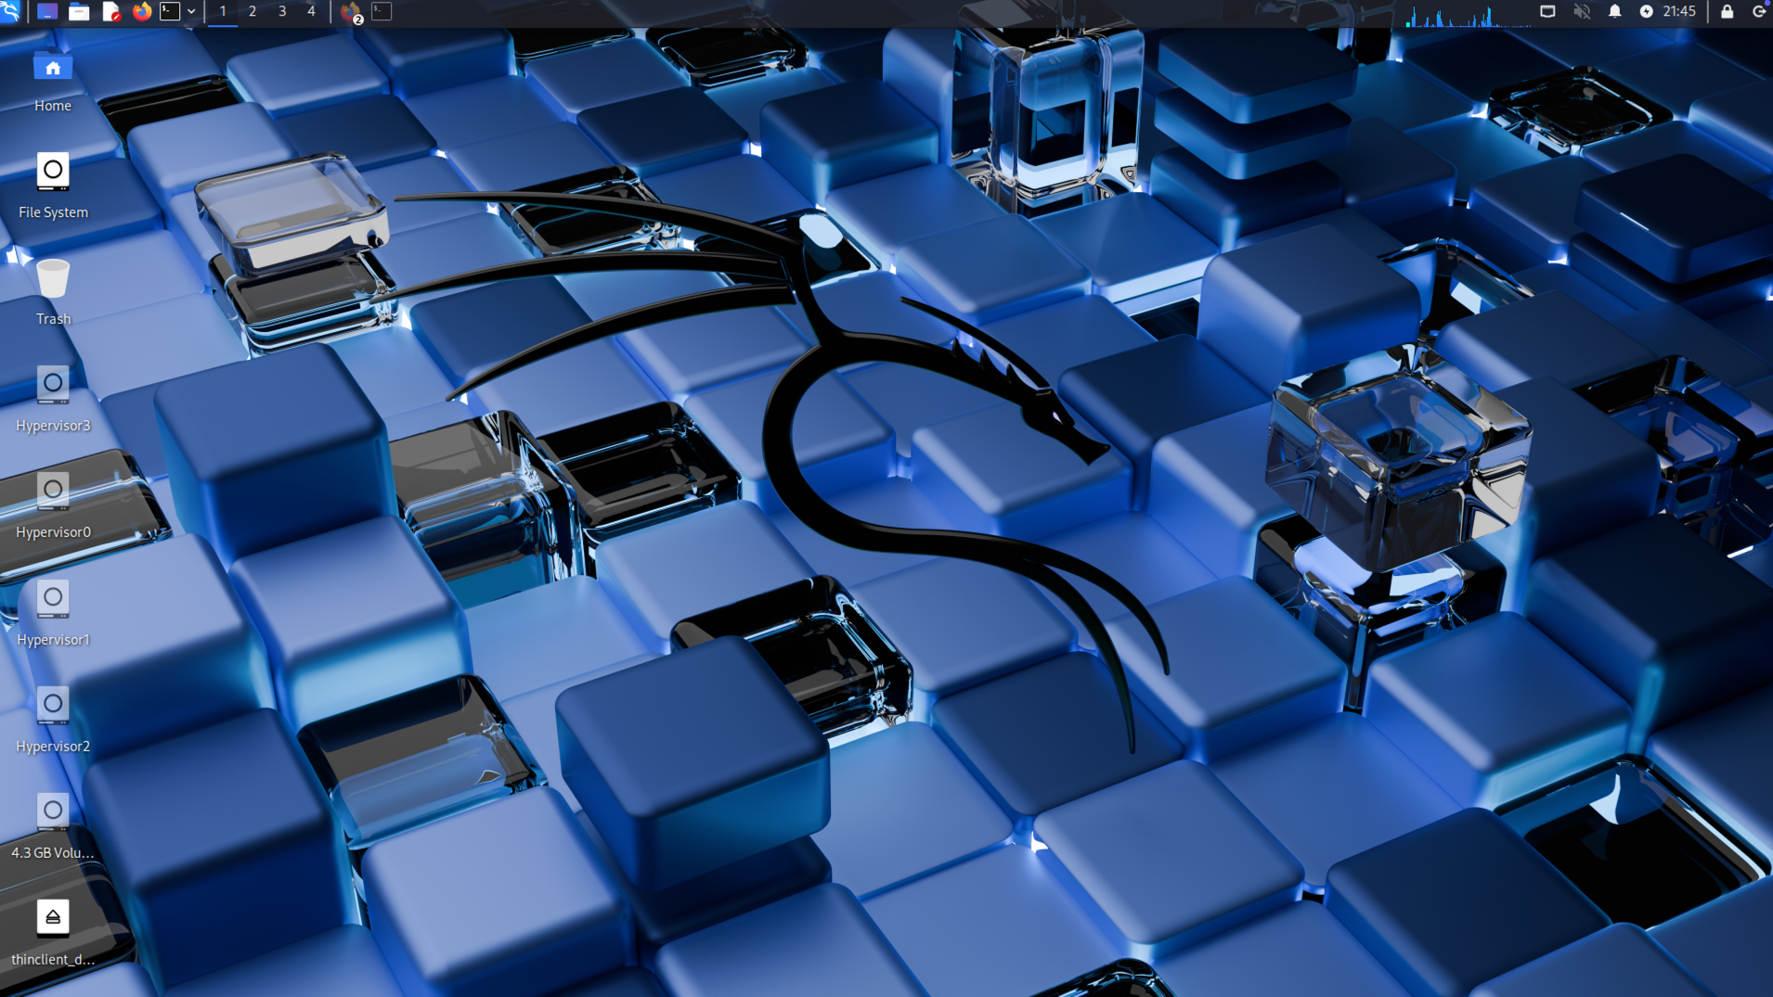



Wi-Fi PCAP Methods
Multi-channel
Multi-channel
Sniffer mode AP
Cisco 9800 WLC
Sidos & NetAlly
Remote Capture
Multi-channel
HPE Aruba/Juniper Mist
Cisco Catalyst Centre
mrn-1X [5|6 GHz]
(WPA3-E)
mrn-PSK [2.4|5|6 GHz] (WPA3-P)
mrn-Guest [5GHz] (OWE)
Ekahau SideKick2
Prof Test Tools
Single channel
Multi-channel
Single channel
Other Vendors
Cisco Meraki
Wi-Fi Clients
macOS (AirTool)
Linux OS
Windows OS (CommView)
https://mrncciew.com/2025/11/05/mastering-wi-fi-packet-captures/
Notes:
https://mrncciew.com/2025/11/05/mastering-wi-fi-packet-captures

Slide 5
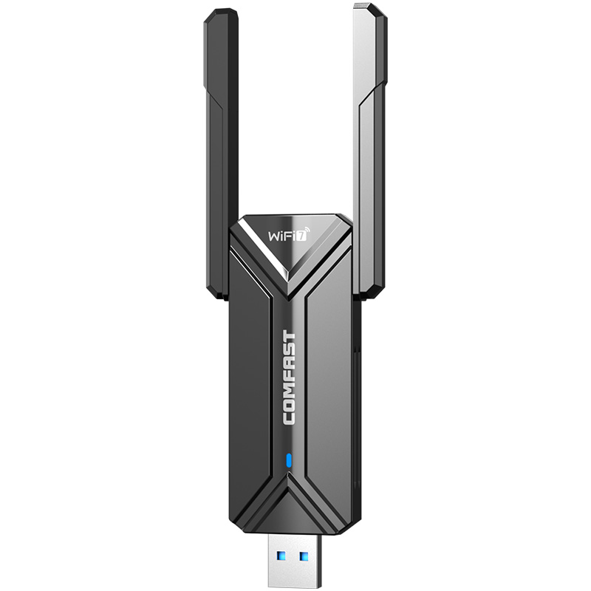
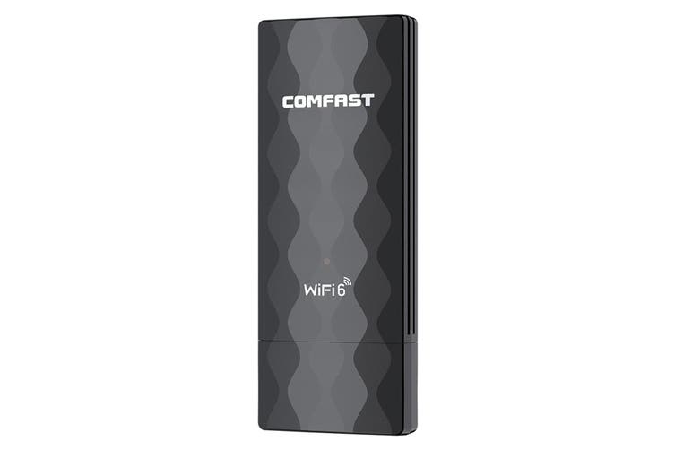
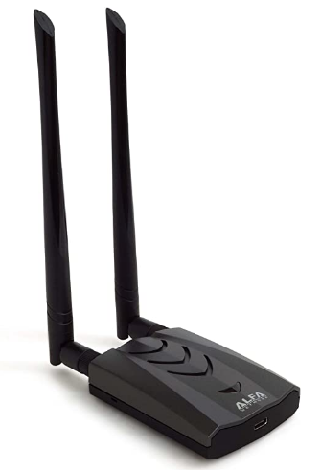

Capture Adapters : What Matters ?
  Operating modes
    Managed vs Monitor
    PCAP requires Monitor mode
  Capabilities
    Wi-Fi 4, 5, 6, 6E, 7
    Spatial streams (SS)
  Capture strategy
    Single channel PCAP
    Multi-cahnnel (roaming analysis)
    Data vs Management/Control traffic

Slide 6
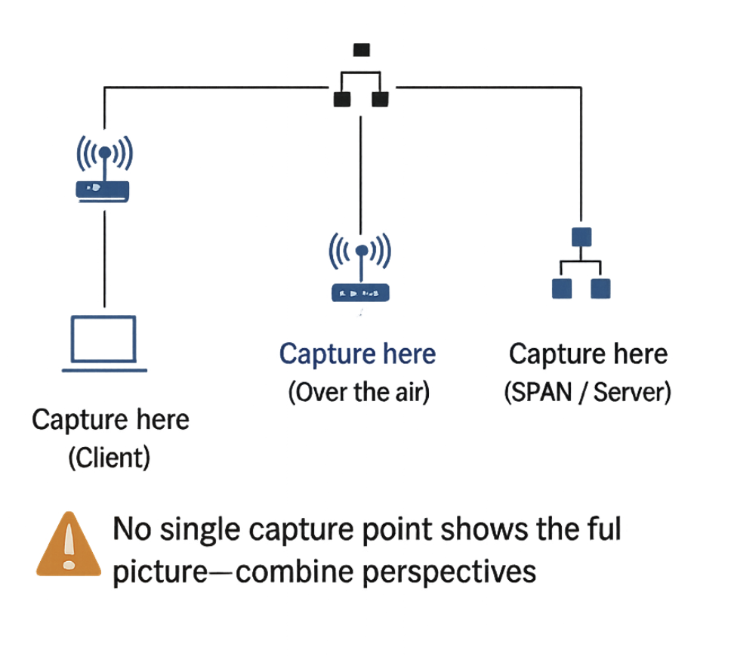
Where to Capture Traffic ?
  Capture perspective
    Client-side vs AP-side?
    Each provides a different view
  Client behavior matter
    Roaming vs Stationary
    Roaming analysis require multi-channel PCAP
  Capture locations
    OTA: Over-the-Air( near Client or AP)
    SPAN (AP/ WLC)
    Auth Server (RADIUS)
    Load balancers

Slide 7



Over-the-Air Capture using Endpoints
(Capturing Wi‑Fi traffic directly from your laptop)

Slide 8

Wi-Fi PCAP on mac-OS (Single Channel)
  What works?
    Built-in Wi‑Fi adapter
    Native monitor mode
    Tools: Airtool2
  Limitations
    Single-channel PCAP
    Limited support on Apple N1
  Advanced feature of AirTool2
    Multi-channel PCAP using WLANPi
    Zigbee/BLE PCAP
mrn-1X [5|6 GHz]
(WPA3-E)
mrn-PSK [2.4|5|6 GHz] (WPA3-P)
mrn-Guest [5GHz] (OWE)
Single channel
Wi-Fi Client
macOS (Airtool2)
https://www.intuitibits.com/products/
8
Notes:
https://www.intuitibits.com/products/

Slide 9
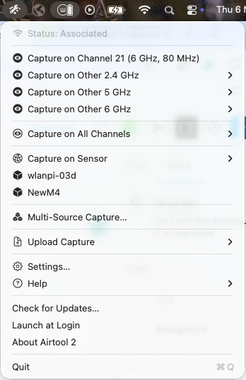
Multi-channel PCAP with mac-OS
Multi-channel
Single channel
WLAN Pi
Why multi-channel
  Capture roaming events
  Avoid missing frames
How to achieve it
  Use external sensor (WLANPi)
  Airtoo2 > Multi-source capture
mrn-1X [5|6 GHz]
(WPA3-E)
mrn-PSK [2.4|5|6 GHz] (WPA3-P)
mrn-Guest [5GHz] (OWE)
Multi-channel
Single channel
Wi-Fi Client
macOS (Airtool2)
9

Slide 10
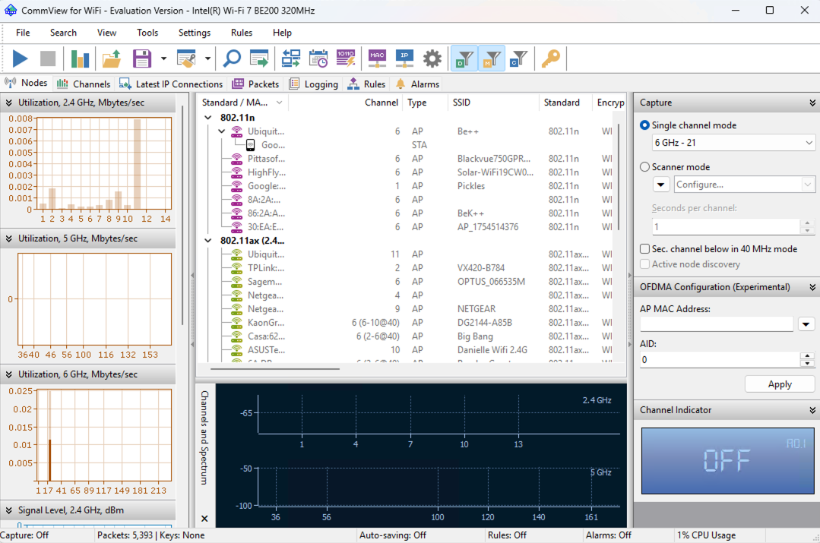
Wi-Fi PCAP on Windows
Key limitation
  No native monitor mode
How it works
  Vendor drivers (eg Tamosoft Commview)
mrn-1X [5|6 GHz]
(WPA3-E)
mrn-PSK [2.4|5|6 GHz] (WPA3-P)
mrn-Guest [5GHz] (OWE)
Wi-Fi Client
Windows OS
https://www.tamos.com/download/main/ca
10

Slide 11
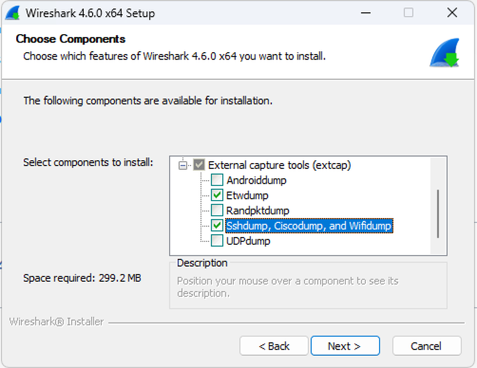
Remote Wi-Fi PCAP on Windows
  WLANPi as remote capture device with Wireshark
  Enable WiFidump when installing wireshark
  Support single channel PCAP
WLAN Pi
mrn-1X [5|6 GHz]
(WPA3-E)
mrn-PSK [2.4|5|6 GHz] (WPA3-P)
mrn-Guest [5GHz] (OWE)
Wi-Fi Client
Windows OS
11

Slide 12
Wi-Fi PCAP on Linux
  Key advantages
  Full monitor mode support
  Flexible and powerful
  Capabilities
  Single-channel capture
  Multi-channel capture
  How it works
  Create monitor mode interface
  Set channel & bandwidth
  Capture with Wireshark / tcpdump
mrn-1X [5|6 GHz]
(WPA3-E)
mrn-PSK [2.4|5|6 GHz] (WPA3-P)
mrn-Guest [5GHz] (OWE)
Wi-Fi Client
Linux OS
12
Notes:
Linux offers the most control and flexibility for Wi‑Fi packet capture

Slide 13
Linux PCAP Commands
Identify interface
Create a ‘monitor’ mode interface
Delete ‘managed’ mode interface
Bring up the monitor mode interface
Set capture frequency
Run Wireshark & Capture traffic on monitor mode interfaces
iw dev
iw phy [phy0] interface add [mrn0] type monitor
iw dev [wlan0] del
ifconfig [mrn0] up
iw dev [mrn0] set freq <control freq> [20|40|80|80+80|160] [<center1_freq> [<center2_freq>]]
13
Notes:
Linux gives full control over monitor mode and capture parameters

Slide 14
Wi-Fi PCAP with Professional Tools
(Beyond Laptop limitations)
Ekahau
NetAlly
Sidos
Notes:
So far we’ve been working with laptops — and we’ve seen their limitations.
This is where professional tools come in — designed specifically for reliable and multi-channel Wi‑Fi capture.

Slide 15
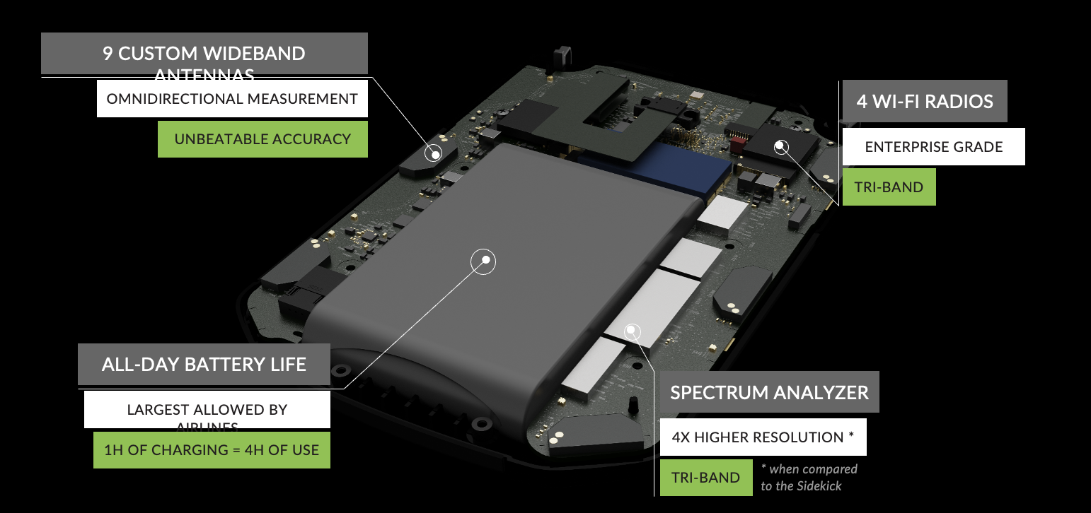
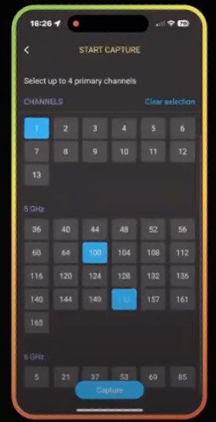
Wi-Fi PCAP with Ekahau Analyzer
Multi-channel PCAP (up to 4)
Support 2.4, 5 and 6 GHz
Require Apple iOS device (iPad/iPhone)
    Ekahau Analyzer App
Cisco CW9178I
CH1@20 [2.4GHz]
CH149@80 [5GHz]
CH21@80 [6GHz]
mrn-1X [5|6 GHz]
(WPA3-E)
mrn-PSK [2.4|5|6 GHz] (WPA3-P)
mrn-Guest [5GHz] (OWE)
Multi-channel
Wi-Fi Client
Ekahau SideKick2
https://www.ekahau.com/watch/product-news-just-go-survey-optimizer-packet-capture-and-more
Notes:
https://www.ekahau.com/watch/product-news-just-go-survey-optimizer-packet-capture-and-more

Slide 16
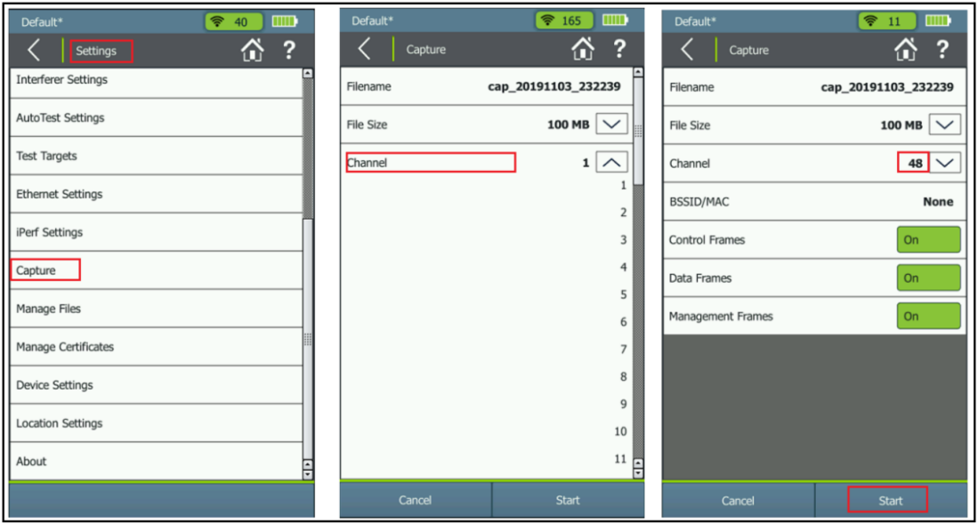
Wi-Fi PCAP with NetAlly
Useful in ad-hoc troubleshooting
Easy handheld device
https://www.netally.com/general/working-with-your-packets/
Notes:
https://www.netally.com/general/working-with-your-packets/

Slide 17
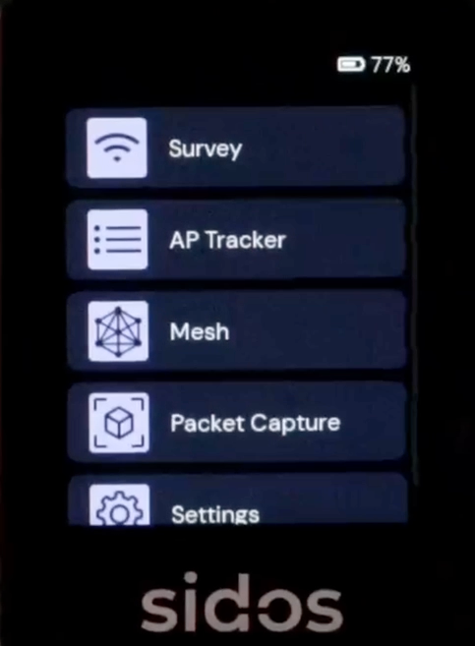
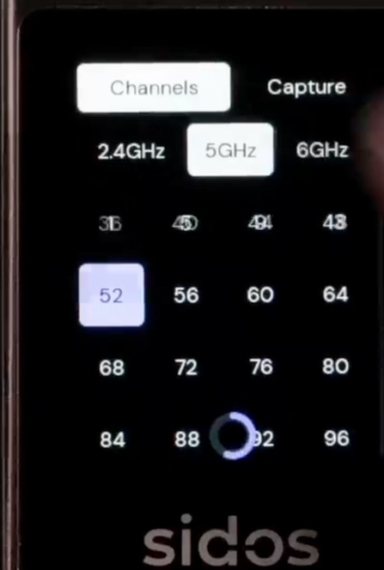
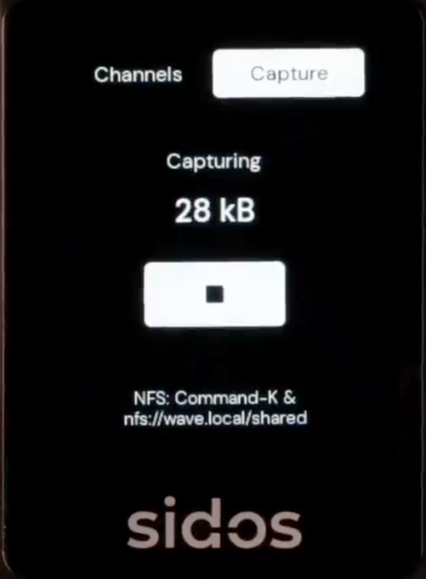
Wi-Fi PCAP with Sidos
https://www.linkedin.com/posts/mika-hakala-54894_sidos-microapps-26-packet-capture-app-activity-7424116631267733504-UN25
Notes:
https://www.linkedin.com/posts/mika-hakala-54894_sidos-microapps-26-packet-capture-app-activity-7424116631267733504-UN25

Slide 18


Wi-Fi PCAP using Infrastructure
(Capture traffic directly from APs and controllers)

Slide 19
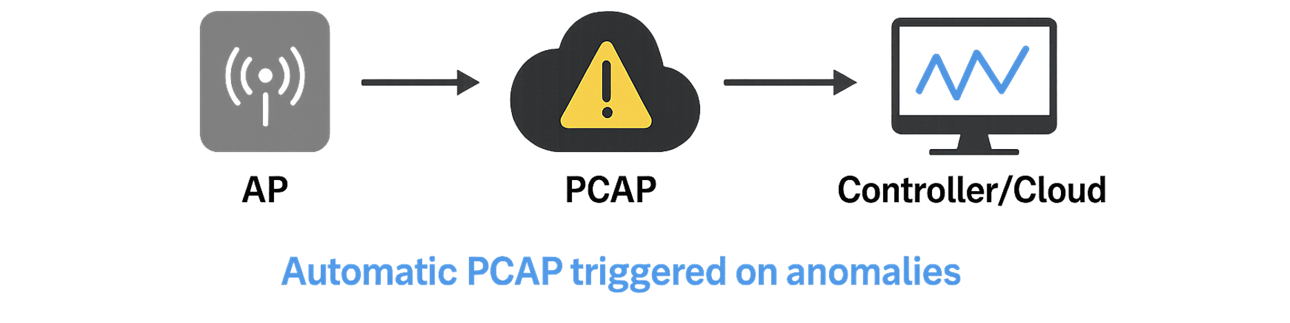
Infrastructure PCAP – Pro & Cons
  ✅ No extra hardware
  ✅ Centralized capture & control
  ✅ Decrypted traffic (vendor dependent)
  ✅ Event-driven / automated capture
  ⚠️ AP-perspective only
  ⚠️ Limited RF visibility
  ⚠️ Vendor-dependent behavior
  ⚠️ Not true OTA capture
19
Notes:
Infrastructure capture is very powerful — especially because you don’t need extra hardware…

Slide 20
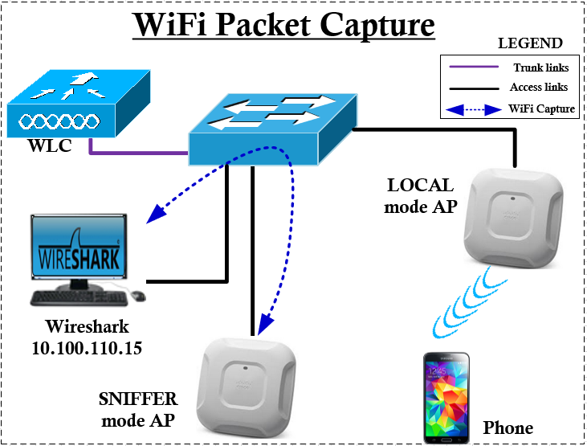
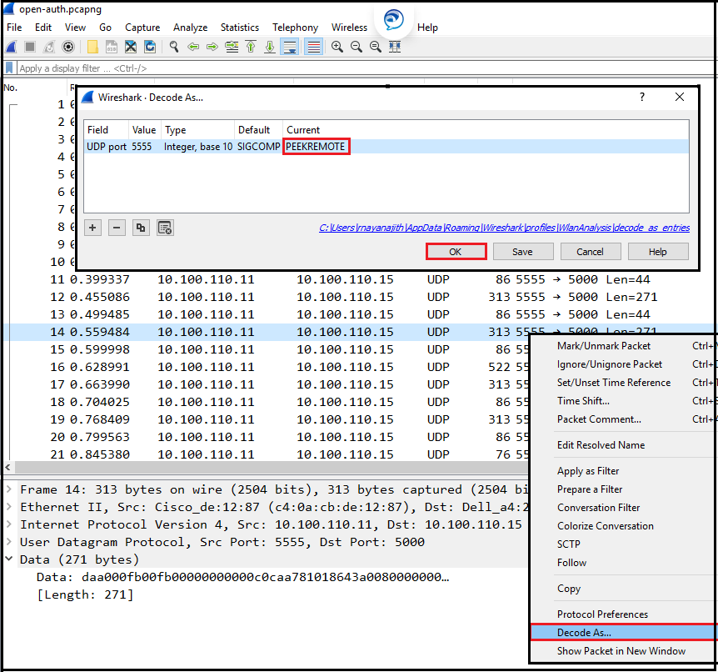
Wi-Fi PCAP with Sniffer AP
https://mrncciew.com/2018/04/07/Wi-Fi-captures-with-sniffer-mode-ap/
Notes:
https://www.ekahau.com/watch/product-news-just-go-survey-optimizer-packet-capture-and-more

Slide 21
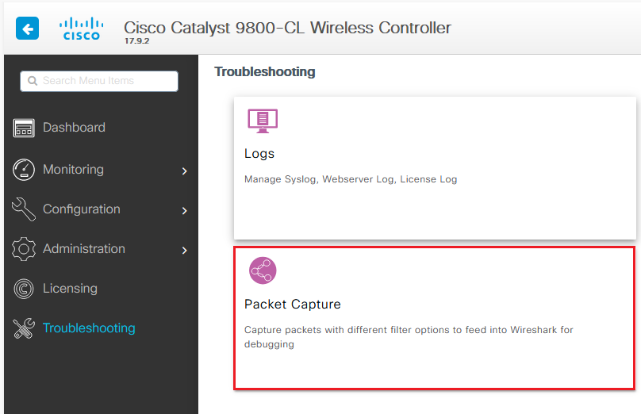

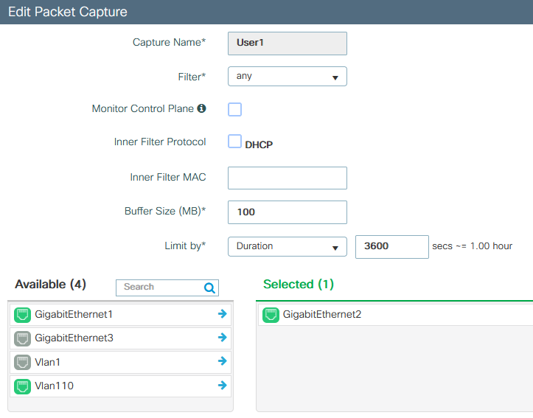
Wi-Fi PCAP with 9800 WLC
Local Mode –> All traffic go to WLC
FlexConnect Mode –> Only Control Traffic go to WLC
Cisco
ISE
Cisco
9800 WLC
Cisco
Catalyst Centre
Cisco
ISE
Cisco
9800 WLC
Cisco
Catalyst Centre

Slide 22
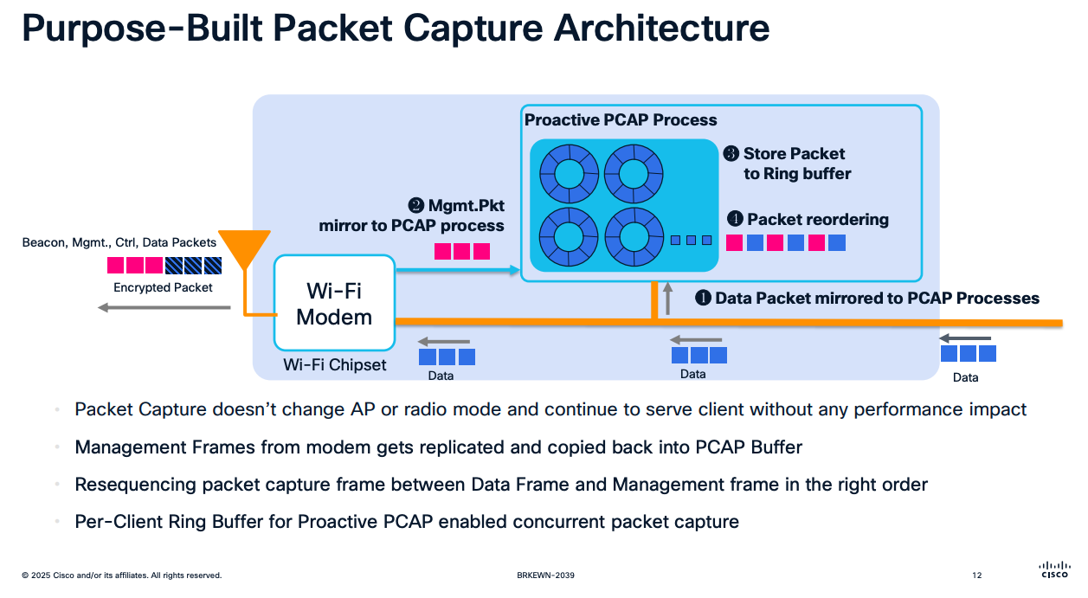
Wi-Fi PCAP with Cisco Meraki
Full Data Capture
Decrypted traffic view
Limit to 100k packets or 20min
https://www.ciscolive.com/c/dam/r/ciscolive/global-event/docs/2025/pdf/BRKEWN-2039.pdf
Notes:
https://www.ciscolive.com/c/dam/r/ciscolive/global-event/docs/2025/pdf/BRKEWN-2039.pdf

Slide 23
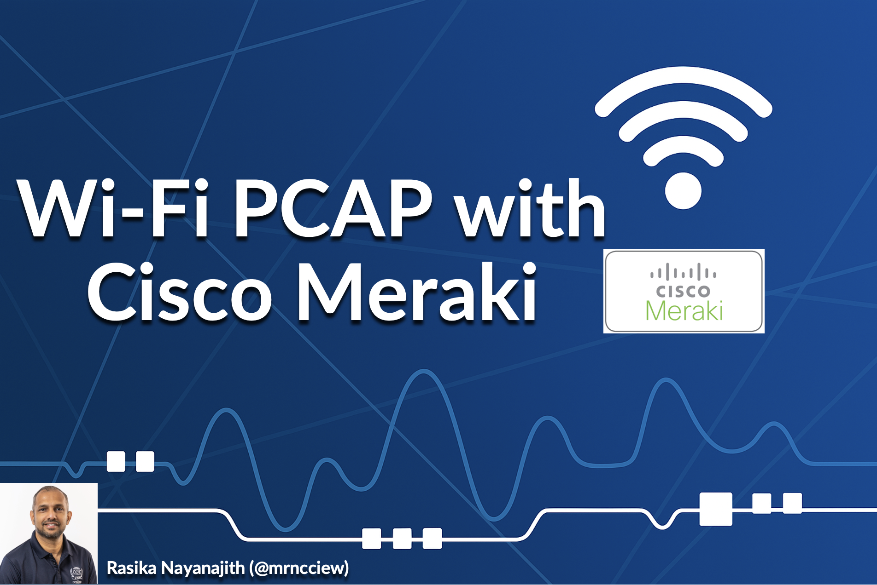
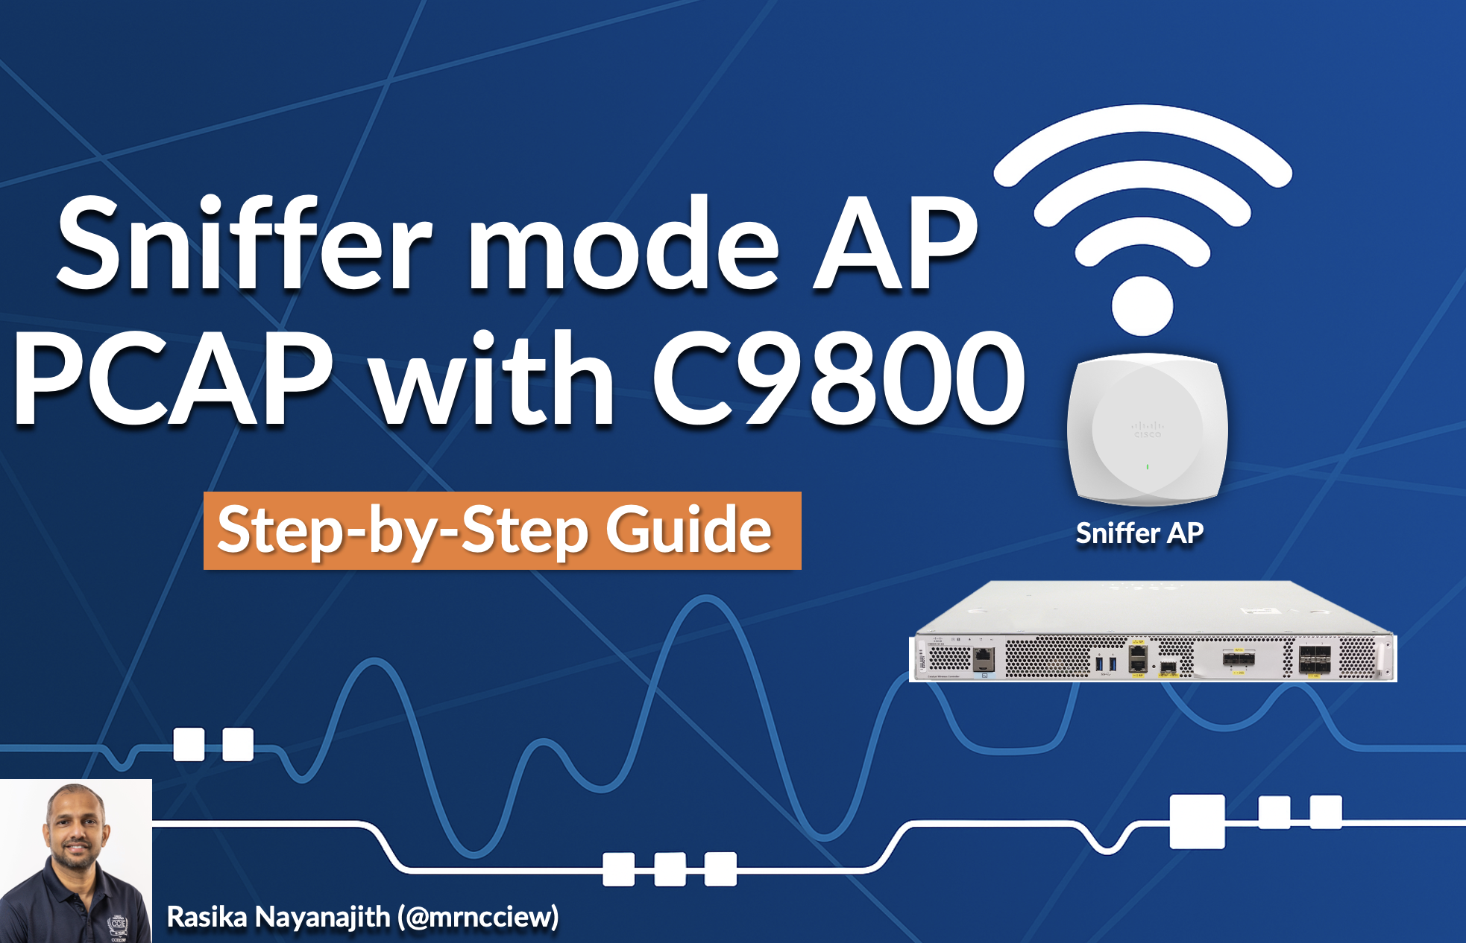



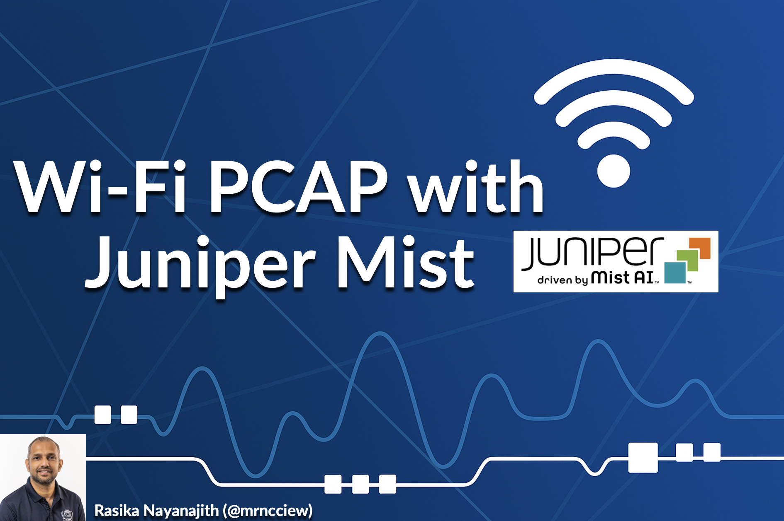


Wi-Fi PCAP with Vendors
https://mrncciew.com/2024/10/13/wi-fi-pcap-with-unifi/
https://mrncciew.com/2024/10/16/wi-fi-pcap-with-mist/
Notes:
https://mrncciew.com/2024/10/16/wi-fi-pcap-with-mist/
https://mrncciew.com/2024/10/13/wi-fi-pcap-with-unifi/

Slide 24
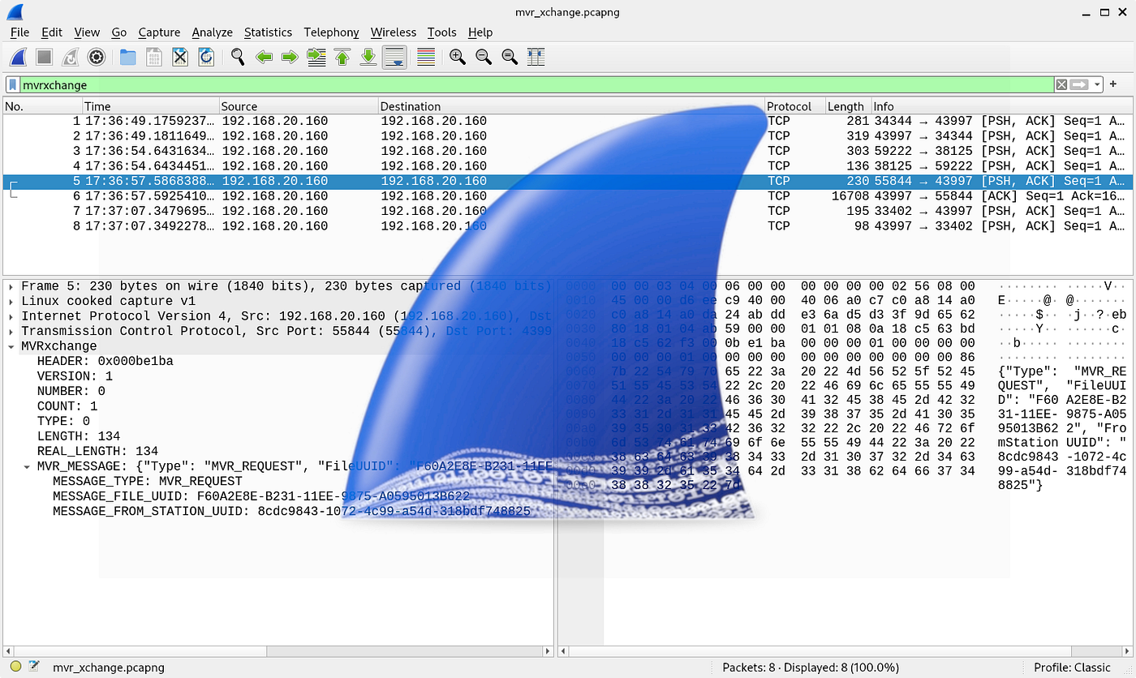


Struggling with PCAPs?
Free tools to analyze faster and smarter
Wireshark
Wi-Fi Hawk
AI + Browser

Slide 25
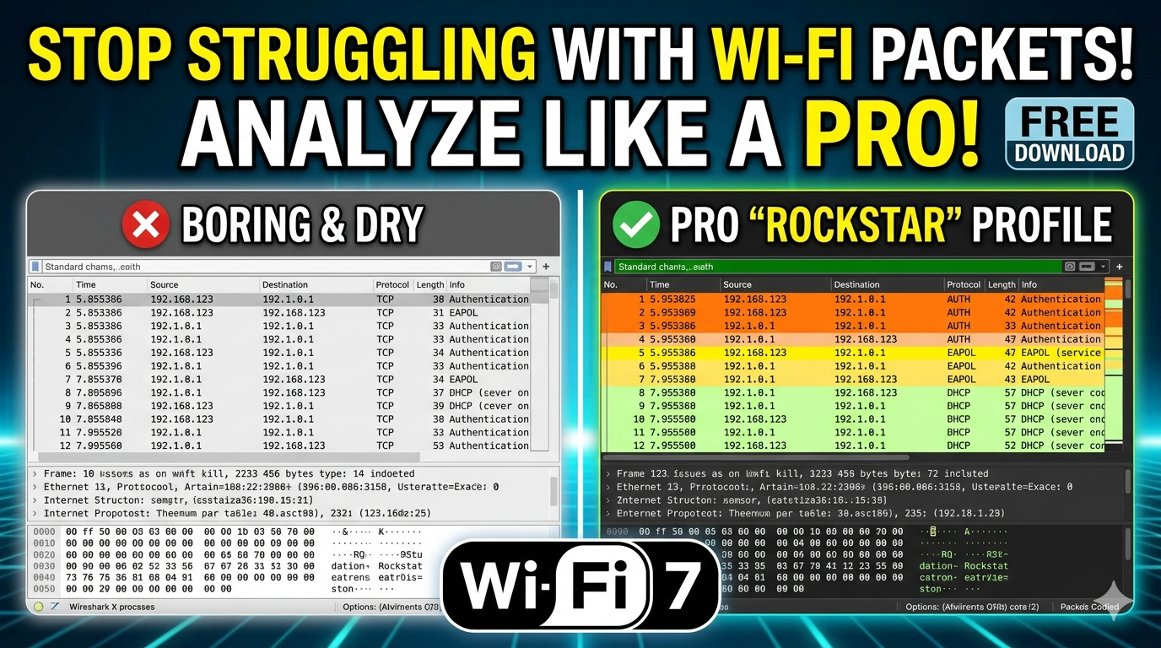
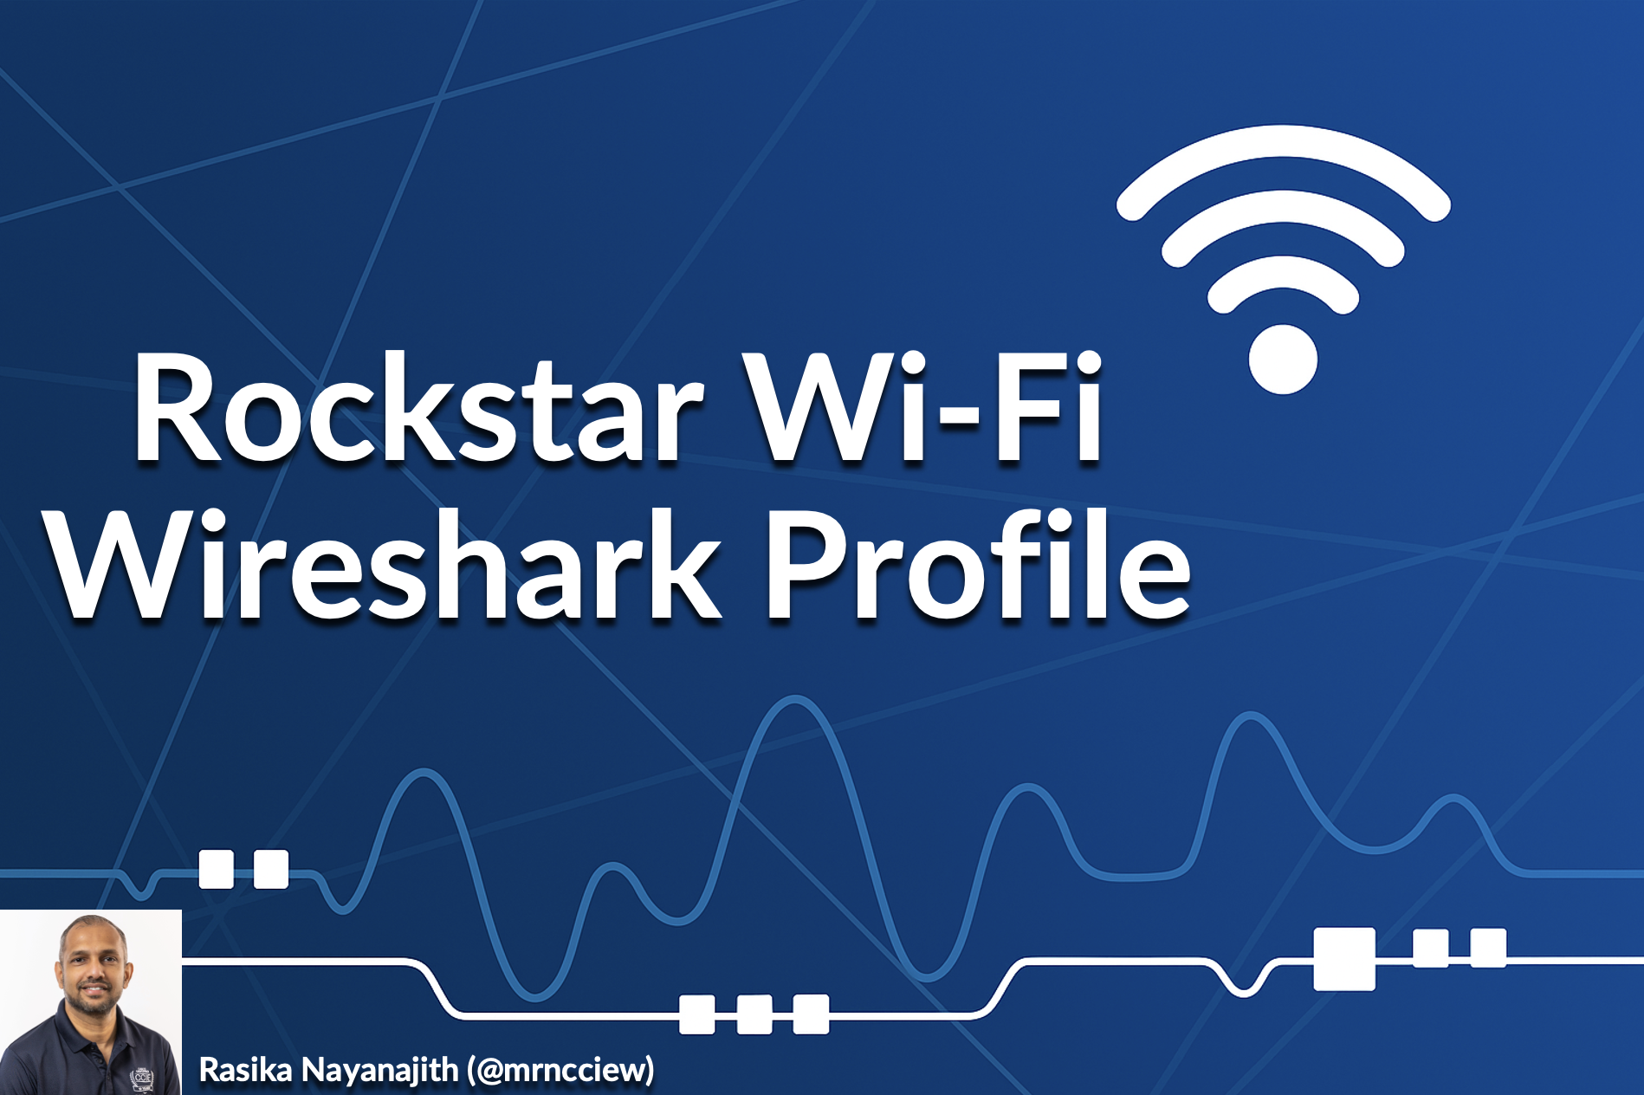

Wireshark Profiles
Custom wireshark profile (free to use)
Wi-Fi 7 Analysis included
https://mrncciew.com/2025/09/02/get-rockstarwifi-wireshark-profile/
Notes:
https://mrncciew.com/2025/09/02/get-rockstarwifi-wireshark-profile/

Slide 26
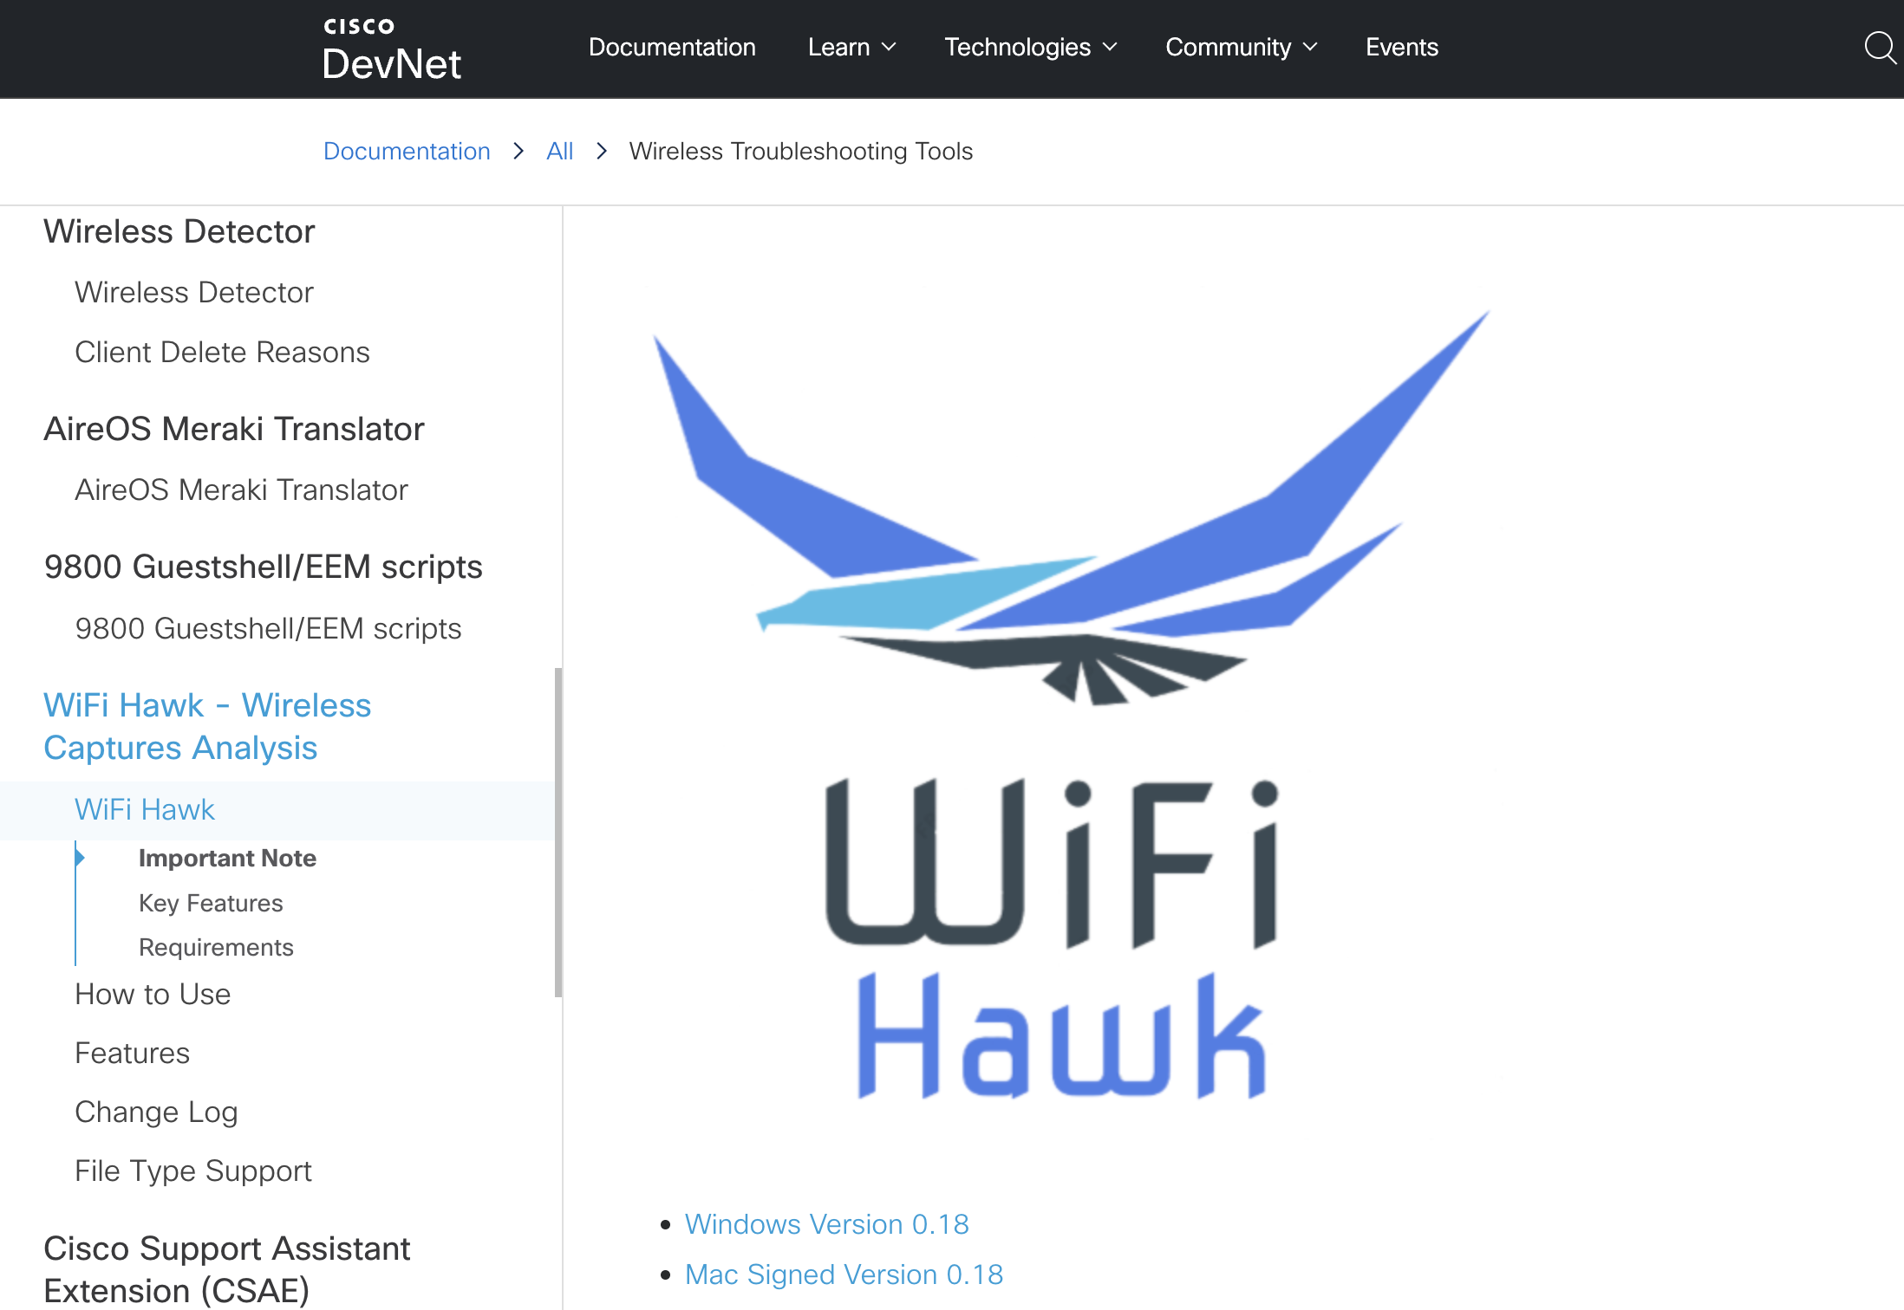

Wi-Fi Hawk
Free Cisco tool for WiFi PCAP analysis
Automated issue detection
Event Flow visualization
Excel-based reporting
Cross-platform with broad PCAP support
https://mrncciew.com/2022/08/09/cisco-wifi-hawk/
Notes:
https://mrncciew.com/2022/08/09/cisco-wifi-hawk/

Slide 27
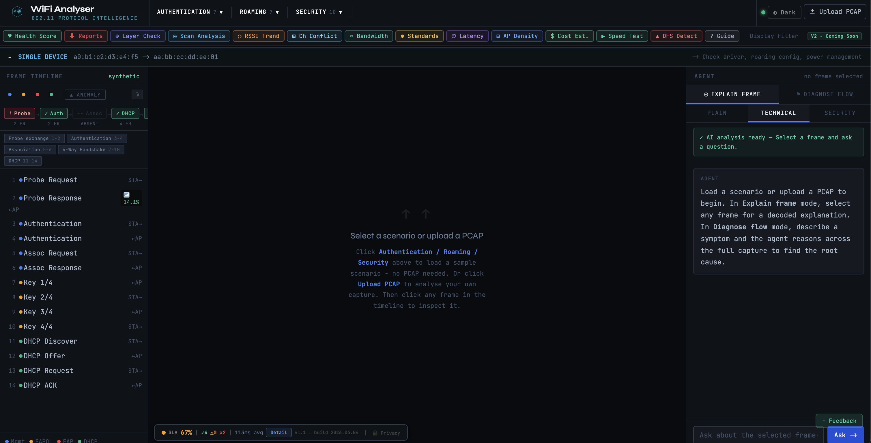


PCAP Analysis : app.wlananalyser.com
Free & browser-based
AI-powered root cause diagnosis
Privacy-first — analysis results are held in RAM for up to 1 hour then auto-deleted
https://app.wlananalyser.com/
Notes:
app.wlananalyser.com
https://shankarwifi.com/

Slide 28

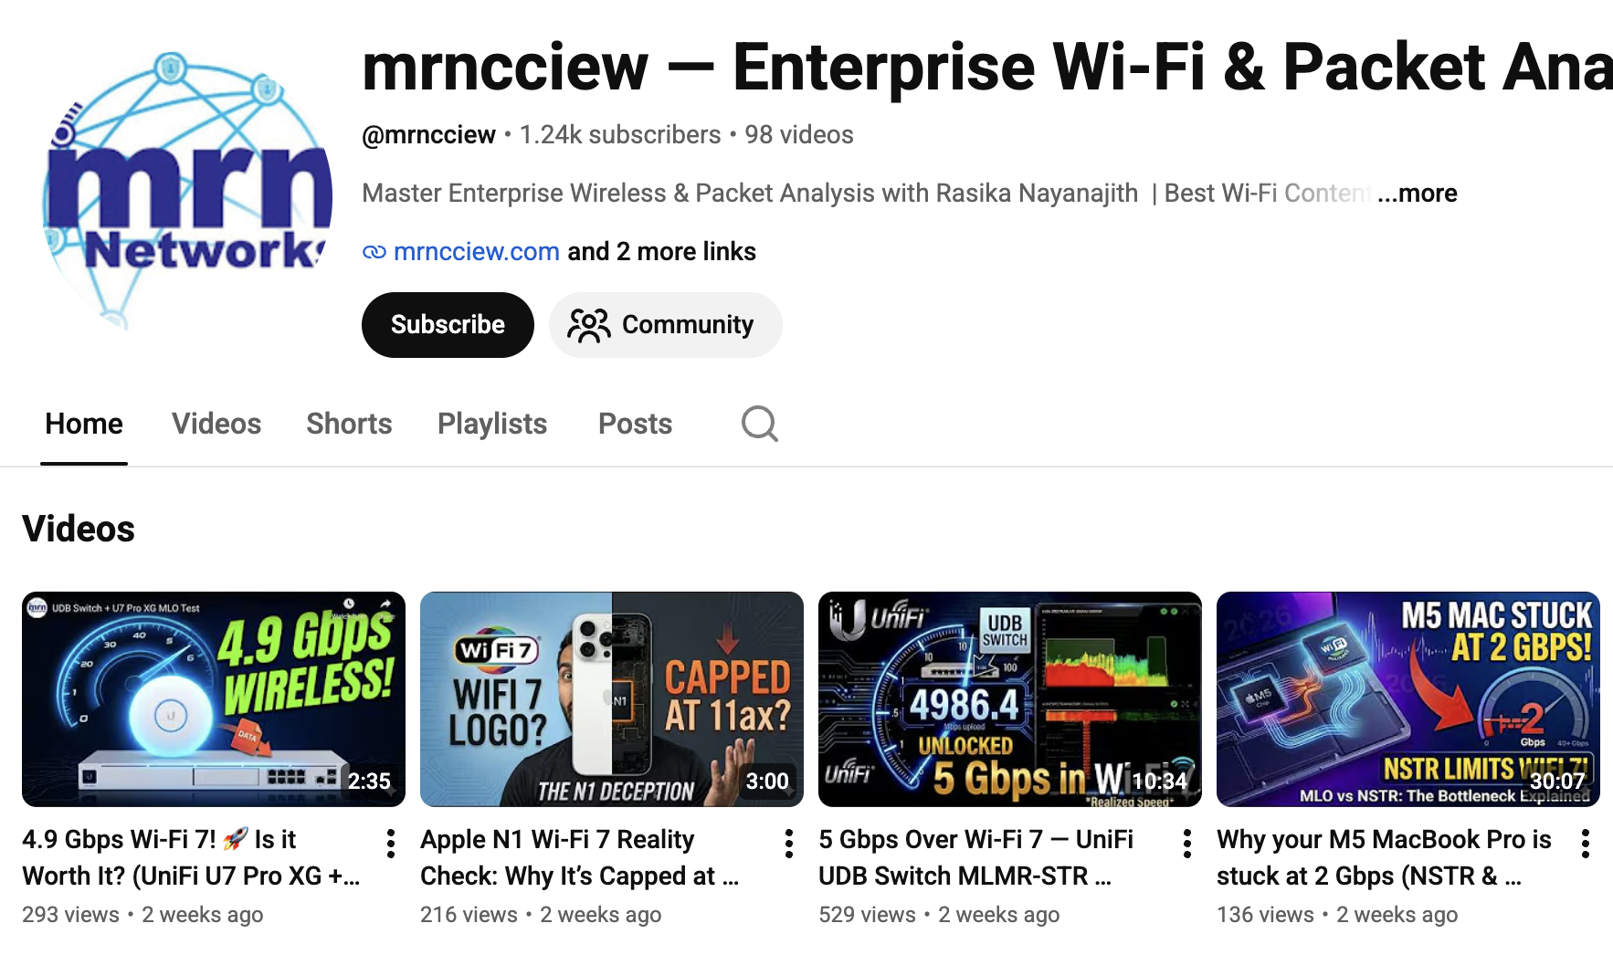


Thank you…

