Slide 1

Wi-Fi 7 Experimental Insights
MLO, OFDMA, and MU-MIMO
Wi-Fi 7 Experimental Insights
MLO, OFDMA, and MU-MIMO

Slide 2
Wi-Fi 7: New Features & Enhancements
New Features
Enhanced Features
Multi-Link Operation
320 MHz
4096 QAM
OFDMA enhancements (+ MRU)
MU-MIMO
Preamble Puncturing
R-TWT

Slide 3
Experiments that would be covered
MLO
  MLMR STR
  EMLSR
OFDMA
  VoIP
  Throughput
MU-MIMO
  Simple use case with 2 clients

Slide 4
MLO MLMR Tests
Asymmetric BW
Link Usage with Attenuation

Slide 5
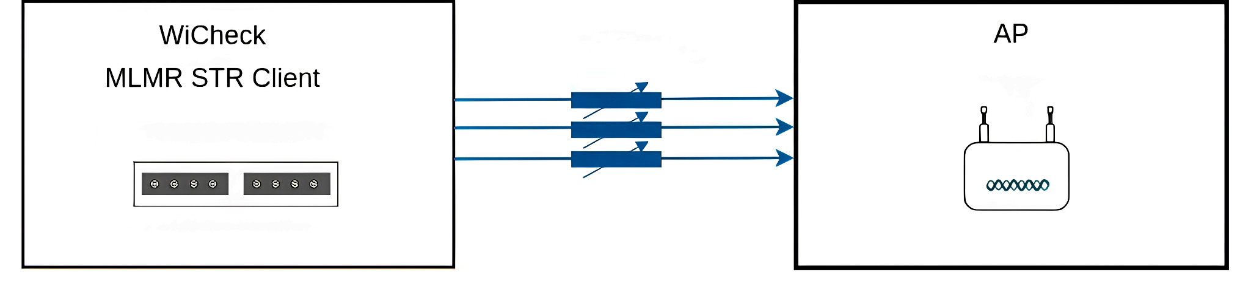
MLO MLMR STR Test Setup
RF Isolated Setup
Control over 3 bands separately via attenuator
Traffic: iperf TCP DL

Slide 6
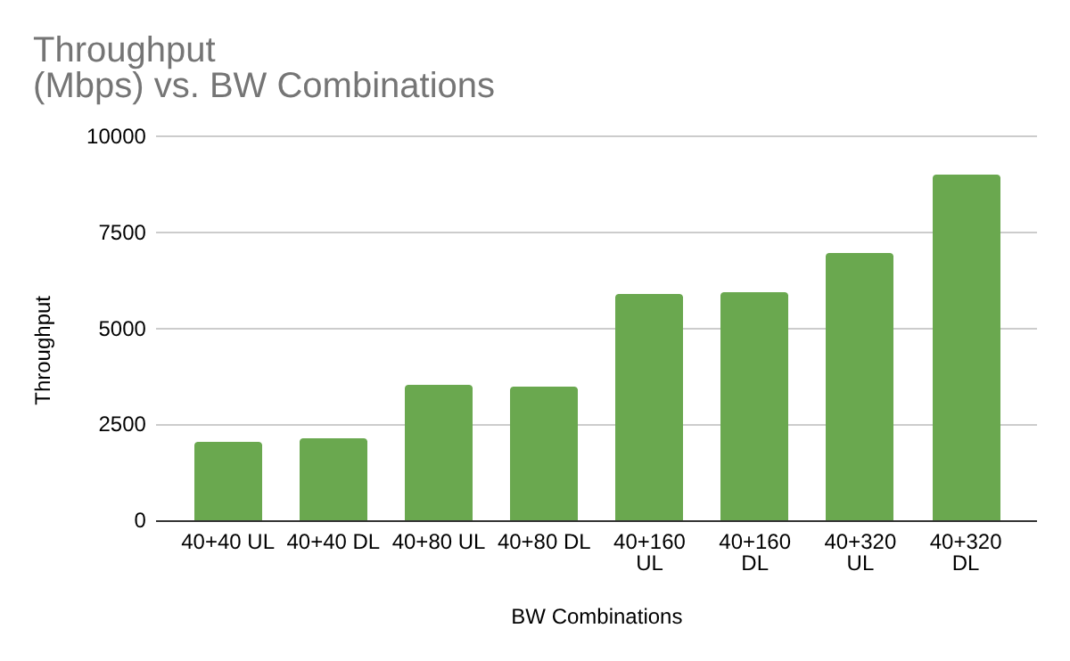
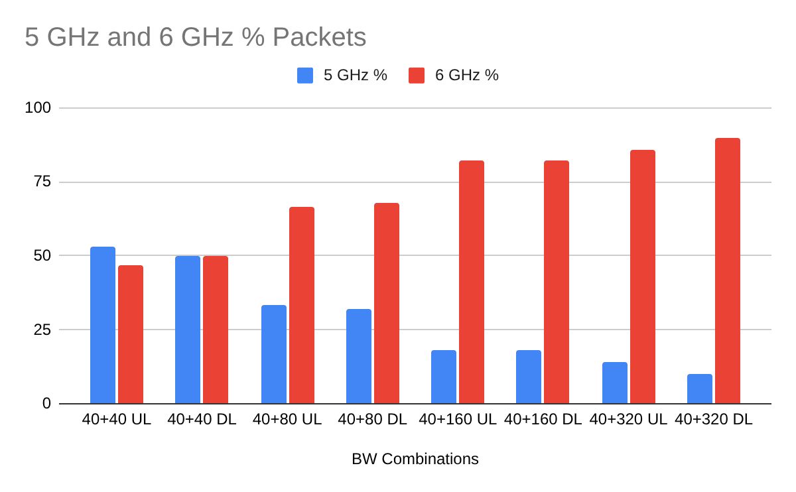
Test Results - MLMR Asymmetric BW Link Usage
Key Takeaways
The distribution of packets is proportional to the BW
Throughput increase is in line with total BW

Slide 7
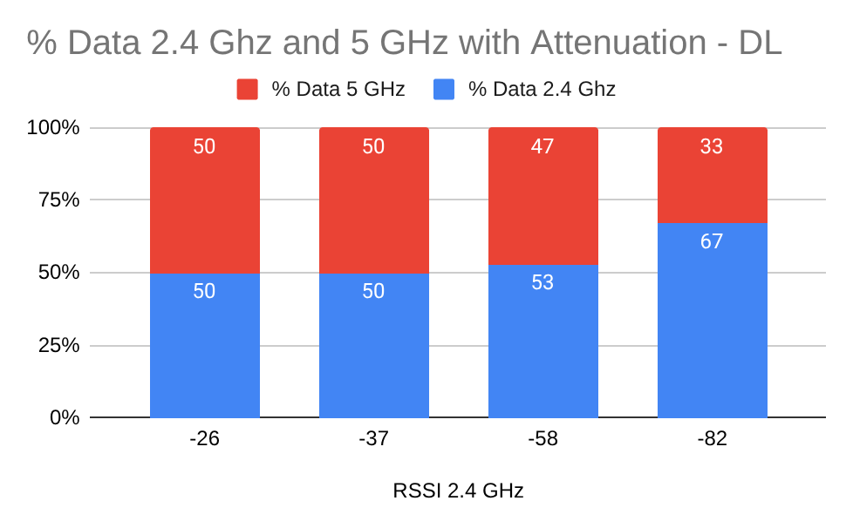
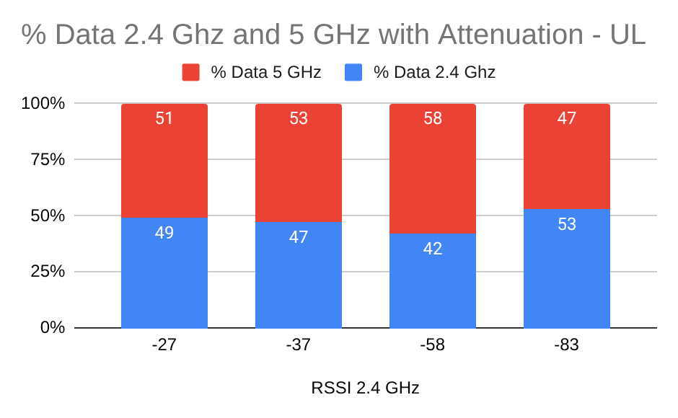
Test Results - MLMR Attenuation v/s Link Usage
This is “MLO RvR” with lesser steps.
20+20 BW is used for the test
Key Takeaway:
The distribution of traffic goes towards 2.4 GHz as attenuation increases.

Slide 8
MLO EMLSR Tests
Multi-client Throughput DL,UL

Slide 9
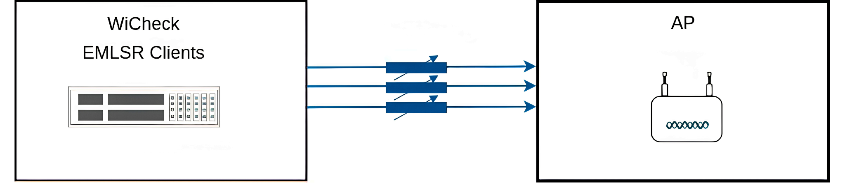
MLO EMLSR Test Setup
RF Isolated Setup
5 clients used in the test
Traffic: iperf TCP DL, UL

Slide 10
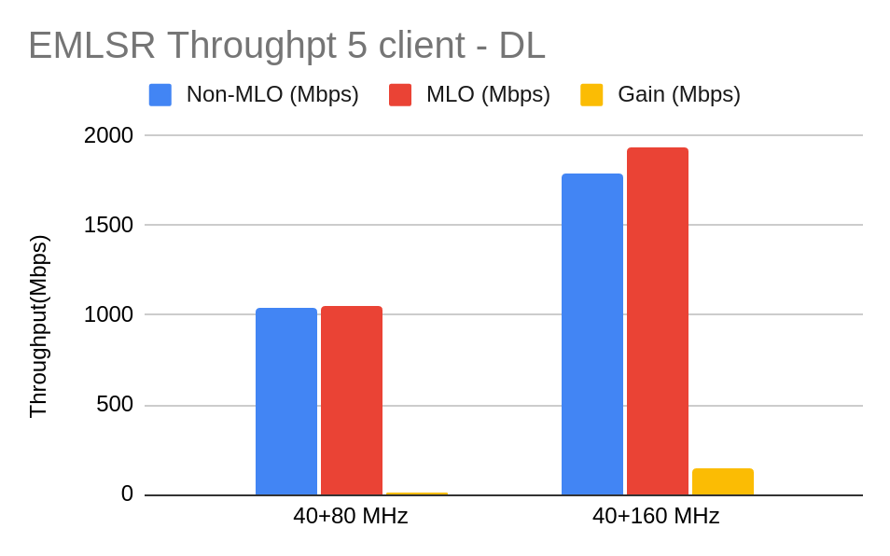
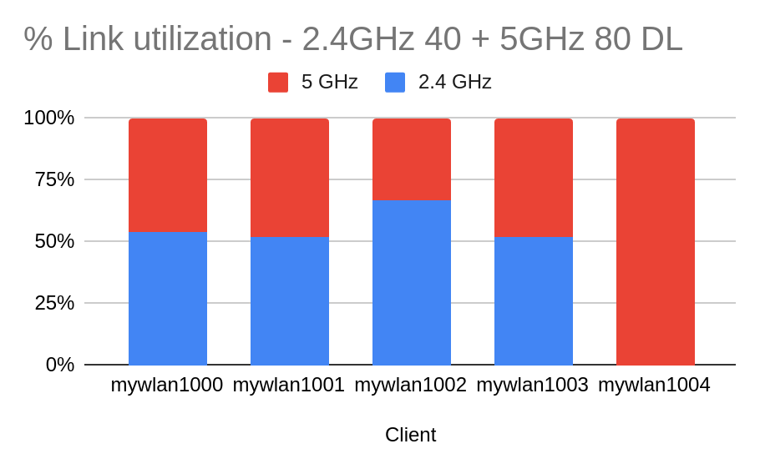
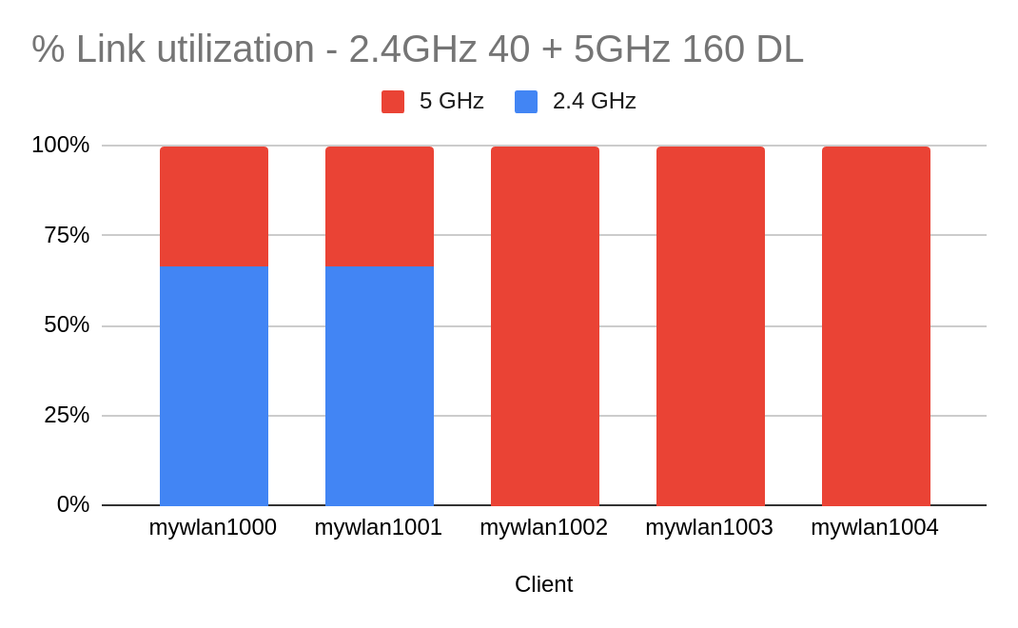
MLO EMLSR Test Results - AP1
Takeaways
Multi client performance of MLO clients is better than Non MLO clients if the incumbent band is same

Slide 11
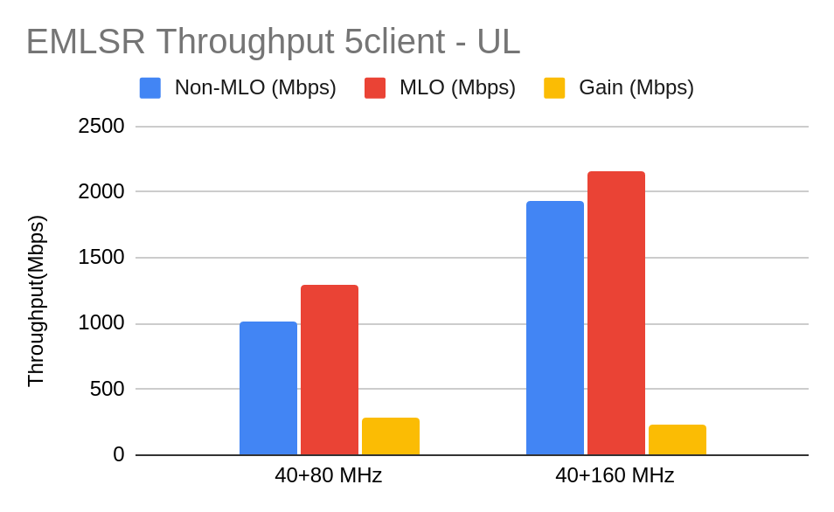
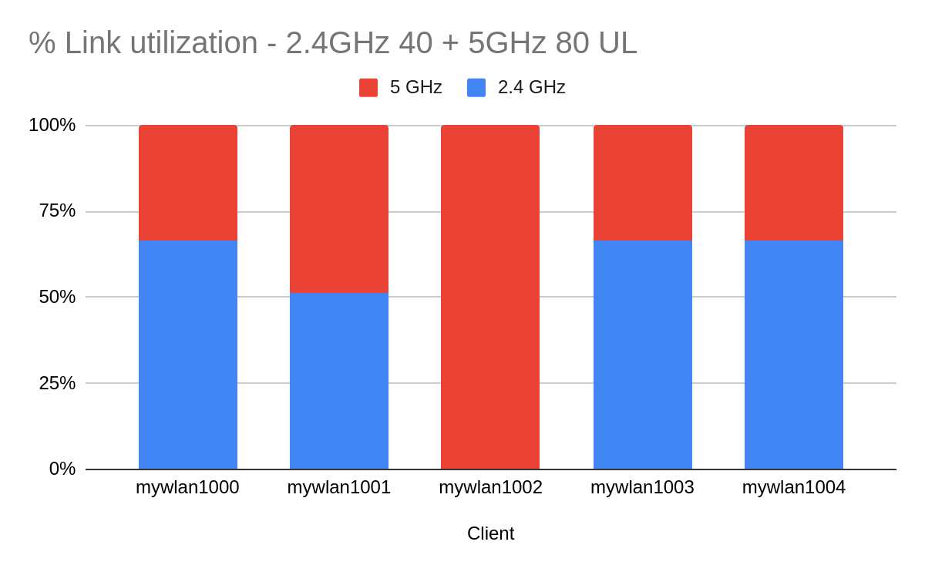
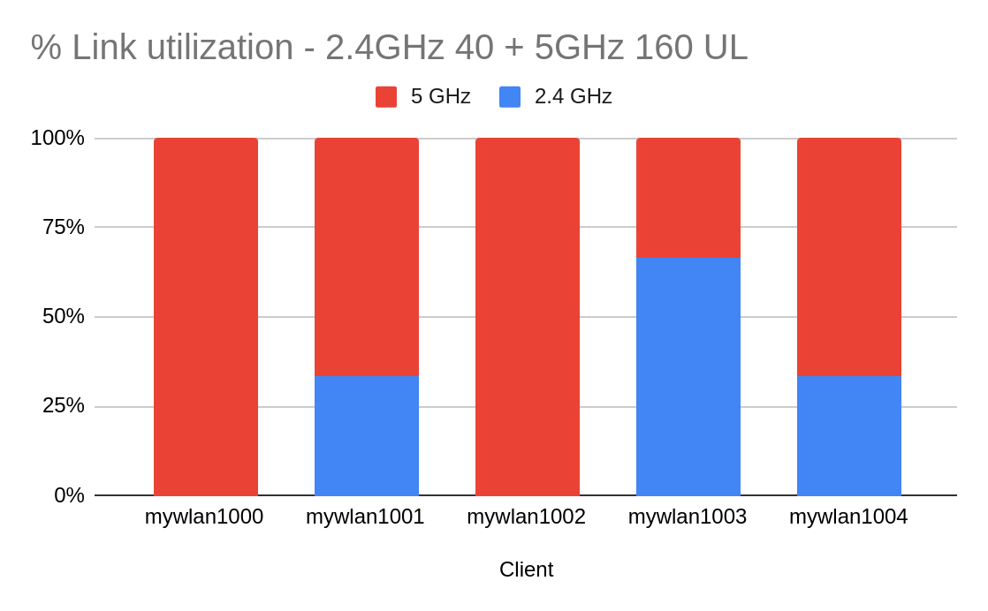
MLO EMLSR Test Results - AP1
Takeaways
Multi client performance of MLO clients is better than Non MLO clients if the incumbent band is same

Slide 12
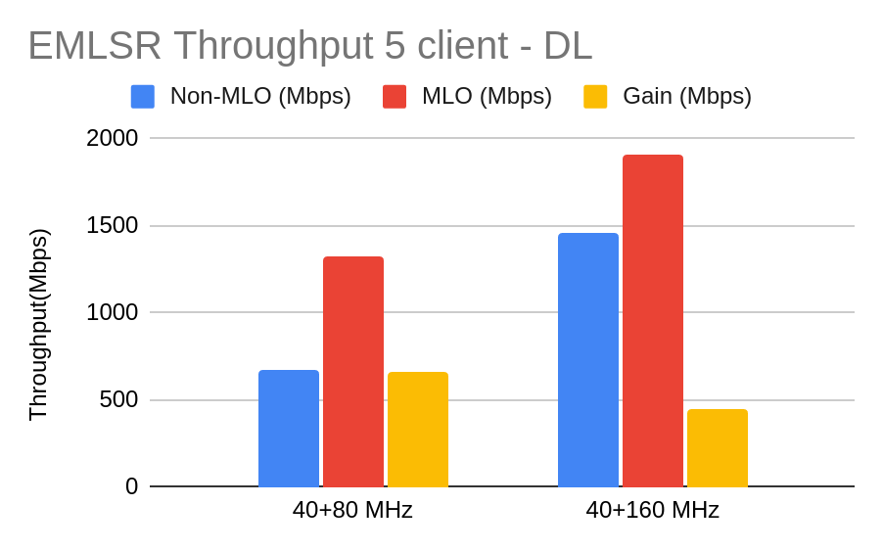
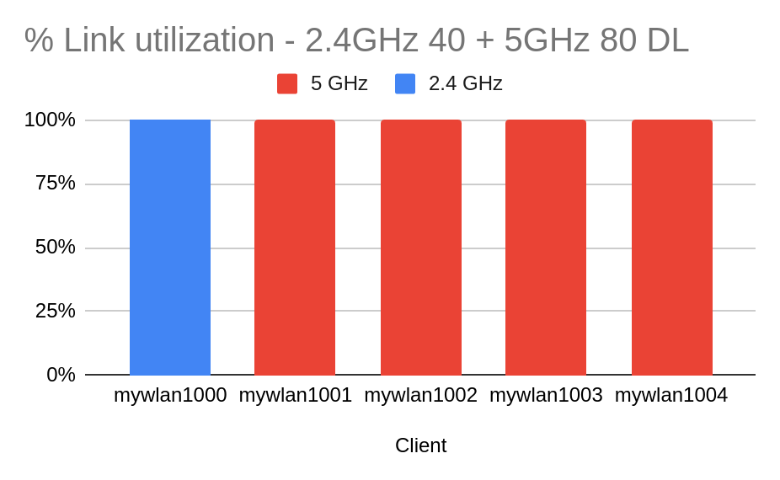
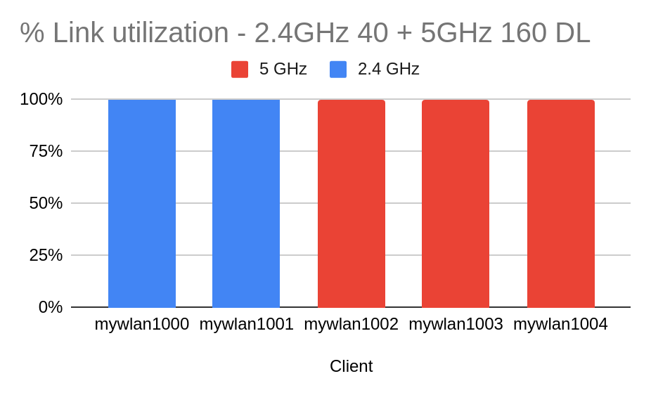
MLO EMLSR Test Results - AP2
Takeaways
Multi client performance of MLO clients is better than Non MLO clients if the incumbent band is same

Slide 13
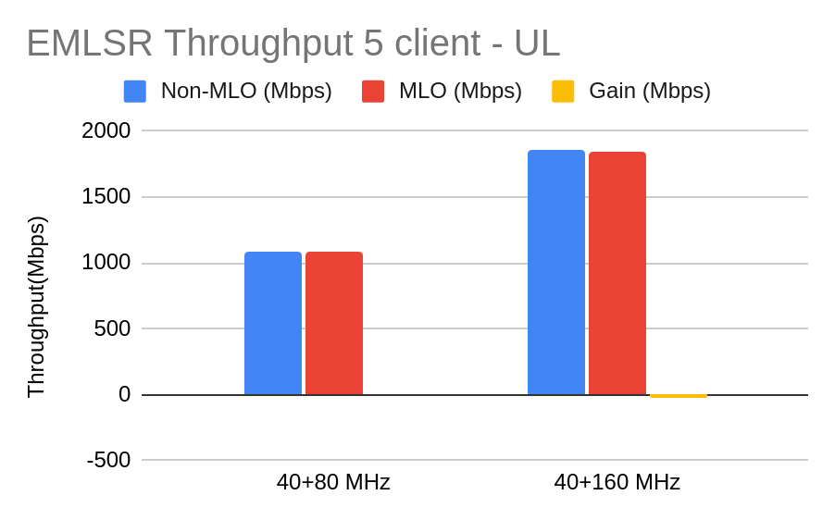
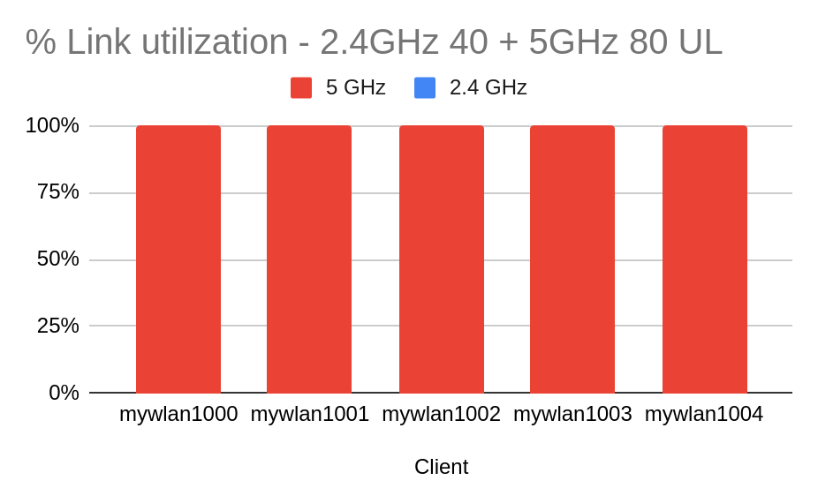
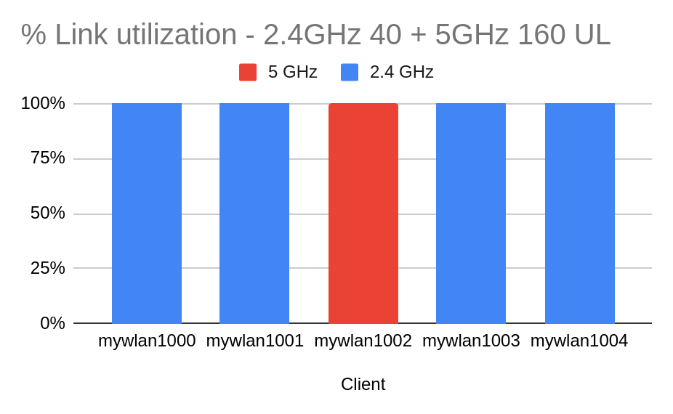
MLO EMLSR Test Results - AP2
Takeaways
Multi client performance of MLO clients is better than Non MLO clients if the incumbent band is same

Slide 14
OFDMA Tests
VoIP
UDP
TCP

Slide 15
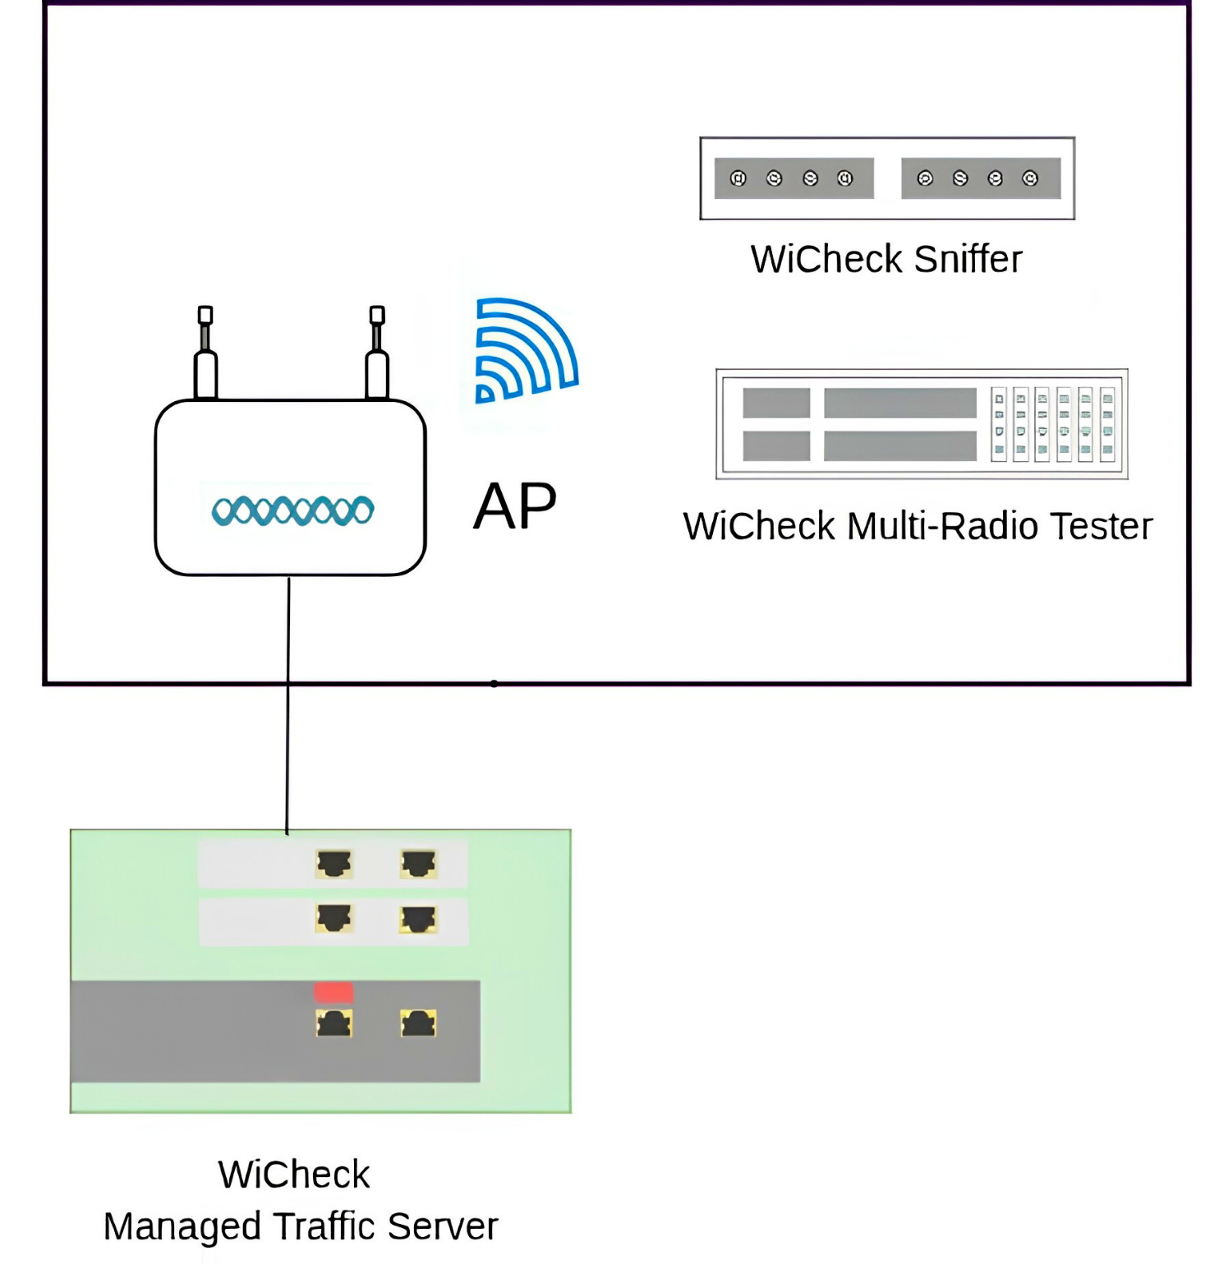
OFDMA Test Setup
RF Isolated Setup
Upto 12 clients usable
Traffic Server supports
  Iperf
  Asterisk server for SIP Calls

Slide 16
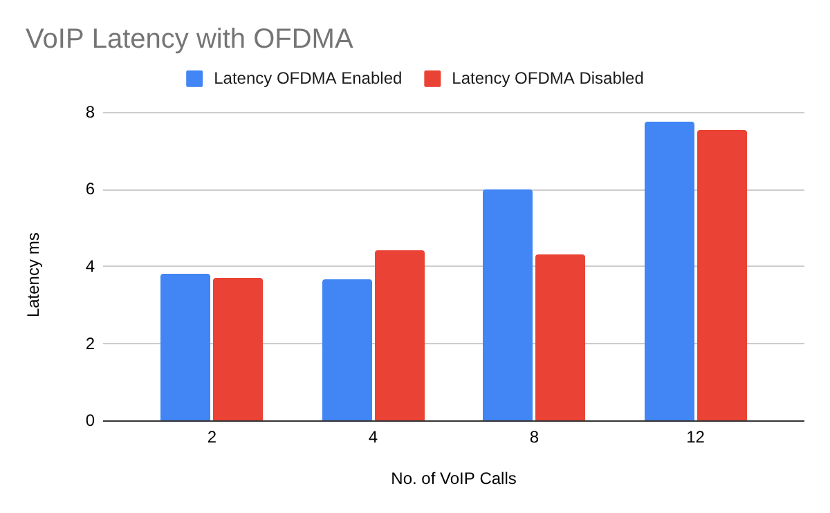
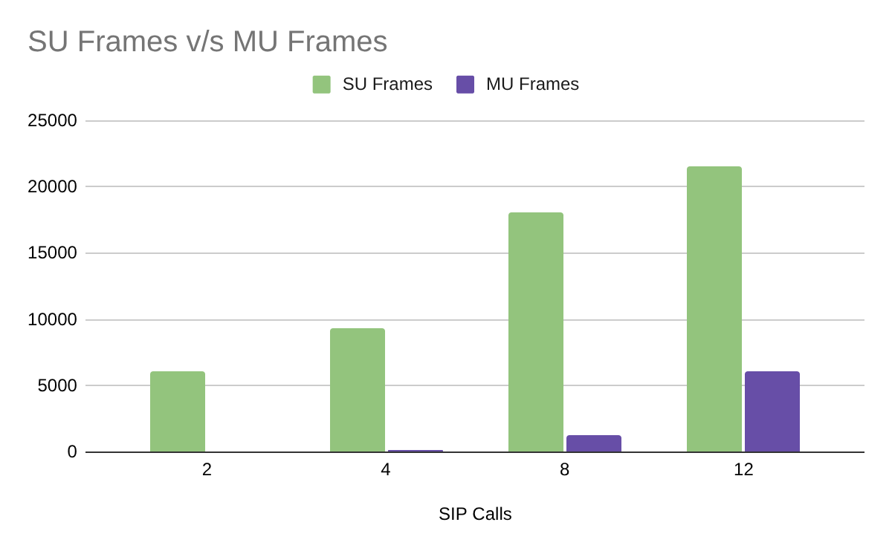
OFDMA VoIP Test Results
OFDMA seem to provide very little benefit for a simple VoIP use case
OFDMA Allocation does not seem to kick-in
Tests were repeated multiple time with multiple APs (Enterprise & Home).

Slide 17
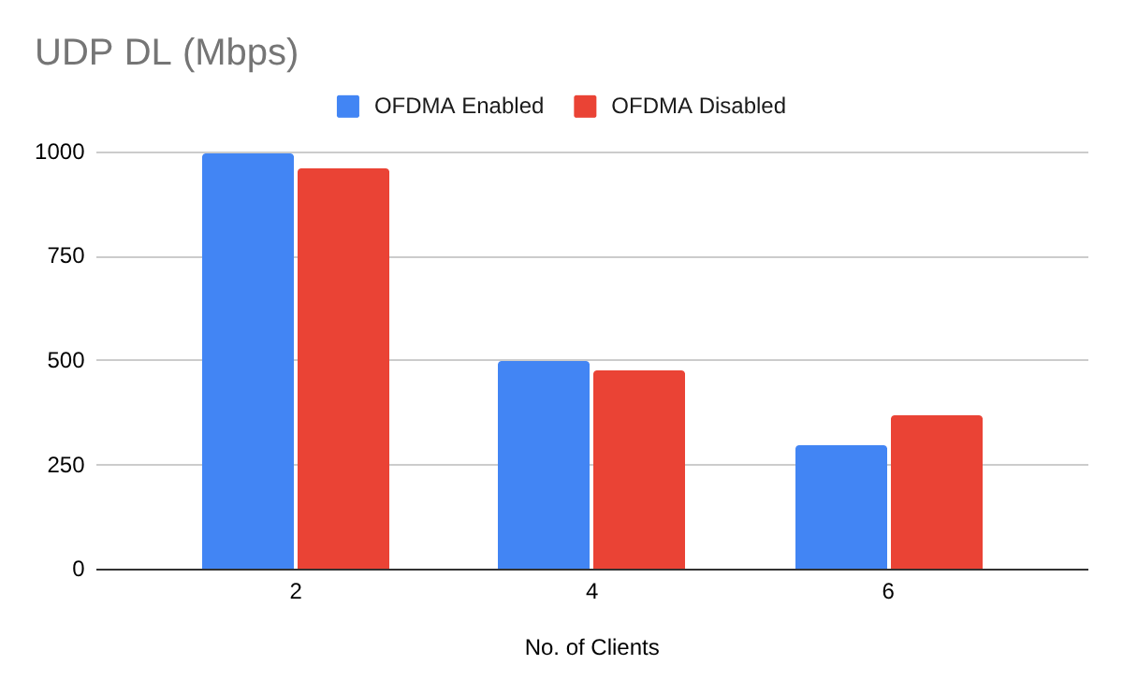
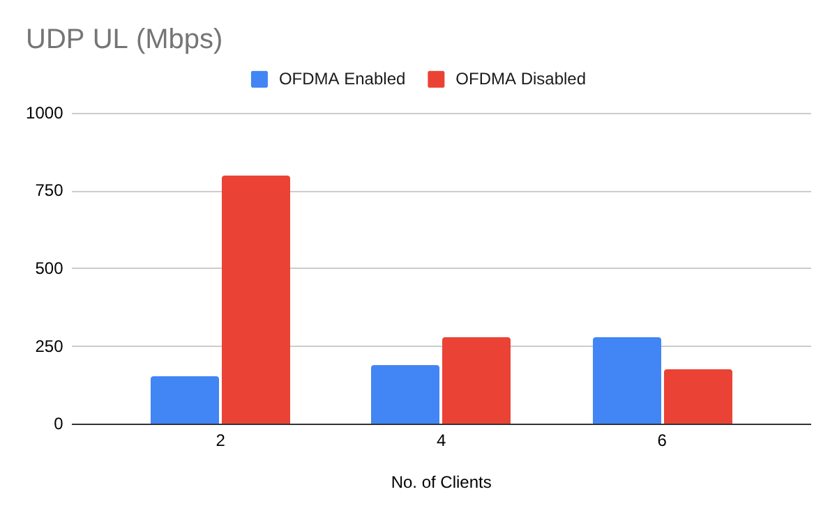
OFDMA Throughput Tests UDP
The tests show marginal or no improvement.
UL OFDMA seems broken

Slide 18
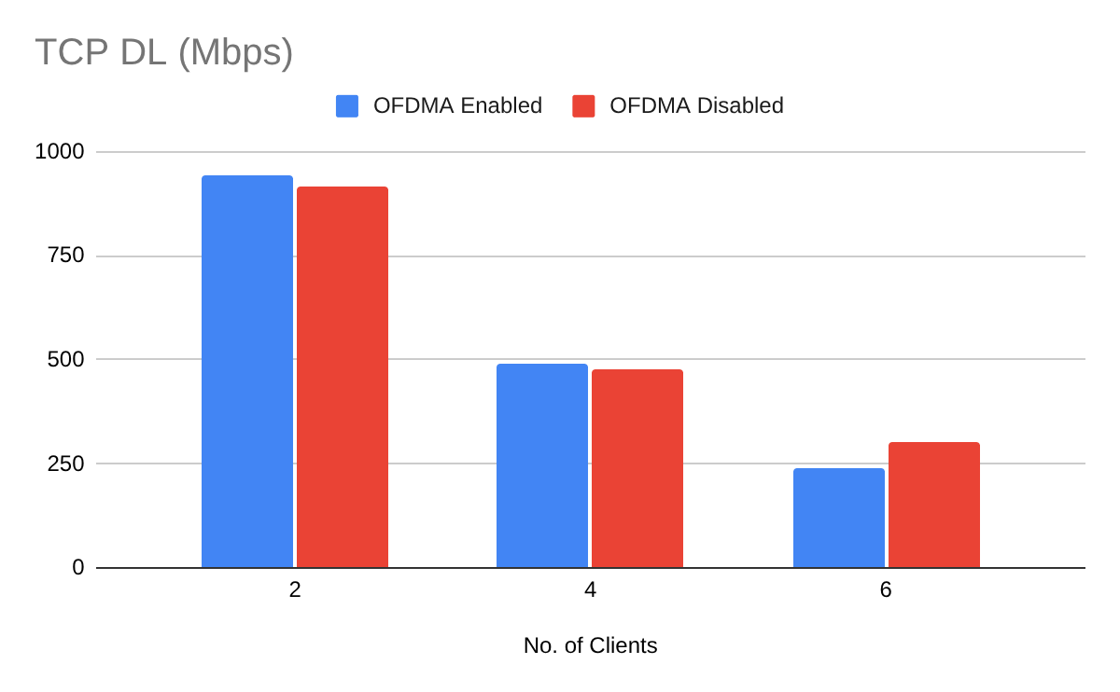
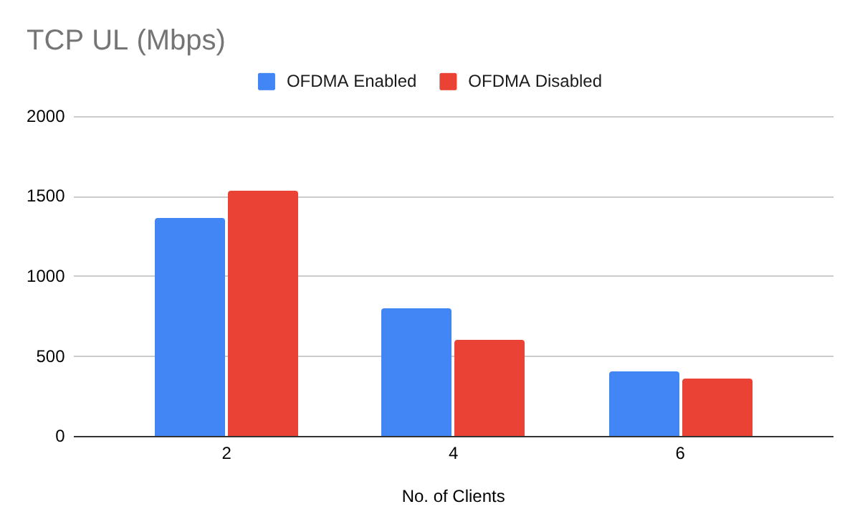
OFDMA Throughput Tests TCP
The tests show marginal or no improvement in both directions

Slide 19
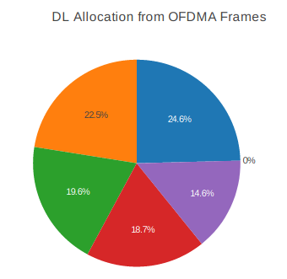
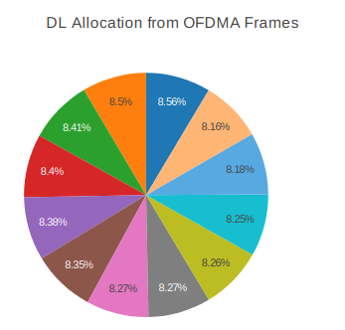
SIP Call Results Wi-Fi 6 (Wi-Fi KS 2022)
Test
  6+6 SIP calls
  12+12 SIP calls
 | Latency (ms) | Jitter (ms) | Loss (%)
OFDMA OFF | 22.98 | 17.49 | 0.04
OFDMA ON | 12.62 | 7.99 | 0
MU Frames 83%
 | Latency (ms) | Jitter (ms) | Loss (%)
OFDMA OFF | 85.93 | 33.64 | 1.48
OFDMA ON | 29.28 | 19.68 | 0
MU Frames 93%

Slide 20
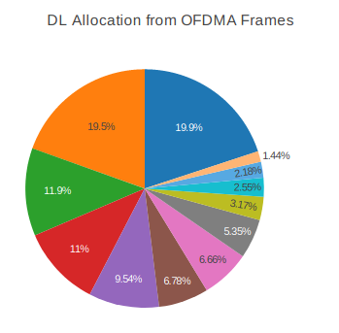
DL Throughput Results Wi-Fi 6 (Wi-Fi KS 2022)
Test done with iperf3 and a ping running in parallel for 12 clients
 | Aggregate Throughput (Mbps) | Latency (ms) | Loss (%)
OFDMA OFF | 507 | 104.87 | 2.69
OFDMA ON | 423 | 79.53 | 3.1
MU Frames 11%

Slide 21
MU MIMO Tests
UDP
TCP

Slide 22
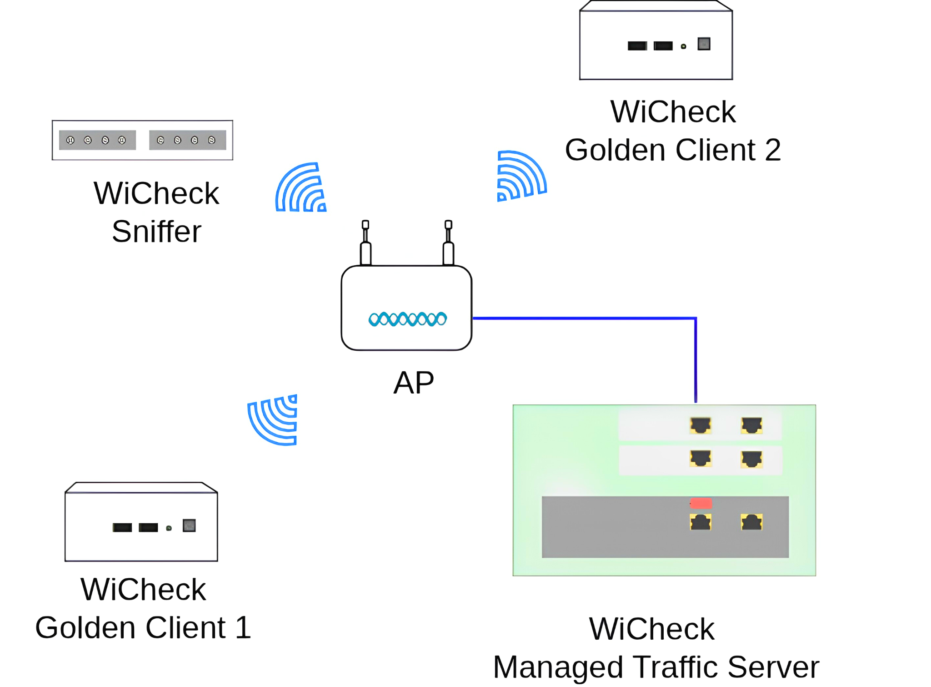
MU MIMO Test Setup
Large RF Isolated Setup
2 MU MIMO clients
Traffic: iperf TCP DL

Slide 23
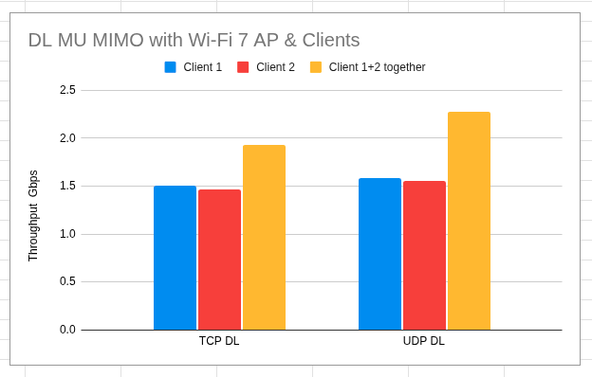
DL MU-MIMO with Wi-Fi 7
 | Efficiency
TCP DL | 30%
UDP DL | 46%
Observations
Tests were done with multiple positions of clients in the RF Tent.
Best Efficiency position is selected
In most other positions, very little improvement is observed
Setup is susceptible to Wi-Fi interference
Notes:
Efficiency = ((Client 1+2) /((Client 1+Client 2)/2) (percentage)

Slide 24
Summary
MLO
  MLMR STR ✅
  EMLSR ✅
OFDMA
  VoIP ❌
  Throughput ❌
MU-MIMO ❓
Lot of scope for more tests to do, More data to be collected for Course Correction

Slide 25
Questions

