Slide 1
Wi-Fi 6E – Practical considerations with Migration strategy
Asvin
asvin@arista.com
Wi-Fi Solution test, Arista Networks, Inc

Slide 2
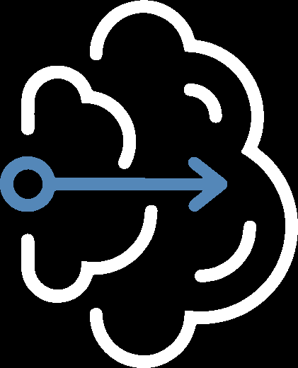
Is upgrading from 5 GHz as simple as replacing the existing deployment with a Wi-Fi 6E AP?
Wi-Fi 6E
Wi-Fi 4/5/6
Let’s find out! We got data & few nuances to share which shall help your upgrade seamless!

Slide 3
Recap of Wi-Fi KS 2022
Tri-band AP is the way forward!
Dual operation mode –
Practical consideration – Device ecosystem, Challenge to Wi-Fi 6E adoption
- 6E started appearing in high end device
- 2.4GHz not going away anytime soon.
- Dual band clients will be majority for year or two!
Propagation differences between 5GHz vs 6GHz
- 5GHz propagates better in free space (~7 to 9dB)
- For obstacles, 6GHz losses are in general higher than 5GHz
- Channel width must be taken into account – 6GHz channels should be 80/160MHz wide

Slide 4
Recap of Wi-Fi KS 2022
Tri-band AP is the way forward!
Dual operation mode –
Lower
Upper
2.4 + 5 + 6 GHz
2.4 + 5 + 5 GHz
OR

Slide 5
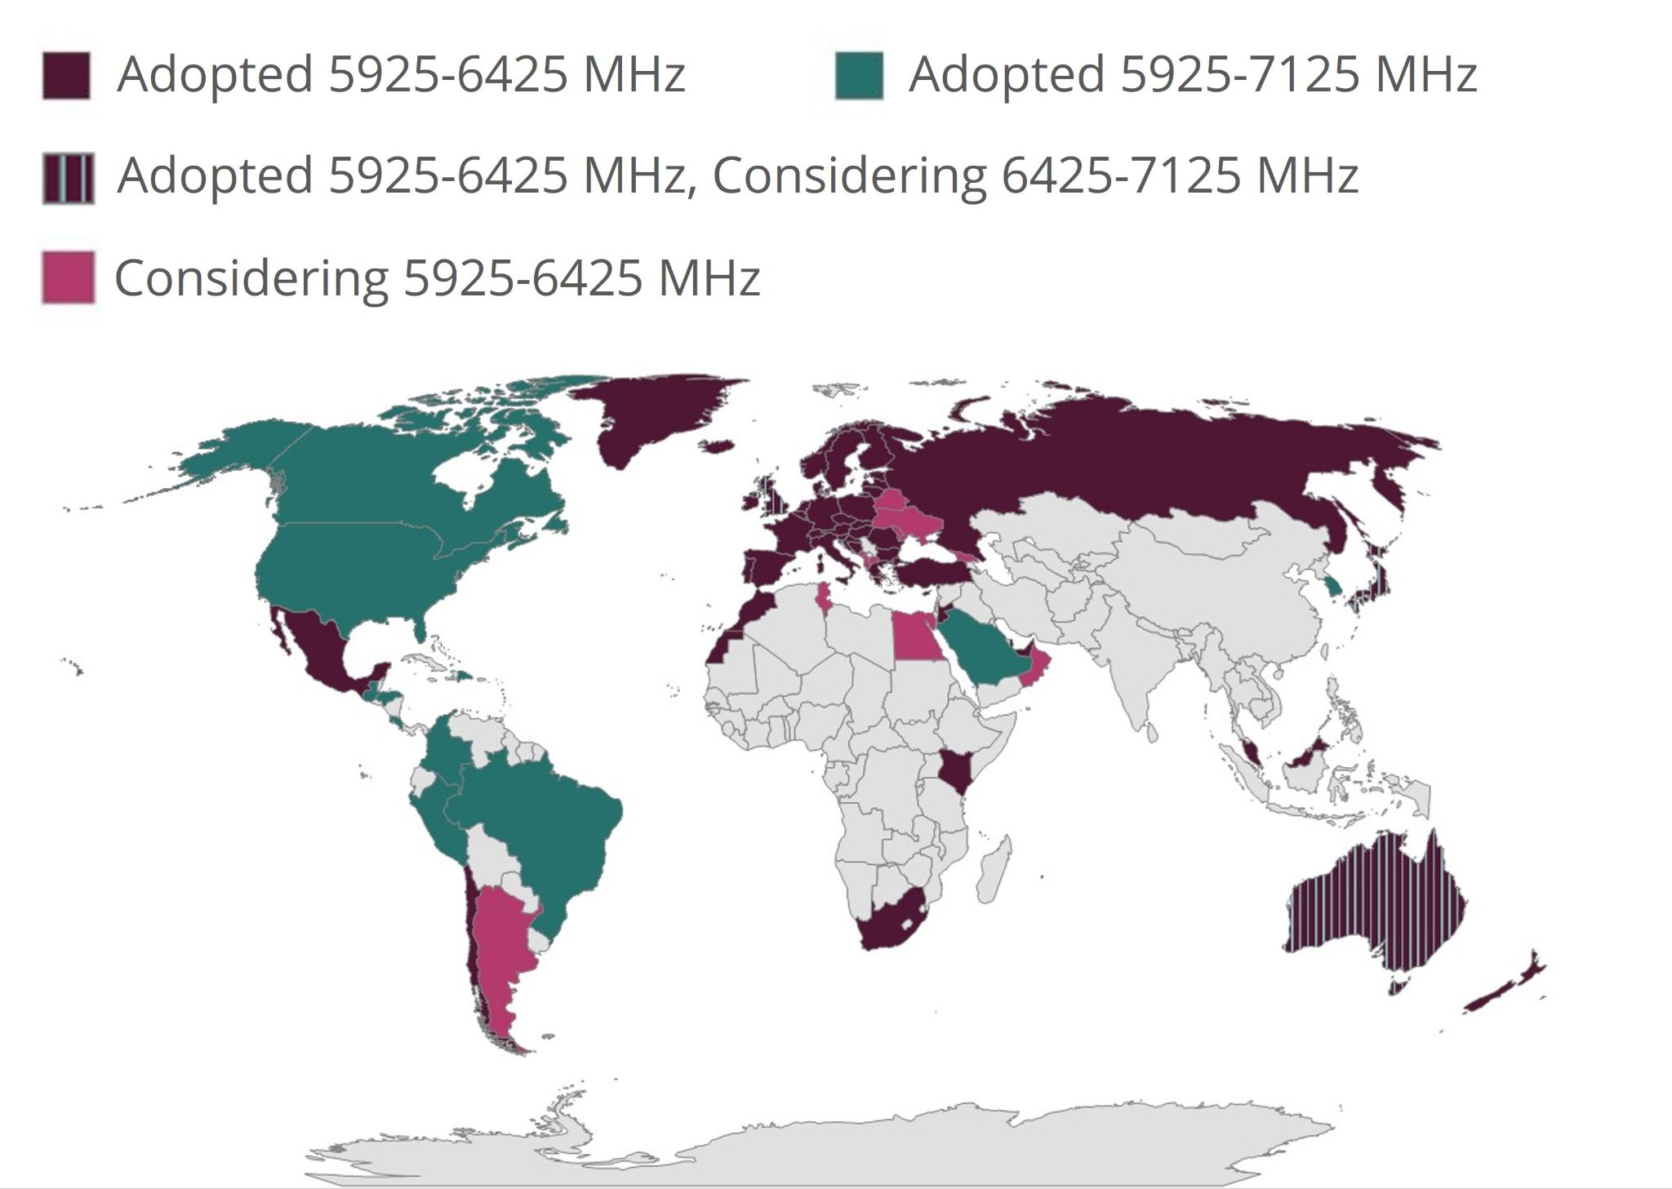
Recap of Wi-Fi KS 2022
Practical consideration – Device ecosystem
Countries Enabling Wi-Fi 6 GHz (Wi-Fi 6E)

Slide 6
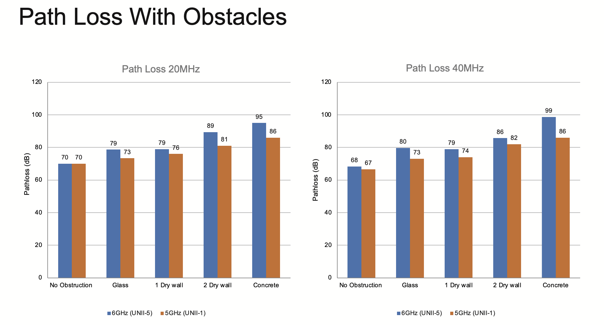
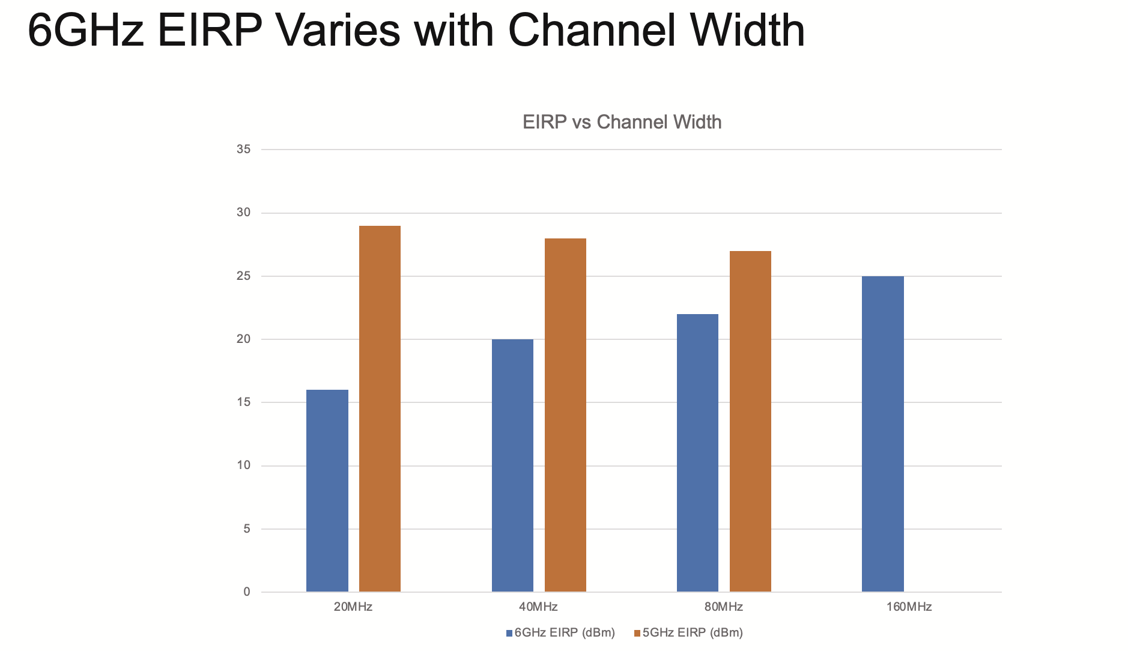
Recap of Wi-Fi KS 2022
Propagation differences between 5 GHz vs 6 GHz
- In summary, 5 GHz propagates better in free space
- In case obstacles, 6 GHz losses are in general higher than 5 GHz

Slide 7
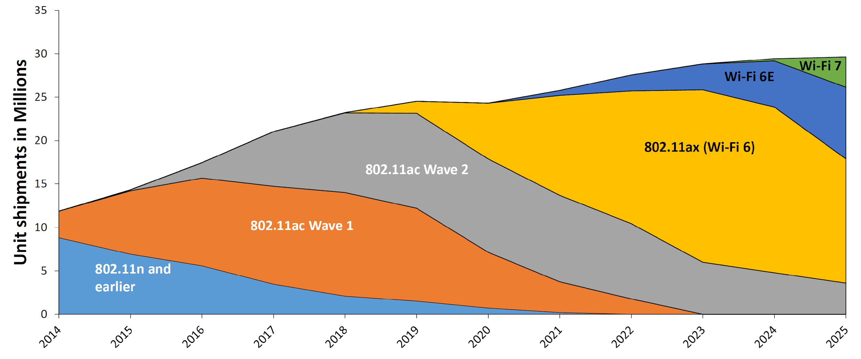
Practical Considerations – Device Ecosystem
State of the device ecosystem
Wi-Fi 6E has started appearing in high end devices
Wi-Fi 6E Enterprise APs are just about starting to be deployed
2.4 GHz devices are not going away
Especially in headless devices – printers, barcode scanners, application specific handheld devices, etc.
Will continue to be around for extended period of time
Dual Band (2.4 & 5 GHz) devices will be a majority for another year or two

Slide 8
Practical Considerations – Device Ecosystem
What is required from the APs?
Deployments need to continue tri-band (2.4, 5 and 6 GHz) operations for the foreseeable future
Triband APs will be more expensive and require more power to operate
Need to allow these AP’s to be powered up with 802.3at power source as well.
Band steering becomes even more important
Out-of-band AP discovery

Slide 9
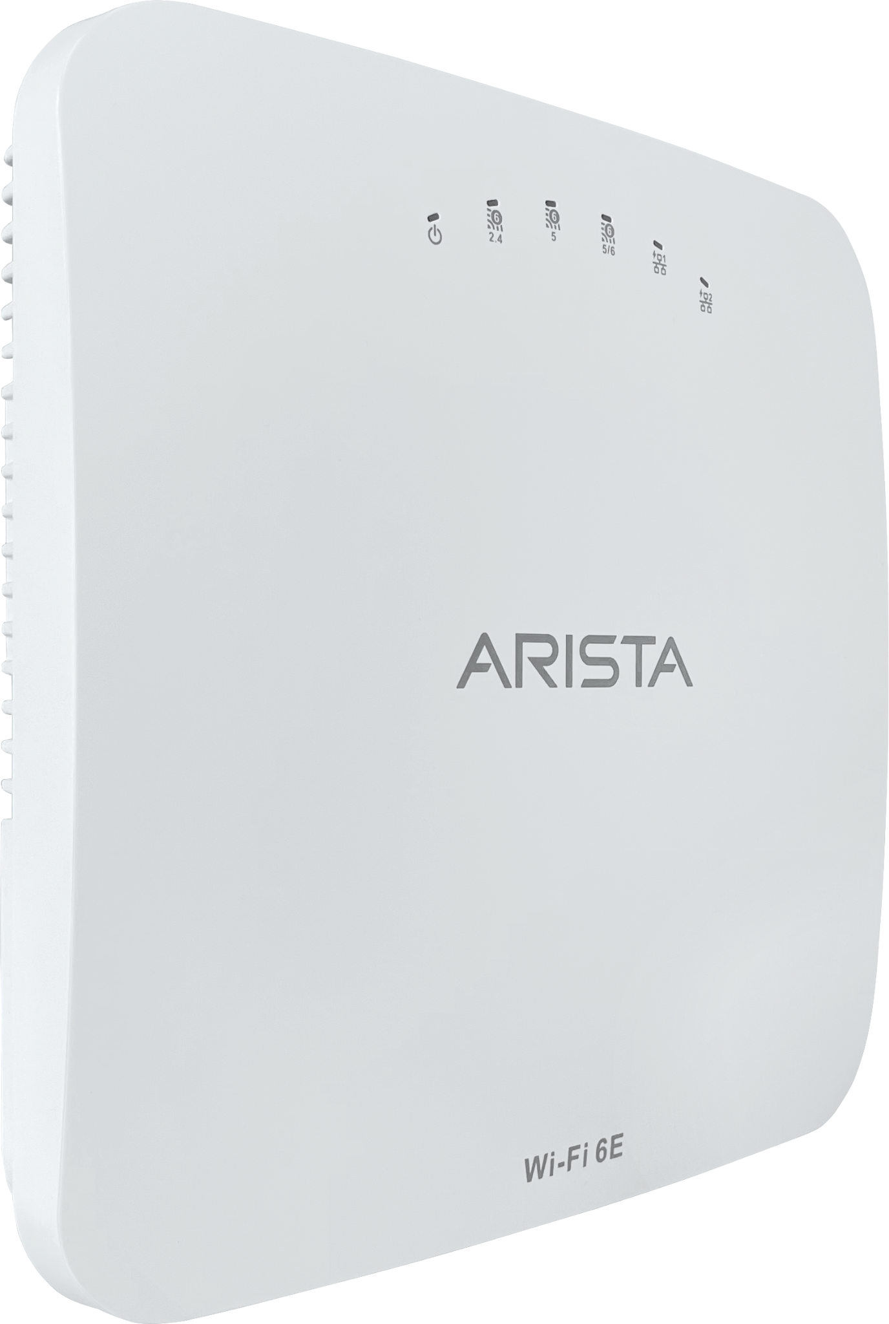
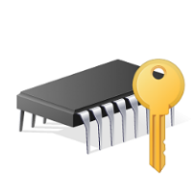
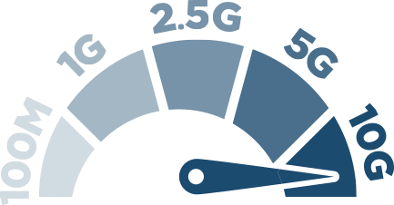
The flagship Wi-Fi 6E AP Hardware
Wi-Fi 6E
Multi-function Radio
Three 4x4:4 Wi-Fi 6E Access radios
Top of the line QCA SoC (Hawkeye 2)
USB 3.0
Dual Operations Modes
TPM Chip
Dual 10GbE backhaul
+
IoT Radio
MACsec capable
Dual PoE

Slide 10
Moving on to Migration Strategy!
SSID strategy
TxPower strategy
Client association behavior
Roaming across the 6 GHz band

Slide 11
SSID Strategy recommendation
With additional availability of 6 GHz spectrum - Creative band planning can be achieved for various Wi-Fi use cases
Enable WPA3 first observe & then adopt 6 GHz
Enable WPA3/OWE Transition mode on 6 GHz multiband SSIDs
Engage & Configure MDM for WPA3 support
Radio | Access category | Application
2.4 GHz | Best-effort | Legacy client device, IOT Wi-Fi device
5.0 GHz + 6 GHz | Critical application | Voice over WiFi calls, etc

Slide 12
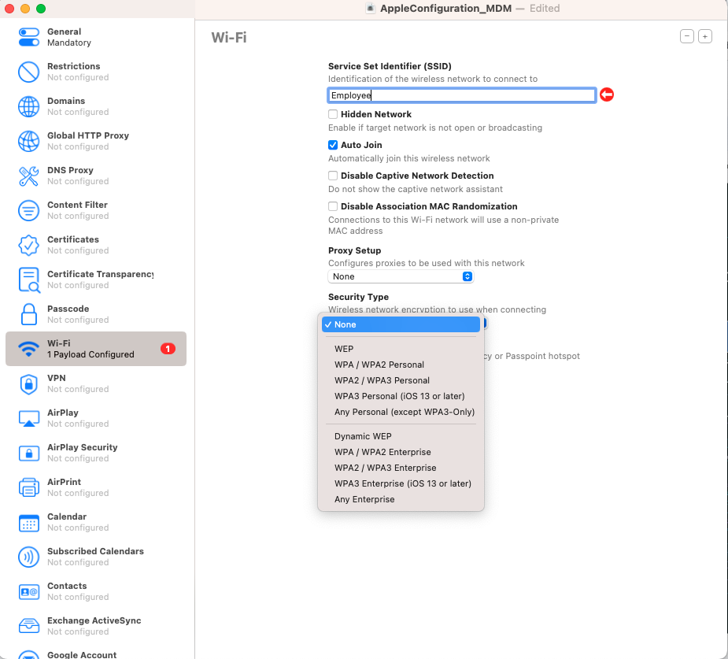
MDM Configuration

Slide 13
TX Power Strategy
Why 20/40 MHz reuse plan still dominant in 5 GHz instead of 80 MHz or higher bandwidth?

Slide 14
5 GHz: SNR degrades as the channel width increase!
BW(MHz) | RSSI (dB) | Noise Floor (dB) | Resulting SNR (dB)
20 | -65 | -90 | 25
40 | -65 | -87 | 22
80 | -65 | -84 | 19
160 | -65 | -81 | 16
Key take-away:
20/40 MHz channel reuse plan still dominant in 5 GHz instead of 80 MHz in some sites
There is simply not enough 5 GHz frequency space in 5 GHz & co-channel interference is guaranteed to occur!
Performance would drop significantly when doubling channel width

Slide 15
6 GHz: SNR remain constant as the channel width increase!
BW(MHz) | RSSI (dB) | Noise Floor (dB) | Resulting SNR (dB)
20 | -65 | -90 | 25
40 | -62 | -87 | 25
80 | -59 | -84 | 25
160 | -56 | -81 | 25

Slide 16
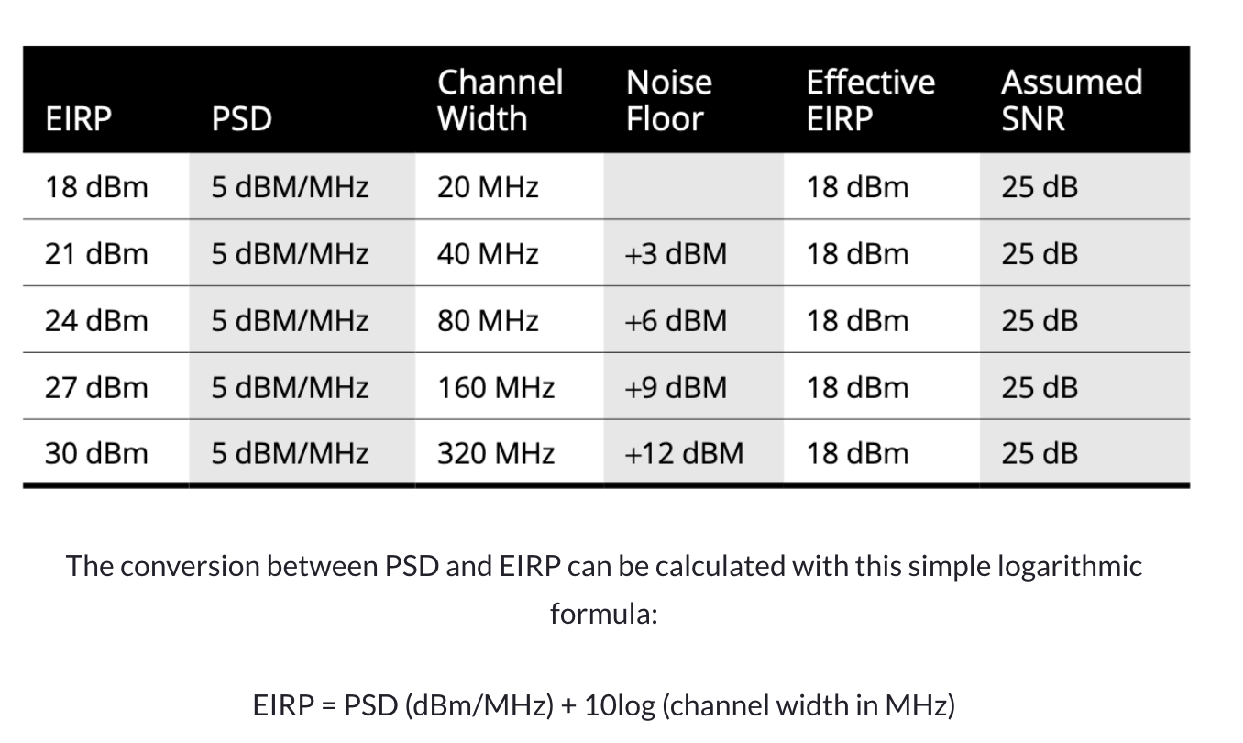
6 GHz: SNR remain constant as the channel width increase!
New transmit power rules favor the use of large bandwidth channel !!

Slide 17
TX Power Strategy
How 6 GHz compares to 5 GHz
Path Loss - 6 GHz will not go as far as 5 GHz
Cell size - Will be smaller compared to 5 GHz
Obstacles - Loss will be relatively high compared to 5 GHz
We’ll know this very well!
So, don’t operate in same power level. Increase the power level by 3 dB

Slide 18
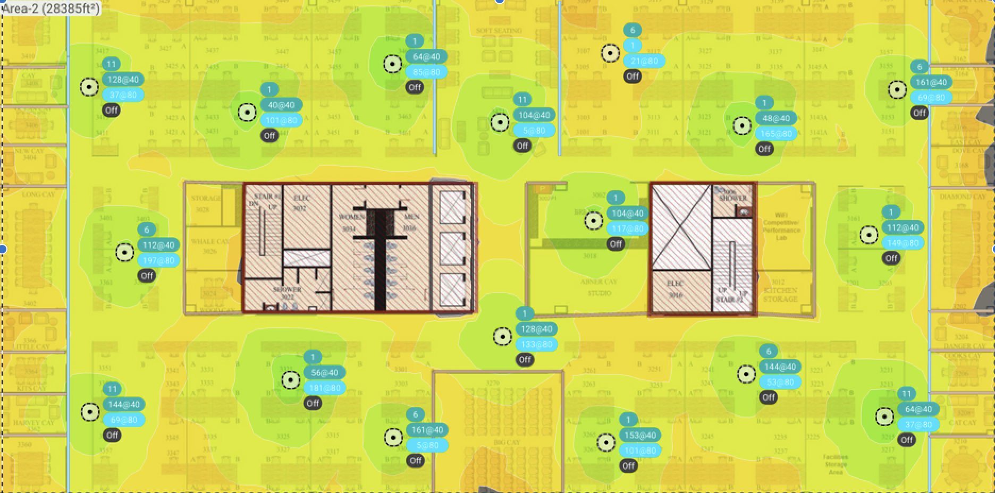
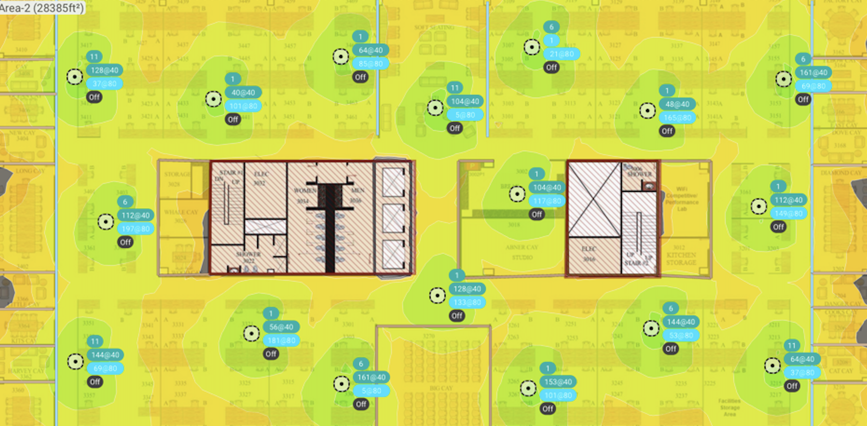
How big is 6 GHz cell be, compared to a 5 GHz cell?
←5 GHz in 40MHz with EIRP=15
Answer is pretty much the same!
6 GHz in 80MHz with EIRP =18→

Slide 19
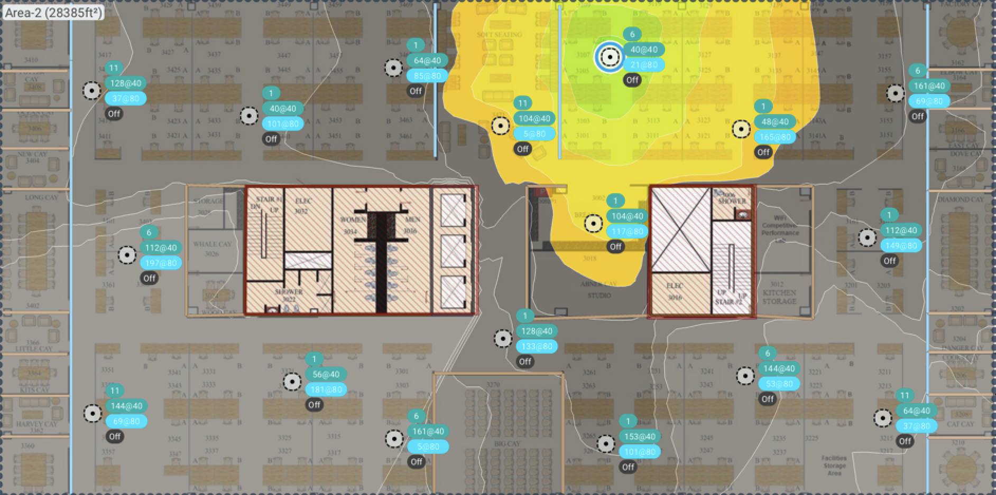
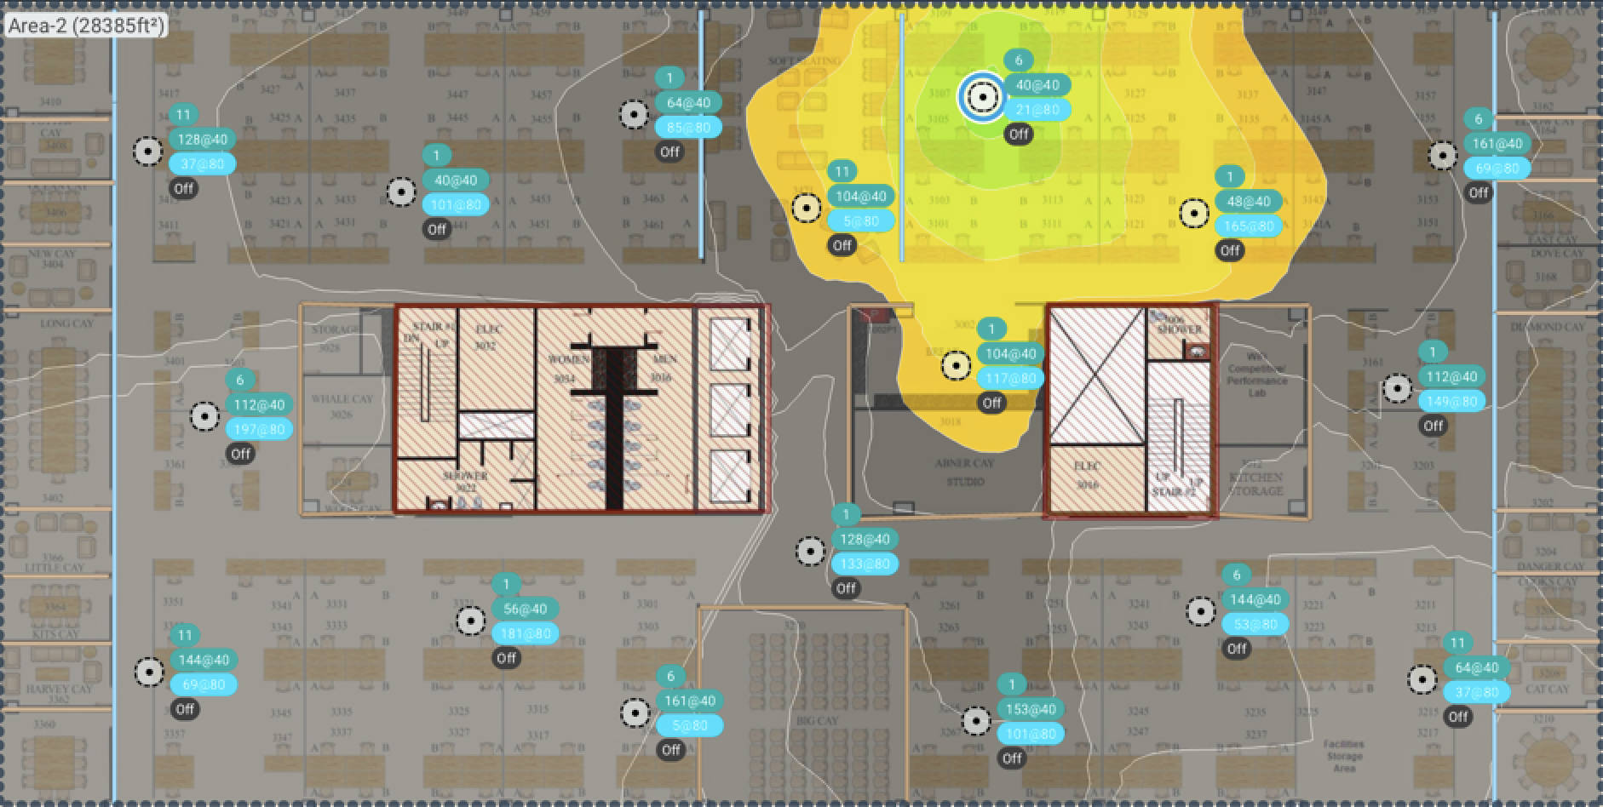
5 GHz (40 MHz) vs 6 GHz (80 MHz) coverage
←5 GHz in 40 MHz
6 GHz in 80 MHz →

Slide 20
6 GHz design recommendation
If you already have capacity based 5 GHz design plan
- Rip & replace with Wi-Fi 6E would just do!
In case of new deployment, proper RF design for 6 GHz can be considered

Slide 21
Wi-Fi 6E client behavior!

Slide 22
Wi-Fi 6E Client behavior
Major client vendors start supporting Wi-Fi 6E but AP discovery mechanism are bit different.
Client Model | OS | IN-BAND discovery | Out-Of--BAND discovery | Comment
iPad Pro | IOS | Not Supported | Support only out-of-band discovery | iPad require 2.4 or 5.0 GHz band to discovery 6 Ghz channel
Samsung S22 | Android | Supported | Supported
Google pixel 7 | Android | Supported | Supported
Intel 11ax 210 | Windows | Supported | Supported
Apple Macbook Pro M2 | MacOS | Not supported | Supported | Apple M2 Pro require 2.4 or 5.0 GHz band to discovery 6 GHz channel

Slide 23
Roaming and Client discovery Strategy
For better roaming, account for 6 GHz losses and plan for 3 dB or more higher power
Enable PSC channel as 6 GHz client usually probe on these channels.
Avoid 6 GHz only SSID – Apple device fail to connect using IN-BAND discovery method
Have either 5GHz or 2.4 GHz SSID when deploying 6 GHz. Client use OUT-OF-BAND discovery method using RNR IE to discovery 6 GHz band
Make use of large set of non-overlapping 6 GHz band channel. Configure 80 MHz by default.

Slide 24
Apple iPad Pro behaviour
Understand bit more on 6 GHz probe pattern
iPad ignore FILS sent by the AP on its primary 6 GHz channel
It also ignores unsolicited probe responses sent by the AP on its primary 6GHz channel if we enable them explicitly.
iPad doesn't actively scan 6 GHz to discovery new SSIDs
It requires SSID on either 2.4 GHz or 5.0 GHz band
Type of Probe Request |  |  | Condition to Send Probe Request | Purpose
Destination Address | BSSID | SSID
Broadcast | Wildcard | Wildcard | Not Allowed | Ban indiscriminate probe responses from all BSSs from all ESSs
Broadcast | Wildcard | SSID | Not more than 1 per 20 ms. | Probe ESS but with reduced frequency
Broadcast | Wildcard |  | Not more than 3 per 20 ms. | Probe specific BSS with reduced frequency

Slide 25
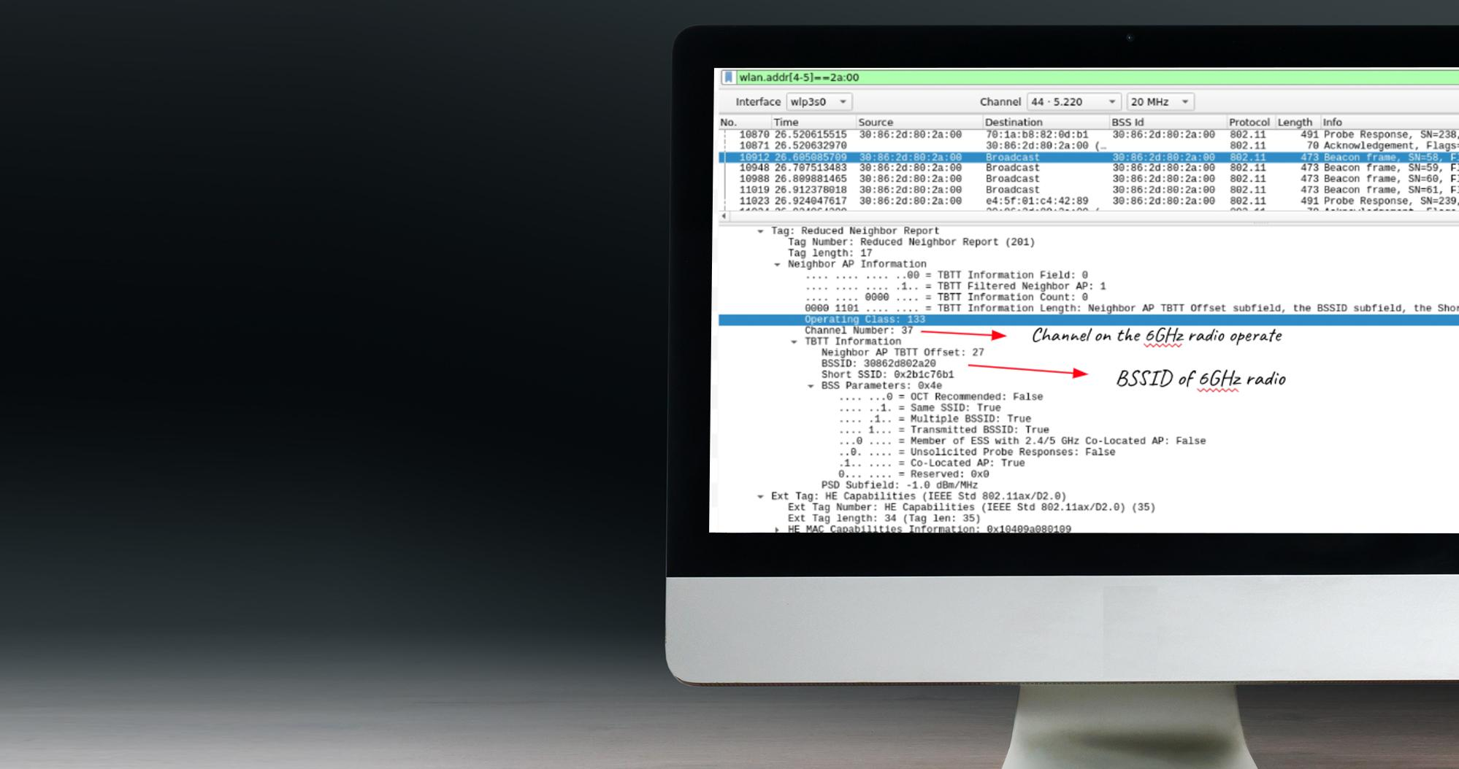
Low Power Indoor(LPI) -
Apple iPad Pro Behaviour
In field deployment when supporting Apple devices. Ensure to enable 5 GHz or 2.4 GHz SSID which will allow the iPad to use RNR IE included in 2.⅘ GHz beacons indicating about 6 GHz band info for the iPad to connect on 6 GHz band.

Slide 26
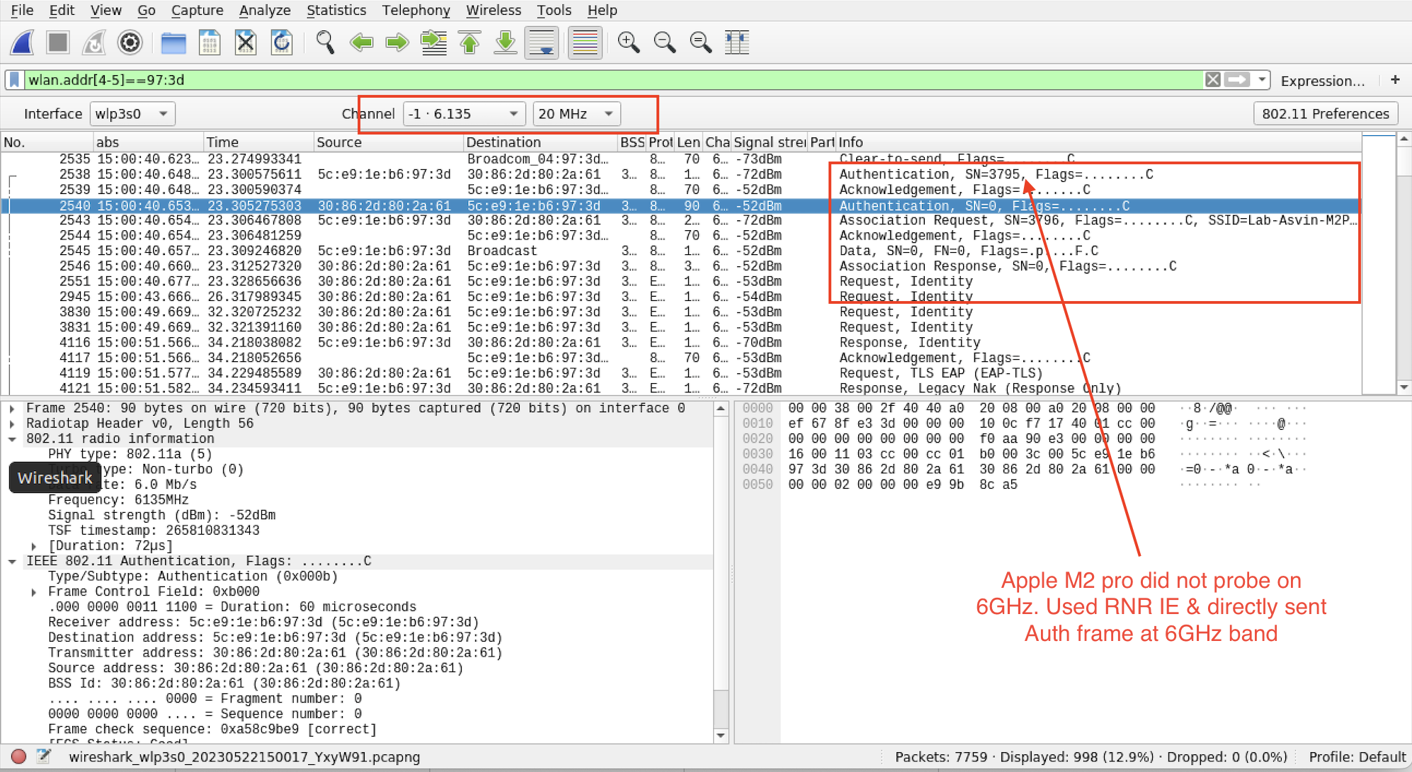
Apple M2 Pro - 6 GHz connectivity

Slide 27
WiFi 6E Client roaming behavior
Disclaimer: Roaming is client driven; Results tend to vary with different driver version!!
Clients | 6 GHz capable (Yes/No) | Initial assoc to 6 GHz AP (Yes/No) | Roam to Target AP in PSC channel
iPad Pro | YES | YES | Successfully roamed to 6 GHz
Samsung S22 | YES | YES | Successfully roamed to 6 GHz
Google pixel 7 | YES | YES | Successfully roamed to 6 GHz
Intel 11ax | YES | YES | Successfully roamed to 6 GHz
Apple Macbook Pro M2 | YES | YES | Successfully roamed to 6 GHz

Slide 28
Is upgrading from 5 GHz as simple as replacing the existing deployment with a Wi-Fi 6E AP?
Wi-Fi 6E
Wi-Fi 4/5/6
Even easier with Cognitive 6 GHz Migration recommendations!!!

Slide 29
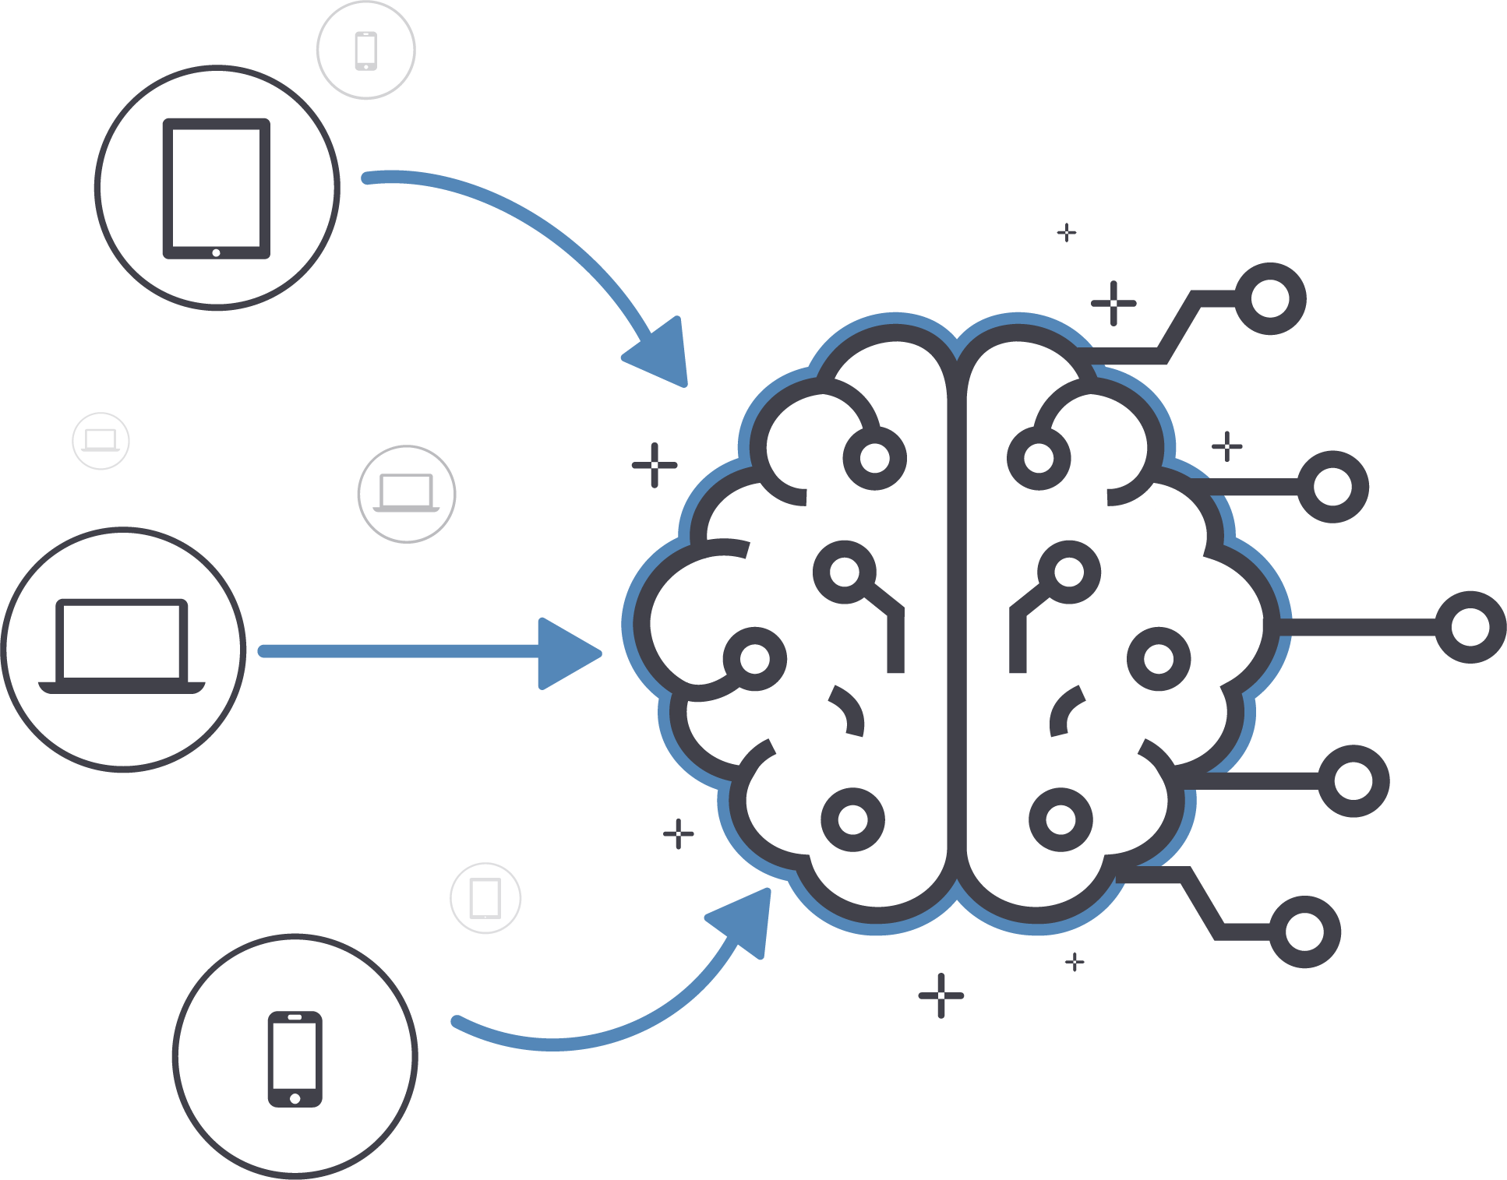
Cognitive 6 GHz location level migration recommendation
2k clients support WPA3
2.5k
iPads
800 clients which support 6GHz
1k clients support per location level
1k
laptops
2k clients support WPA3
3.4k clients provide cognitive migration strategy
5K
smartphones

Slide 30
Reference
6 GHz Deployment: A Reality check - Link
Practical considerations for deploying Wi-Fi 6E, Wes purvis- Link
Arista 6 and 6E FAQ - Link
Practical considerations for deploying Wi-Fi 6E, Jatin - Link
Get ready for 6 GHz, David coleman - Link

Slide 31
Questions!

