Slide 1
Understanding Home Wi-Fi Through Data: Lessons from Large-Scale Telemetry
WIFI-KS May 21, 2026
BENGALURU

Slide 2
Agenda
Hidden reasons behind churn
1
3 min
Operator Managed Wi-Fi Landscape
2
2 min
3
Architecture at Scale
5 min
4
Data Modelling
5 min
5
Early Warning System
7 min
6
Key Takeaways & QA
3 min

Slide 3




















Who We Are
Our Customers
With 21 years of Wi-Fi and connectivity expertise, Airties is the preferred partner of leading ISPs in connectivity experience management.
50M+
22
Households managed to
date by Airties Cloud
Years perfecting Wi-Fi
technologies
400+
80%
Employees of
18 nationalities
Employees in R&D
130+
40+
Z
Different CPE platforms
integrated
Wi-Fi related patents
HQ
Backed
in Paris/France
Board/Sales/Marketing
by Providence Private Equity Partners

Slide 4

Hidden reasons behind churn
Challenges:
Coverage gaps and poor node placement.
Wi-Fi performance is dominated by contention, interference, and bufferbloat rather than peak speed.
Solution:
AI correlates Wi-Fi Experience to NPS score
Device and application-level insight and autonomous resolution.
Add Mesh to remove dead zones and interference.
~50% of customers leave due to poor experience.
Majority of churners don’t switch for price.
54-60% pay the same or more after switching.
$189 B lost to churn.
~$1050 cost to replace lost customer.
Outcome:
Reduced churn rate.
ARPU uplift.
Source:
https://insights.airties.com/26q1-churn-report-d78b6f0f-4690-4451-b090-08c87d35ca19
Notes:
Airties recent whitepaper on why churn occurs along with sample churn impact

Slide 5
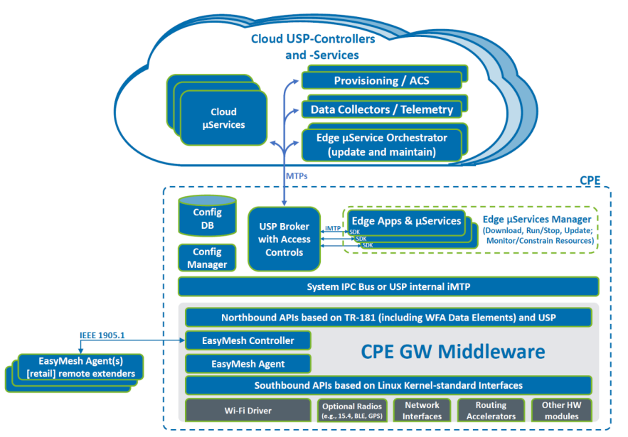
Operator Managed Wi-Fi Landscape
Users typically associate Wi-Fi service with Broadband internet, therefore WI-FI as a service needs to be managed by Operators.
Multiple open and closed source architecture to manage exist that solve the same problem in diverse ways.
WBA’s OMWi reference architecture defines common standards-based building blocks while still providing room for value-added proprietary components implemented as edge or in the cloud.
Fig 1: Architecture from “Operator Managed Wi-Fi: Reference Architecture and Requirements Specifications & guidelines, WBA white papers, White papers; December 2024”
Notes:
Architecture of operator manged wifi

Slide 6
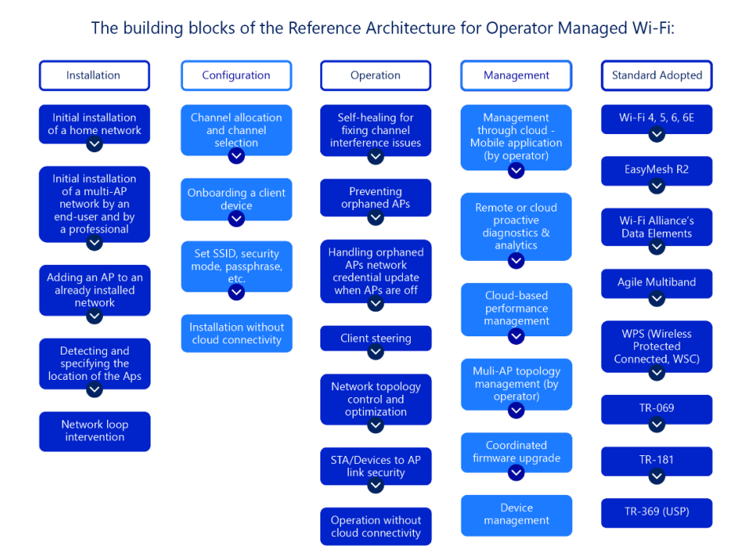
Operator Managed
Wi-Fi Landscape
Fig 2: Building blocks from “Operator Managed Wi-Fi: Reference Architecture and Requirements Specifications & guidelines, WBA white papers, White papers; December 2024”

Slide 7
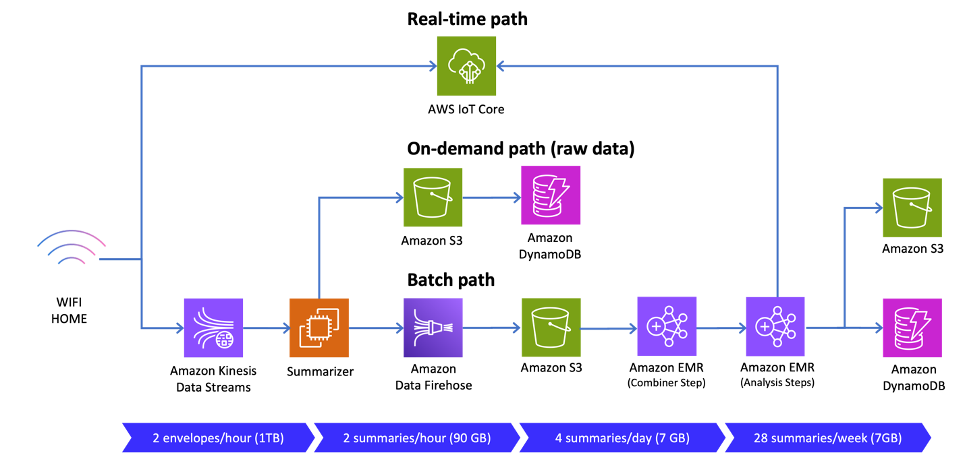
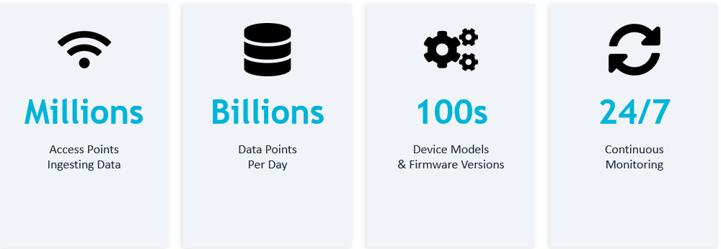
Architecture at scale
Source : AWS and Airties blog
https://aws.amazon.com/blogs/big-data/how-airties-achieved-scalability-and-cost-efficiency-by-moving-from-kafka-to-amazon-kinesis-data-streams/

Slide 8
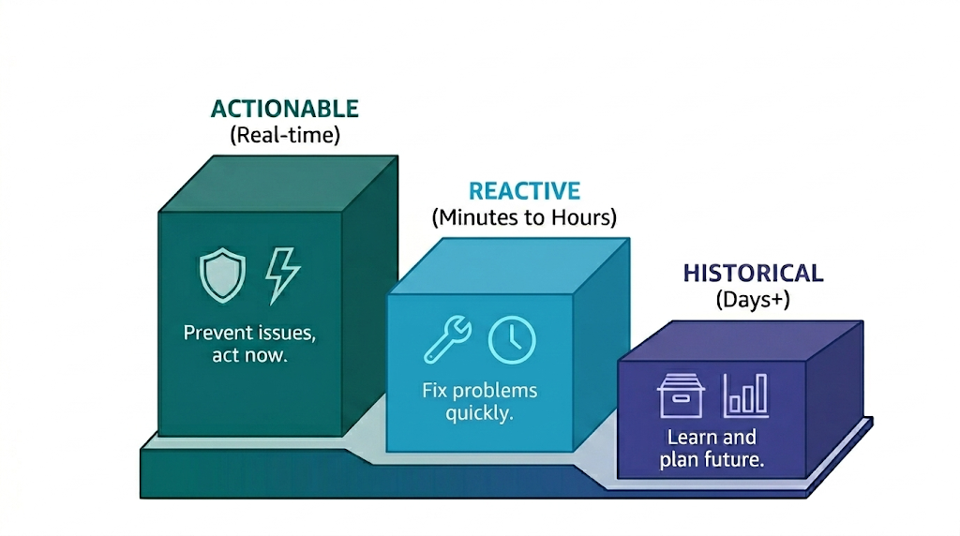
Data modelling
1) Insight value decays rapidly with time
The economic value of data is highest at the moment of creation and drops sharply as latency increases. Delayed analysis converts actionable signals into historical artifacts, limiting impact to reporting rather than intervention.
2) Historical data has diminishing actionability but retained strategic value
Forrester frames long-term stored data as low immediate value for intervention, but still useful for trend analysis, benchmarking, and planning. It supports decisions that are not time-sensitive.
3) Pick the right data model for your use case
E.g, Inmon Data Warehouse Model, Data Vault Modeling, 3NF Normalized Modeling, Anchor Modeling, Wide Table / Denormalized Modeling, Star Schema, Snowflake Schema, Graph Data Modeling, Document Data Modeling
“Source: Forrester Research (Mike Gualtieri) – Perishable Insights / Real-time Analytics”

Slide 9
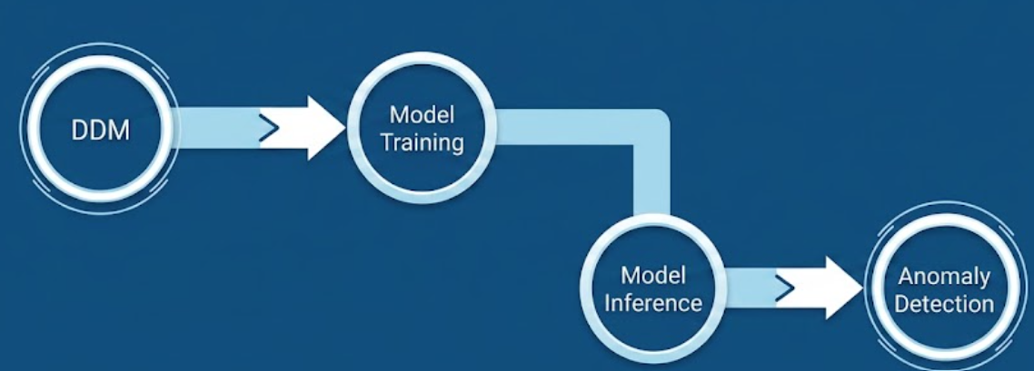
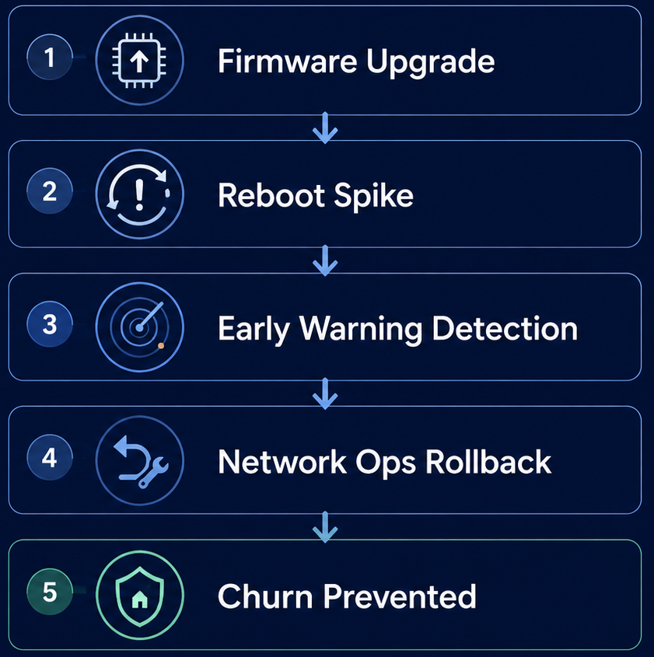
Early warning system
1) What are we monitoring?
Monitoring happens at a Population, Device Model and a Device firmware level.
We detect:
Sudden changes in Metrics (spikes, drops)
Seasonality deviations
Degradation of metrics
2) Results?
Speed of Detection : Hours not weeks to determine firmware regression across millions of devices
Identify root cause: Which device model + firmware are experiencing problems
Quantify: How many homes are affected and prioritize remediation.

Slide 10
Early warning system
Previous Approach ❌ | Current Approach ✅
Approach: LSTM+CNN. | Approach: Transformers.
Metric Handling: One model per metric; no cross-metric learning. | Metric Handling: Single transformer across metrics within a cohort; enables cross-metric learning and better fault detection.
Customizability: Cannot infer for a new tenant without retraining. | Customizability: Transformers enable us to detect on unseen cohorts.
Scalability: Poor. Requires 1 model per metric per cohort. | Scalability: High. One transformer can cover 100+ device models and 100+ firmware versions.
What did not work vs what is working

Slide 11
key Takeaways
1
Managed Wi-Fi service
Reduces churn
Wi-Fi, if managed and analyzed well, improves QoE and reduces churn.
2
Structure your data early
Dimensional data modelling is the foundation. Without it, analytics and ML are fighting upstream.
3
Unified models beat per-metric models
Cross-metric, cross-cohort models are more scalable, more accurate, and easier to maintain.
4
Early warning = proactive operations
Anomaly detection transforms operator support from reactive firefighting to proactive quality management.

Slide 12
Thank you!

Slide 13
BACKUP
Notes:
Architecture of operator manged wifi

Slide 14
BACKUP
Latest specifications
USP → v1.3 (March 2025)
TR-181 (Device Data Model) → Issue 2 Amendment 20 (December 2025)
Wi-Fi Data Elements → Release 2.1
EasyMesh → Release 4 (referenced in OMWi spec), with Release 6 recommended for Wi-Fi 7
Notes:
Architecture of operator manged wifi

Slide 15
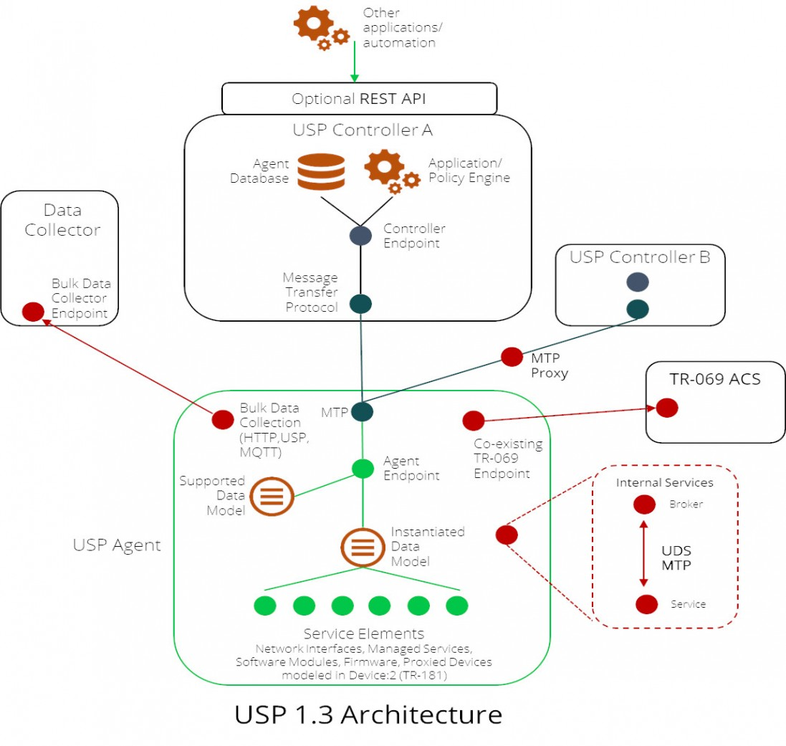
BACKUP
Notes:
Architecture of operator manged wifi

