Slide 1
Wi-Fi IoT: features and performance of 802.11ah
Wi-Fi (HaLow) in Sub GHz
Presented at Wi-Fi Knowledge Summit, Bangalore, May 2023.

Slide 2
Agenda
01
Introduction to IEEE 802.11 ah (Wi-Fi HaLow)
02
Requirements of Wireless IoT
03
Features of 802.11ah
04
Regulatory requirements and field tests

Slide 3
About Morse Micro
Morse Micro team
Wi-Fi HaLow market leader
World-class team of 160+ Wi-Fi chip experts
Over AU$200m in funding
Wi-Fi HaLow silicon
Smallest, fastest & lowest power Wi-Fi HaLow chip in the world
FCC certified, Wi-Fi Certified HaLow™ modules
Mass production
Official Wi-Fi HaLow
testbed vendor

Slide 4
Introduction to IEEE 802.11ah
01
Wi-Fi in Sub-1 GHz

Slide 5
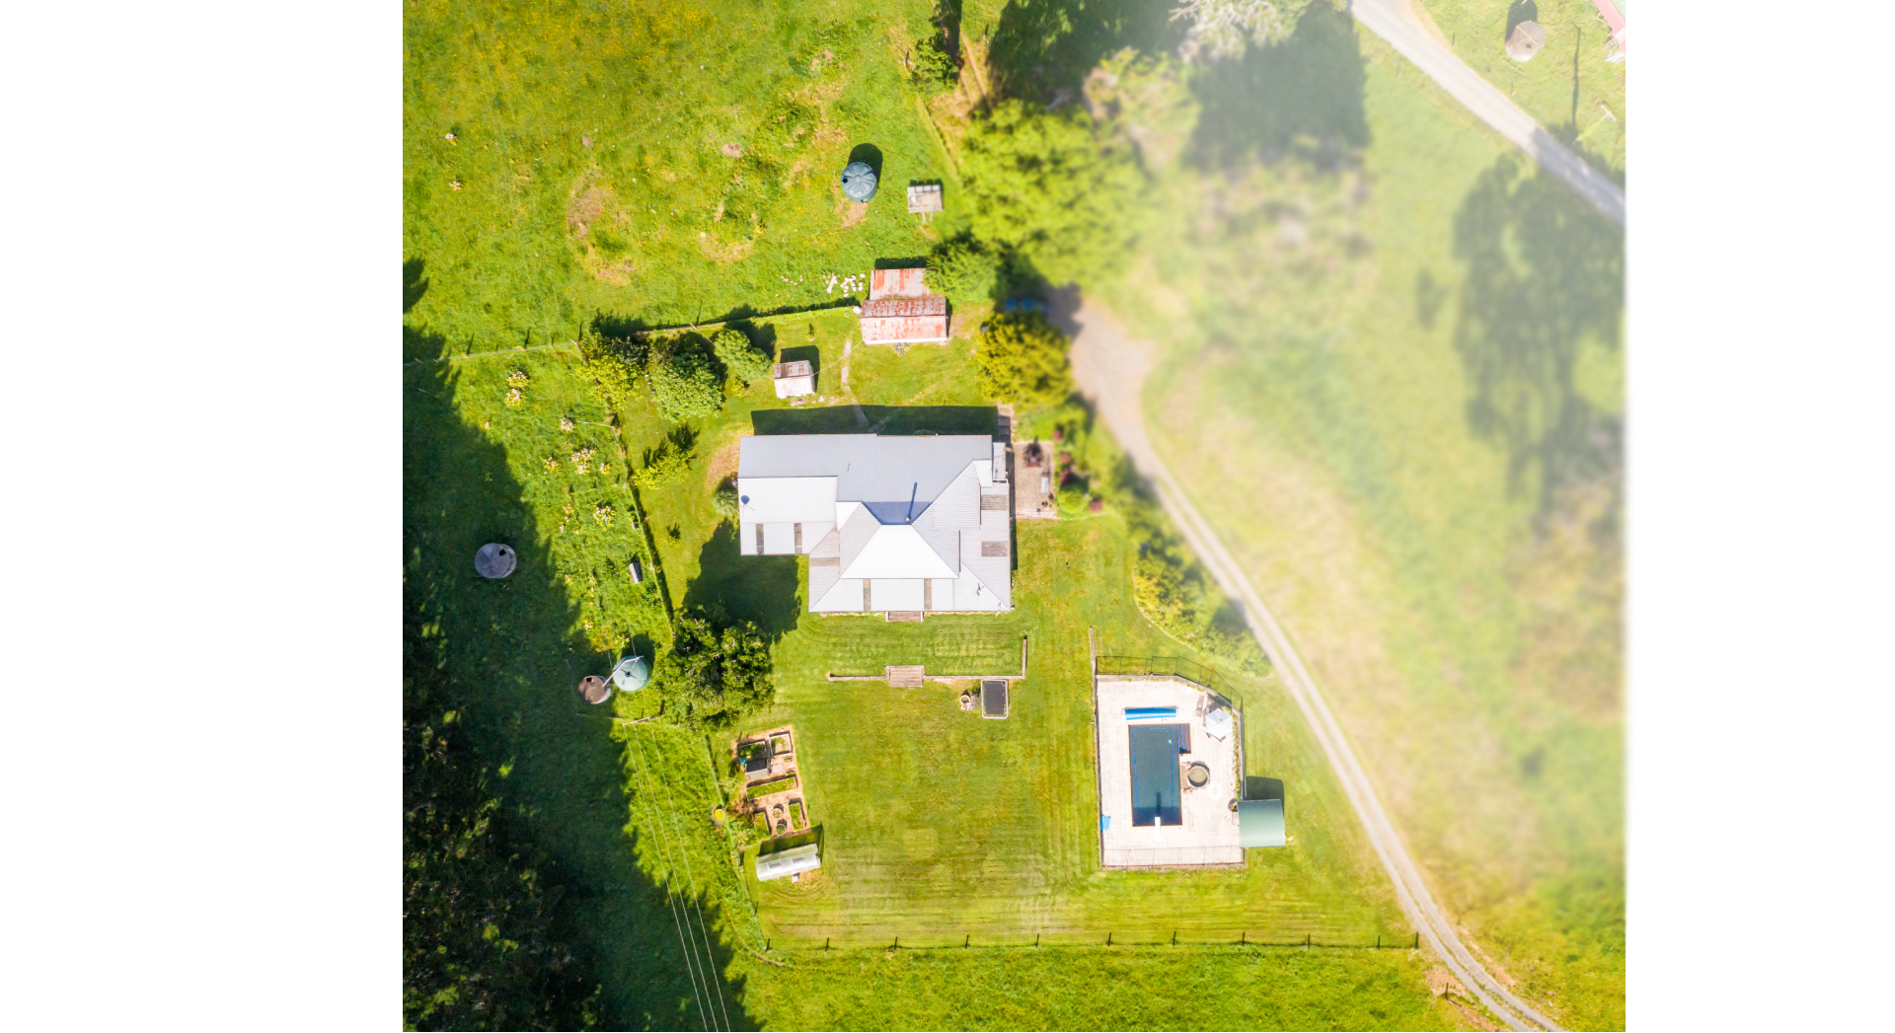
Today, IoT devices and mesh APs can only reach as far as the 2.4GHz Wi-Fi network permits.
‹#›

Slide 6
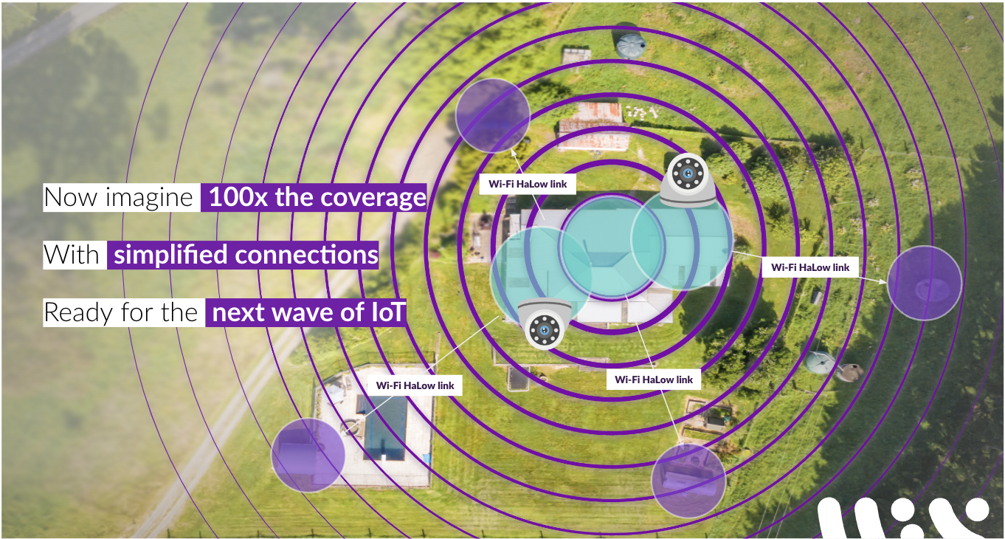

Slide 7
Wireless IoT Technology Comparison
INTRODUCTION TO IEEE 802.11AH
Criteria | Wi-Fi.11ah | Wi-Fi .11n | LoRa | Sigfox | NB-IOT | BLE / BT5 | Z-Wave | ZigBee
Energy Efficiency | High | High | Low | Low | Low | High | Med | Med
Idle Power Consumption | Low | High | Low | Low | Low | Low | Low | Low
Data Rate | 150 Kbps - 86.7 Mbps | 6.5 Mbps - 600 Mbps | 100 bps- 50 Kbps | 100 bps - 600 bps | 20 Kbps - 25 Kbps | 125 kbps - 2 Mbps | 100 Kbps | 250 Kbps
Range | 1 km | 100 m | 10 km | 10 km | 10 km | <100 m | 30 m | 20 m
Material Penetration | Best | Poor | Best | Best | Good | Poor | Good | Poor
Security | Best | Best | Poor | Poor | Good | Good | Good | Good
Network Capacity | Best | Best | Poor | Worst | Poor | Good | Good | Poor
Interoperability | IEEE Std | IEEE Std | Proprietary | Proprietary | 3GPP | Bluetooth | Proprietary | IEEE Std
Native IP support | Yes | Yes | None | None | Yes limited | None | None | None

Slide 8
IoT technology comparison
INTRODUCTION TO IEEE 802.11AH
Key
Wi-Fi HaLow (802.11ah)
Bluetooth
802.15.4 (zigbee)
Sigfox
LoRa
Wi-Fi (802.11n)
100,000
10,000
1,000
>10x farther than Wi-Fi
> 1000x faster than LoRa
100
Data rate (Kbps)
10
1
0.1
10m
100m
Range
1km
10km

Slide 9
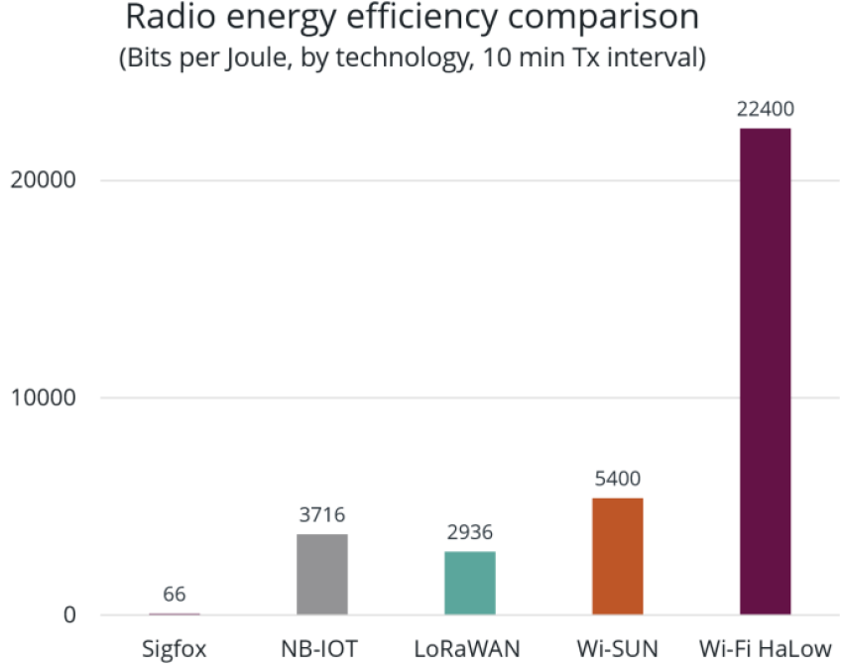
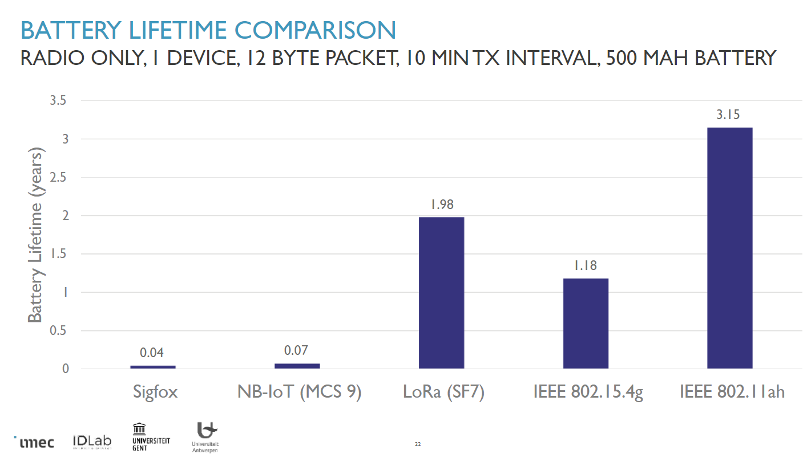
IoT technology comparison: energy efficiency
INTRODUCTION TO IEEE 802.11AH
Wi-Fi HaLow demonstrates at least four times (4x) more energy- efficiency than several other well-known IoT technology options Source: Wi-Fi Alliance: Wi-Fi HaLow Technology Overview
Wi-Fi HaLow Battery lifetime comparison with several well-known IoT technology options
Source: A study by IMEC Research Group: The Long Life of IoT Devices

Slide 10
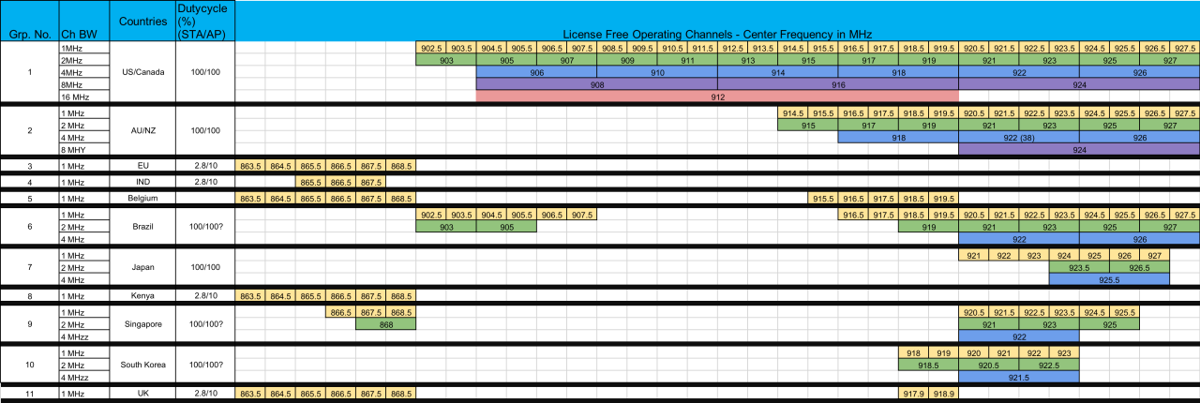
Sub-1 GHz WW Spectrum Availability
INTRODUCTION TO IEEE 802.11AH

Slide 11
The Wi-Fi HaLow advantage
INTRODUCTION TO IEEE 802.11AH
Ultra-low power, long range, secure connections at a higher capacity.
Sub-1 GHz spectrum operation
Long range opportunities: over 1km
Narrow band OFDM channels
Increased usability: Better penetration through walls and other obstacles w/higher data throughput than other wireless IoT devices
Native network TCP/IP stack
Fast to market: Simplifies connections for multiple cloud IoT ecosystems and Matter
Wi-Fi WPA3 security
Peace of mind: leverage market proven WPA3 security protocol to ensure wireless link is secured

Slide 12
Requirements of Wi-Fi IoT
02
From the user’s perspective

Slide 13
Wi-Fi IoT Requirements
WI-FI IOT REQUIREMENTS
Support high density of STA per AP so that more sensors can be deployed per sqm
MAC Protocol control the contention and collision window to support high density
Collisions will be common in high density networks. It brings down the overall goodput
Should minimize the protocol overhead when large number of sensors are present
Support devices of all power classes and BW classes
MAC should support high efficiency i.e., minimum overhead over the PPDU
MAC should minimize the interference when there is overlap between two APs
Adapt to the changes in the environment and IoT network
Manage the mission critical application traffic

Slide 14
Comparison of Wireless IoT Standards
WI-FI IOT REQUIREMENTS
Narrowband IoT standards and their features
Ref: N. Ahmed, et al, “MAC Protocols for IEEE 802.11ah-based Internet of Things: A Survey ”,IEEE Internet of Things Journal, Aug. 2021

Slide 15
Features of 802.11ah
03
Wi-Fi HaLow across applications

Slide 16
IEEE 802.11ah Standard Highlights
IEEE 802.11AH FEATURES
IEEE 802.11 Wi-Fi Standard operating in Sub 1 GHz channels
ISM band channels available world-wide at various bandwidths and carrier between 850 MHz and 950 MHz
Standard supports 1 MHz/ 2 MHz/ 4 MHz/ 8 MHz and 16 MHz bandwidths
Data rate scales accordingly from 150 Kbps to 347 Mbps
Same MCS set as legacy: 0 to 7 and additional 8,9 (256 QAM) and 10 (extended range MCS0 mode)
10x downclock version of IEEE 802.11ac
2 MHz channel of 11ah is equivalent to 20 MHz channel of 11ax
1 MHz is a special mode for low cost IoT applications with long range and 300 Kbps rate at the minimum
Supports upto 4 Spatial streams and data rate doubles or quadruples at short distances from AP
Long range performance and good wall penetration performance than 2.4 GHz Wi-Fi radios
More than 2 Km for MCS10
Sub GHz carrier aids in lesser FSPL and wall penetration - makes it ideal for home automation sensors and IoT devices
MAC features which improves the efficiency and power save options (snooze modes)
MAC header compression, TWT and RAW, Extended sleep time counter, U-APSD, WMM-APSD, NDP Paging, etc.
No need for additional Gateway before data hits the wired infrastructure
Enhanced security features of Wi-Fi 11ax, 8191 STA support per AP and seamless handover between bands
World-wide bands (channels) support

Slide 17
Uniqueness of IEEE 802.11ah
IEEE 802.11AH FEATURES
Only standard which can cater to wide-range of IoT classes
Longer range and good wall penetration than 2.4 GHz (10x improvement)
Narrow band (1 MHz) and Wide-band (8 or 16 MHz) support as per regulatory restrictions
24.5 dB link budget gain compared to 2.4 GHz ISM band for the lowest data rates↕
High data rate compared to ZigBee, LoRA, Sigfox and Bluetooth at the highest range
Suitable for both Indoor and outdoor sensors simultaneously
Same AP can talk to indoor and outdoor sensors without any need for relays
Has the energy efficiency of BLE but at long range and provides long battery life
High data rates indoor (Upto 87 Mbps for 8 MHz, 2x2) and farthest distance outdoor (150 Kbps)
Upto 8191 STA can be supported per AP making is it ideal for home and and industry automation
Good control over the duty cycling and STA wakeup times
TWT and RAW, Group paging, NDP Paging can reduce the collision during the Random access
World-wide bands (channels) support (See next slide graphics)
↕ 8.5 dB (FSPL) + 10 dB (10x BW reduction) + 6 dB (1 MHz BW and 2x repetition coding compared to 20 MHz MCS0)

Slide 18
802.11ah Power Save Features
IEEE 802.11AH FEATURES
Short Frame Header: PV1 is short compared to PV0
> 50% reduction in size
NDP CMAC Frames
Reduces the overhead for the control frames (PS-Poll, ACK, etc.)
ACK is 0 or 1. Why send it as additional payload?
Short Beacon support
Some fields are removed in short beacons to improve efficiency. E.g., DA, BSSID, etc.
Relay Node support - Reduces the interference since relay communicates between AP and STA
Hierarchical STA organization - TIM/AAID is organized as pages, blocks and sub-blocks
New Power-save Mechanisms
Wakeup times are controlled by hierarchical TIM and TWT and RWA
TXOP-based and Group-based Sectorization
Fast Association and Authentication - CAC and DAC supported
Small Frame Transmission and Expanded NDP Control frames
Compressed header, Block ACK, NDP Paging

Slide 19
Performance in real world scenarios and regulatory restrictions
04
Wi-Fi HaLow in the real world

Slide 20
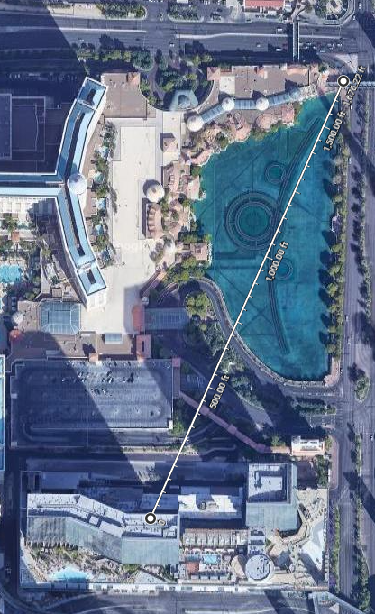
REAL WORLD TESTING
Las Vegas
Arguably, one of the world’s loudest urban environments is Vegas; believed to be one of the noisiest cities in the USA.
Despite this high-density environment, our HaLow technology achieved throughput of 1.8Mbps at a range of 510m (line-of-sight).

Slide 21
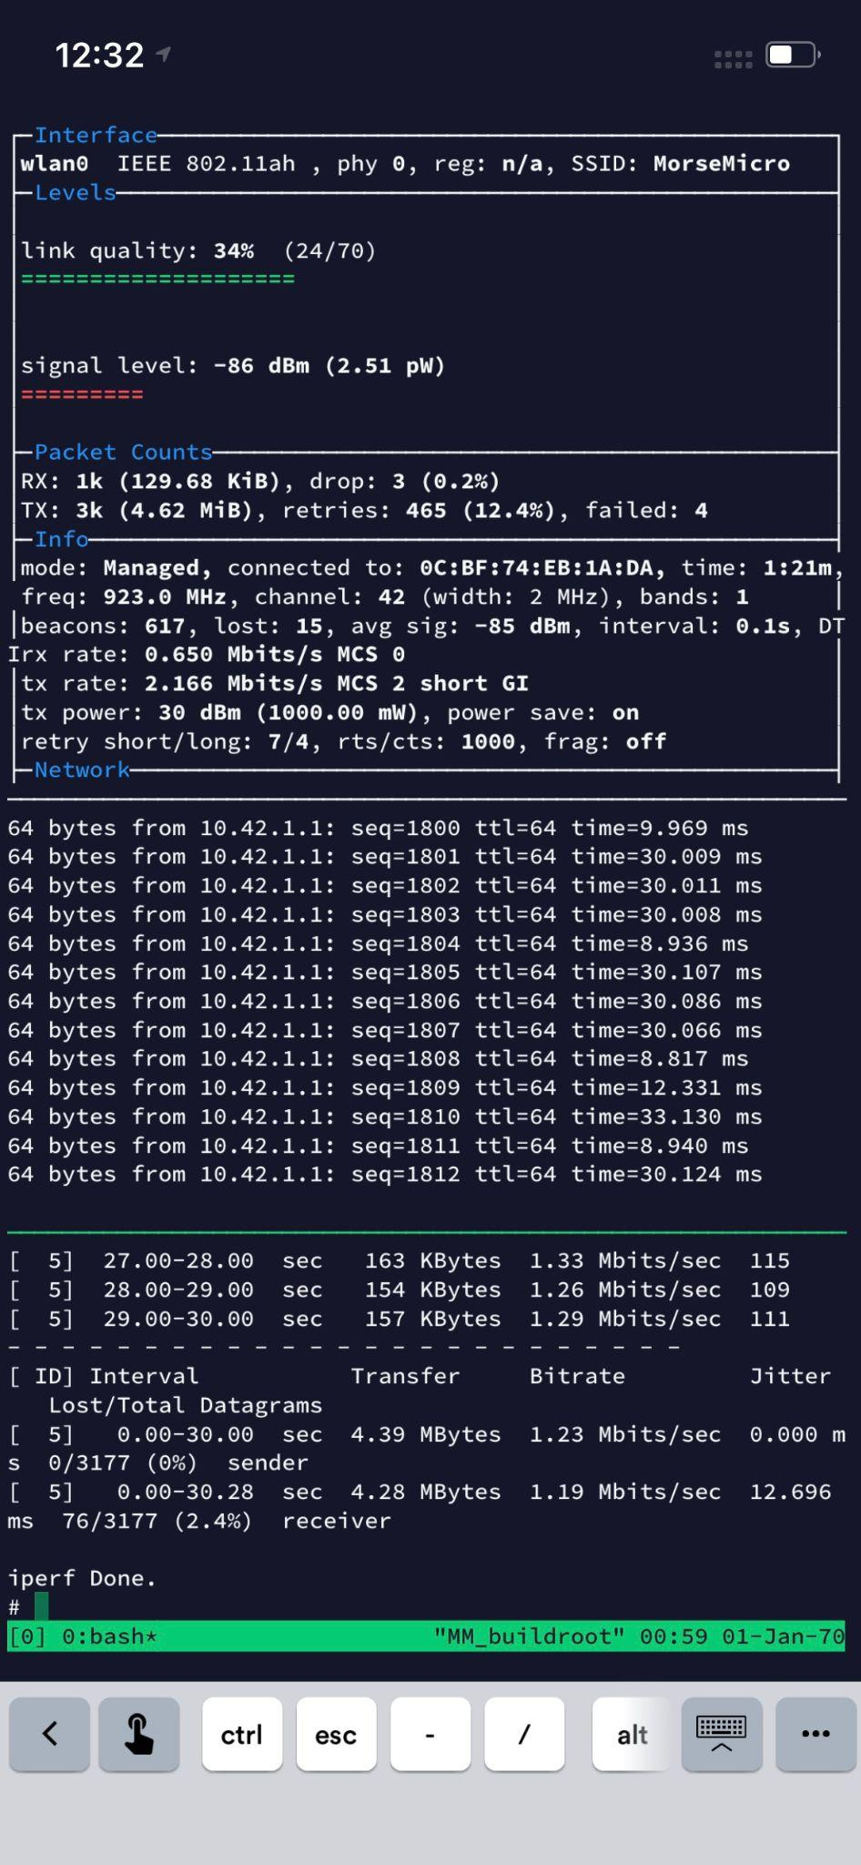
REAL WORLD TESTING
Joshua Tree
At the other end of the noise spectrum is Joshua Tree National Park. Here HaLow consistently maintained signal, with a low packet error rate across line of sight. Networking throughput was measured 1.2Mbps across the terrain with a max distance of 15.48km.
‹#›

Slide 22
Experimental data for a mobile user (10 mph)
REAL WORLD TESTING
Ref: Il-Gu Lee, et al, “ WiFi HaLow for Long-Range and Low-Power Internet of Things: System on Chip Development and Performance Evaluation”, IEEE Communications Magazine, July 2021.
‹#›

Slide 23
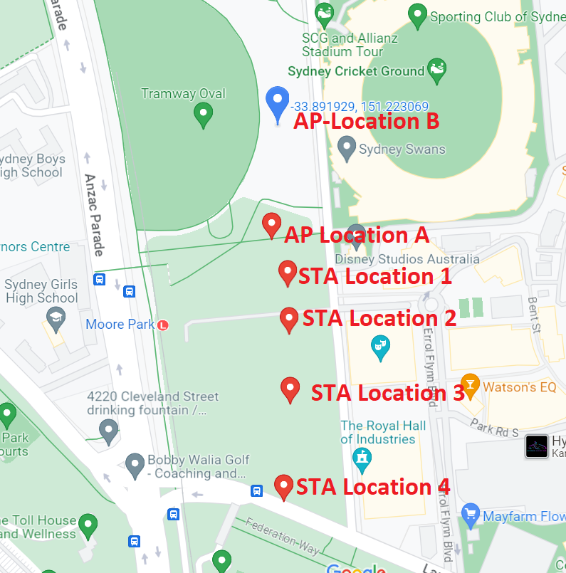
Experimental data for static user in public park
REAL WORLD TESTING
AP Location A - Approx. 60cm from ground
STA at 1.5m height was moved to 4 locations (Multipath Ch)
iPerf from STA to AP
Performance constrained by non-WLAN Interference
STA Location # | Distance from AP-A (m) | AP RSSI (dBm) | Min rate (Mbps) | Max rate (Mbps) | Avg. Rate (Mbps)
1 | 60 | -45 | 12.7 | 20.1 | 17.5
2 | 110 | -63 | 6.3 | 12.3 | 9.2
3 | 170 | -65 | 2.1 | 12.7 | 10.3
4 | 270 | -77 | 1.85 | 4.2 | 3.2
‹#›

Slide 24
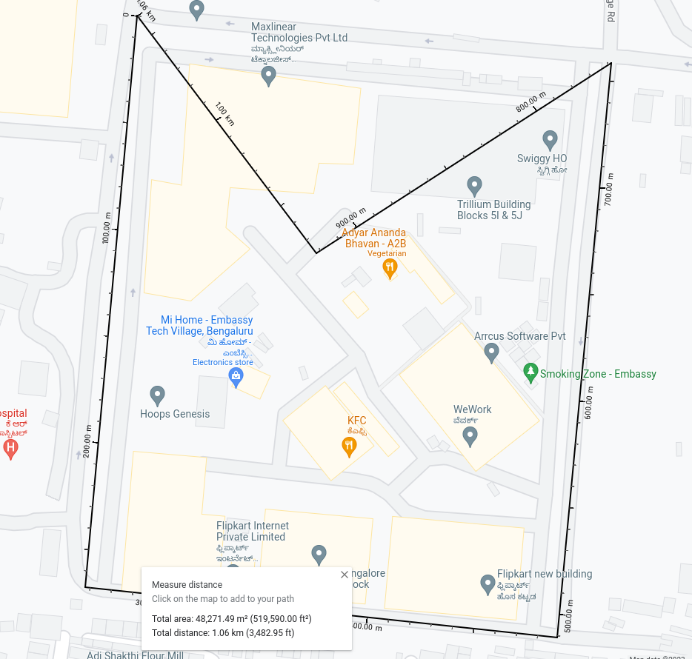
Experimental data for 802.11s Mesh over Wi-Fi HaLoW
REAL WORLD TESTING
5 Mesh nodes - OTA testing at Embassy Tech Village, Bangalore
Providing seamless wireless connectivity over an area of more than 1KM, which is covered with full of tall buildings.
Nodes placed 4 corners of a rectangular area and 5th node in approximate central location with non-line of sight distance.
Mesh allows further range increase addressing wide range of applications like smart cities, industrial automation, and smart agriculture, disaster response.
Node # | Distance from Central node | RSSI (dBm)
1 | 200m (non line of sight) | -62dBm
2 | 250m (non line of sight) | -66dBm
3 | 600m (2 hops) | -62dBm, -52 dBm
4 | 750m (2 hops) | -66dBm, -55dBm
‹#›

Slide 25
Wi-Fi HaLow ecosystem
Working together - our ODM partners and evaluation kits

Slide 26
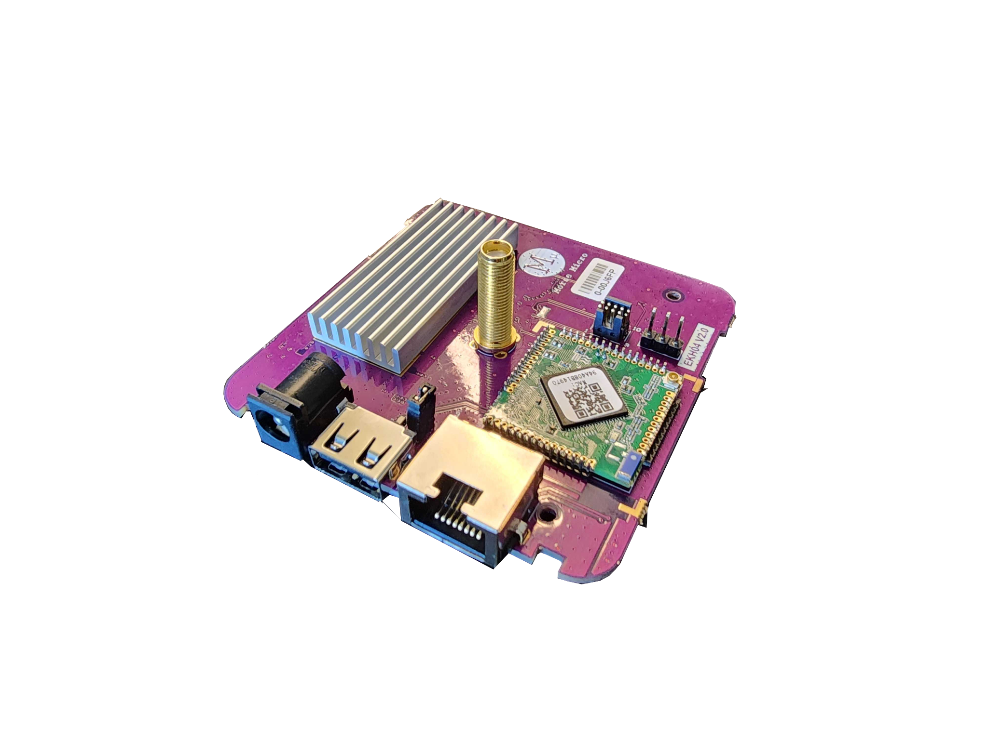
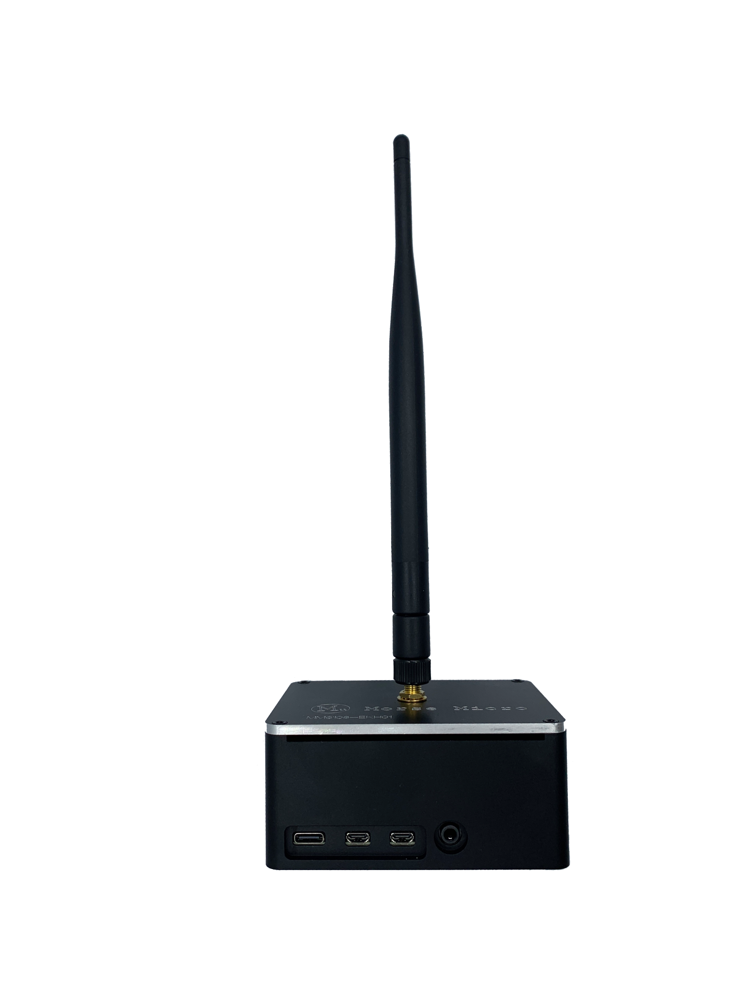
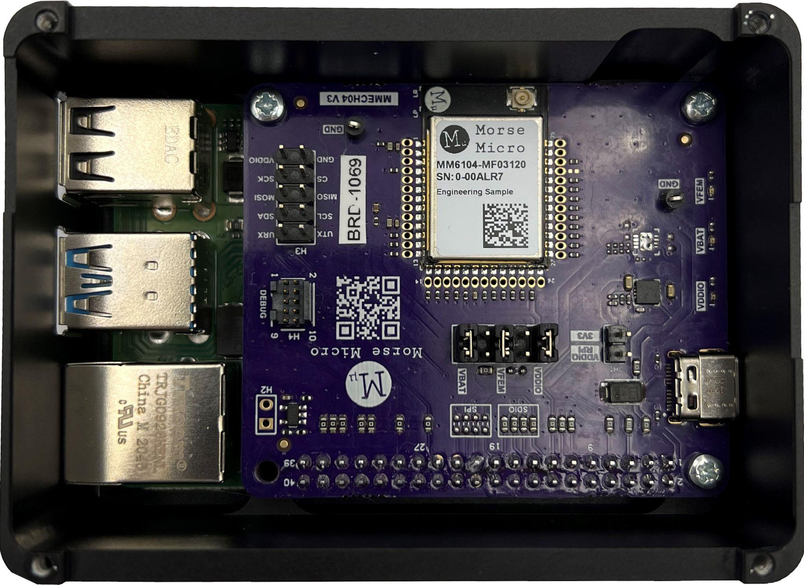
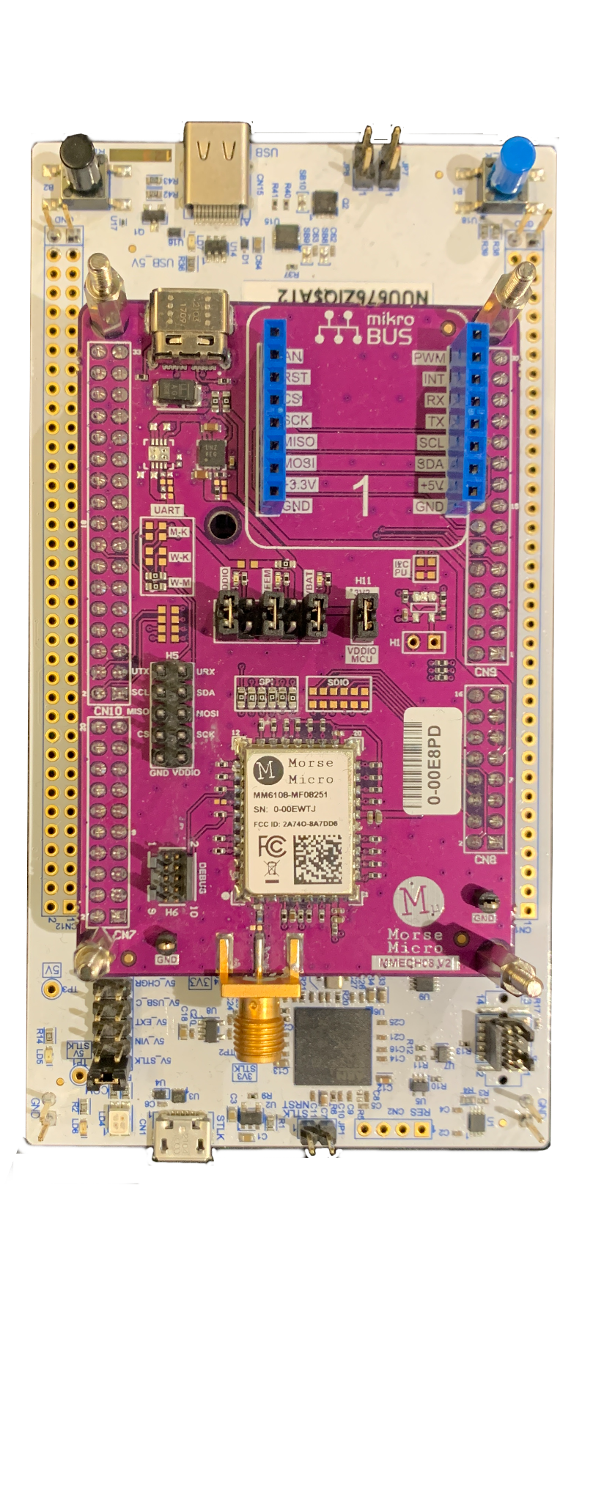
Platforms at a glance
WI-FI HALOW HARDWARE PLATFORMS
MM6108-EKH01
Wi-Fi HaLow RPi-Hat + RPi + Enclosure
MM6108-EKH08-01
Wi-Fi HaLow Shield + STMicro STM32WB55RG
MM6108-EKH04
Wi-Fi HaLow Router / USB Adapter / Ethernet Adapter
‹#›

Slide 27
Software Support
WI-FI HALOW SOFTWARE PLATFORMS
AP Platforms (EKH01 & EKH04):
OS Support
Linux (RPi4B)
OpenWRT (Mediatek)
Full compliance with WFA-HaLow
Features
Native Linux cfg80211/mac80211
Various modes of operation
AP & STA modes
Extender / Router
Bridge (AP/STA)
WMM
WPA3-SAE (PMF) & OWE
DPP - Device Provisioning Protocol
TWT - Target Wakeup Time
RAW - Restricted Access Window
WFA Easy-Mesh and 802.11s Mesh
IBSS (Ad-Hoc) with BATMAN
CAC (Centralized Auth Control)
STA Platform (EKH08):
OS Support
FreeRTOS (STM32 MCU)
Full compliance with WFA-HaLow
Features
LWIP support (IPv6, IPv4, TCP/UDP)
WMM
WPA3-SAE (PMF) & OWE
RAW - Restricted Access Window
BSS Colour
Proprietary Power Save Extensions
TIM Segmentation
S1G Rate Control
‹#›
Notes:
1MHz OBW Performance. 8MHz is better

Slide 28
Chicony - Wi-Fi HaLow Camera
WI-FI HALOW APPLICATIONS
Morse Micro MM6108 Wi-Fi HaLow
Ambarella & Sigmastar Camera SoC
PIR support

Slide 29
ALFA Networks - Wi-Fi HaLow AP
WI-FI HALOW APPLICATIONS
Morse Micro MM6108 Wi-Fi HaLow
MediaTek MT7628 2x2 Wi-Fi 4 router SoC
Ethernet with PoE
Linux OpenWRT
Applications
Wi-Fi HaLow Router
Wi-Fi HaLow AP
Ethernet / USB to Wi-Fi HaLow adapter
‹#›

Slide 30
Module Partners
WI-FI HALOW APPLICATIONS
Several module ODM partners already manufacturing Wi-Fi HaLow modules based on Morse Micro’s MM6108 microchip, and leveraging FCC-certified reference designs. These modules are compliant with IEEE 802.11ah and Wi-Fi HaLow. It operates in 850–950MHz bands with 1/2/4/8MHz channel width.
P/N: FGH100M
LGA module, 44-pins
Dimension: 13x13x2.2mm
Host I/F: SDIO/SPI
Sample: Now
P/N: AW-HM581
LGA module, 44-pins
Dimension:13x13x2.1mm
Host I/F: SDIO/SPI
Sample: Now
P/N: AW-HM593
Stamp module, 34-pins
Dimension: 14x18.5x2.25mm
Host I/F: SDIO/SPI
Sample: Now
P/N: MM610X-001
Stamp module, 43-pins
Dimension: 22x17x2.0mm
Host I/F: SDIO/SPI
Sample: Now

Slide 31
Indoor Testing and Power Consumption
REAL WORLD TESTING
Device Latency | Average Power @ VBAT (Gen 1 device) | Calculated Battery Lifetime for 4200 mAh | Average Power @ VBAT (Gen 2 device) | Calculated Battery Lifetime for 4200 mAh
Sleep mode | 158 uW | 10 years | 66 uW | 23 years
Receive Beacon@ Wakeup Interval = 300 msec (DTIM = 3) | 1.18 mW (including the sleep mode current) | 1.3 years | 683 uW (including the sleep mode current) | 2.3 years
Receive Beacon@ Wakeup Interval = 1 sec (DTIM = 10) | 465 uW (including the sleep mode current) | 3.4 years | 250 uW (including the sleep mode current) | 6.3 years
Receive Beacon@ Wakeup Interval = 5 sec (DTIM = 50) | 218 uW (including the sleep mode current) | 7.25 years | 102 uW (including the sleep mode current) | 15 years
‹#›
Notes:
1MHz OBW Performance. 8MHz is better

Slide 32
LoRA Vs HaLow in India/EU
REAL WORLD TESTING
LoRA Vs HaLow in India/EU
11ah [India, EU]: For digital transmissions with occupied bandwidth (OBW) between 600K and 1 MHz, the maximum allowed Tx Power is limited to 25 mW (+14 dBm) [Ref: EN 304-220]
There is a <10% duty cycle limit for a AP device and <2.8% duty cycle limit for a STA device [Ref: India GSR. 853 (E) dated 10-Dec-2021]
LoRa [India, EU] Though being a low bandwidth device with OBW of 125 KHz, upto 25mW Tx power is only permitted
<0.1% duty cycle limit applies in EU [EN 300-220]
10% duty cycle limit applies for AP and upto 2.5% limit applies for STA [India GSR. 853 (E) dated 10-Dec-2021]
Number of bytes that can be transferred in 1 sec for 11ah with 2.8% duty cycle is >100 Kbps (STS=1)
Tens of voice channels and several sensor data can be transferred even with this restriction
With 25 mW (14 dBm) Tx power restriction, the range can be lower
But, for the same Tx power LoRA can send only few tens of bps compared to 100 Kbps for 11ah

Slide 33
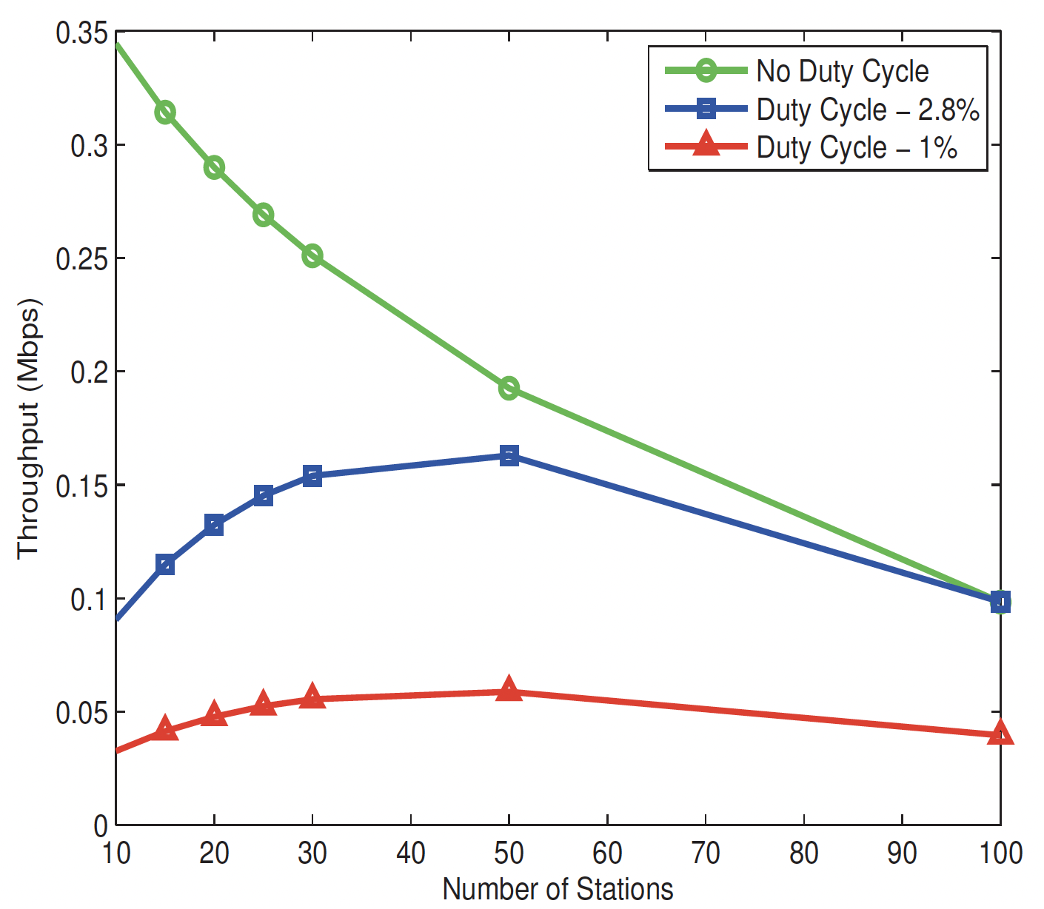
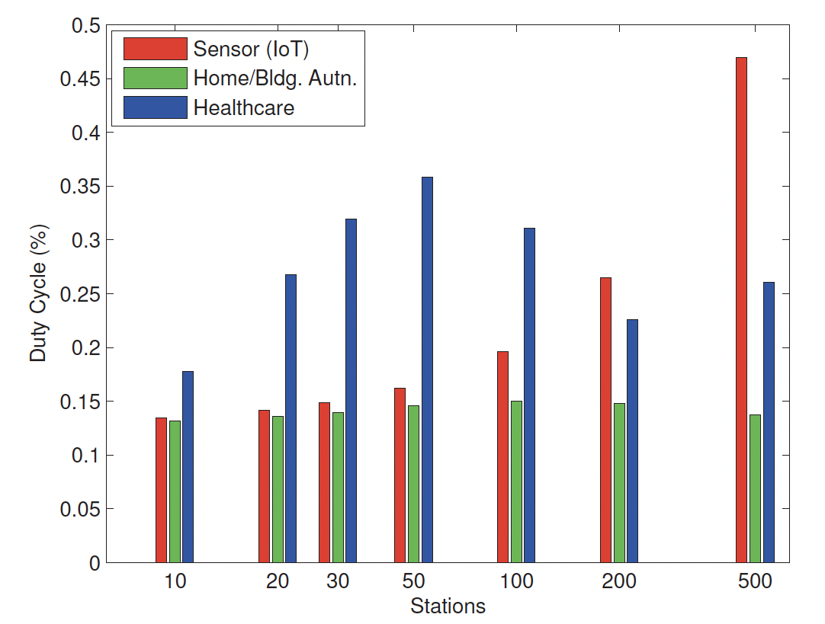
Network throughput with duty cycle limitation
REAL WORLD TESTING
As the number of stations increase, the average throughput per STA comes down due to the shared media
Having per STA duty cycle restriction does not cripple the network in both saturated and unsaturated network
AP’s duty cycle also will not be bottleneck for most of the practical applications
Network Throughput in Saturated Traffic with STA duty cycle limitation
(b) AP Duty cycle in Unsaturated Traffic with 2.8% STA limit
Ref: M. Qutab-ud-din, et al, “Duty Cycle Challenges of IEEE 802.11ah Networks in M2M and IoT Applications “, European Wireless 2016,

Slide 34
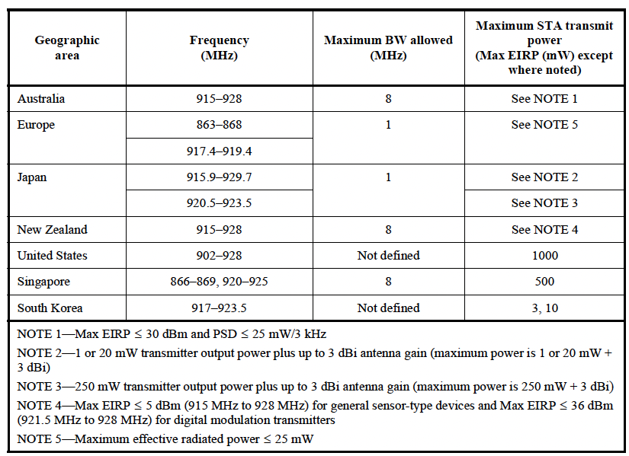
Regulatory Requirements WW(1)
REAL WORLD TESTING
Transmitter Regulations (except Mask)
Note: Indian specifications is similar to EU Regulations with different duty cycle requirements

Slide 35
Awards and Recognitions
Wi-Fi HaLow silicon
Industrial IOT - Product of the year 2022,2023
CES Innovation awards 2021
Embedded wireless solution of the year, WiFi Now- 2021
Product of the year, IOT Evolution Awards- 2021
Best WiFi IOT product, WiFi Now- 2020

Slide 36
Our board of directors & advisors
OVERVIEW
Strong board with experience in building and scaling successful businesses.
Michael De Nil Board Member
Founder & CEO
Morse Micro
Andrew Terry
Board Member
Founder & CTO Morse Micro
Bill Bartee
Board Member
Managing Partner
Main Sequence Ventures
Ray Stata Board Member
Founder & Chair of Analog Devices
Robyn Denholm
Advisor
Operating Partner Blackbird & Chair of Tesla

Slide 37
Global presence
OVERVIEW
Tokyo
Hangzhou
Cambridge
San Jose
Irvine
Boston
Taipei
Bangalore
Sydney - HQ

Slide 38
Summary
CONCLUSIONS
IEEE 802.11ah is clearly a winner when it comes to Wi-Fi IoT applications
24.5 dB performance boost coming from the Sub 1 GHz carrier, 10x lower bandwidth and MCS10
Wide range of BW, data rates and operating distance supported by one standard
One Wi-Fi standard device which caters to multiple class of IoT devices
From a few hundred Kbps to tens of Mbps makes it a reality
>2 Km range coverage enables several wireless sensor applications which were not possible earlier
Upto 8191 devices per AP allows dense deployment of sensors in a warehouse scenario
High MAC efficiency and low power snooze power snooze enables to conserve the battery
4200 mAh battery can last for a few years to 15 years depending on the latency of the sensor and data
Availability of WW Sub 1 GHz ISM band channels make the deployment ubiquitous
Restriction of Tx power and duty cycling does not preclude made sensor applications
Morse Micro - a clear leader in 802.11ah devices in terms of power, performance and price
Current offering in terms of reference designs, commercial modules and silicon sales has enabled several OEMs and ODMs

Slide 39
Thank you
Contact: www.morsemicro.com

Slide 40
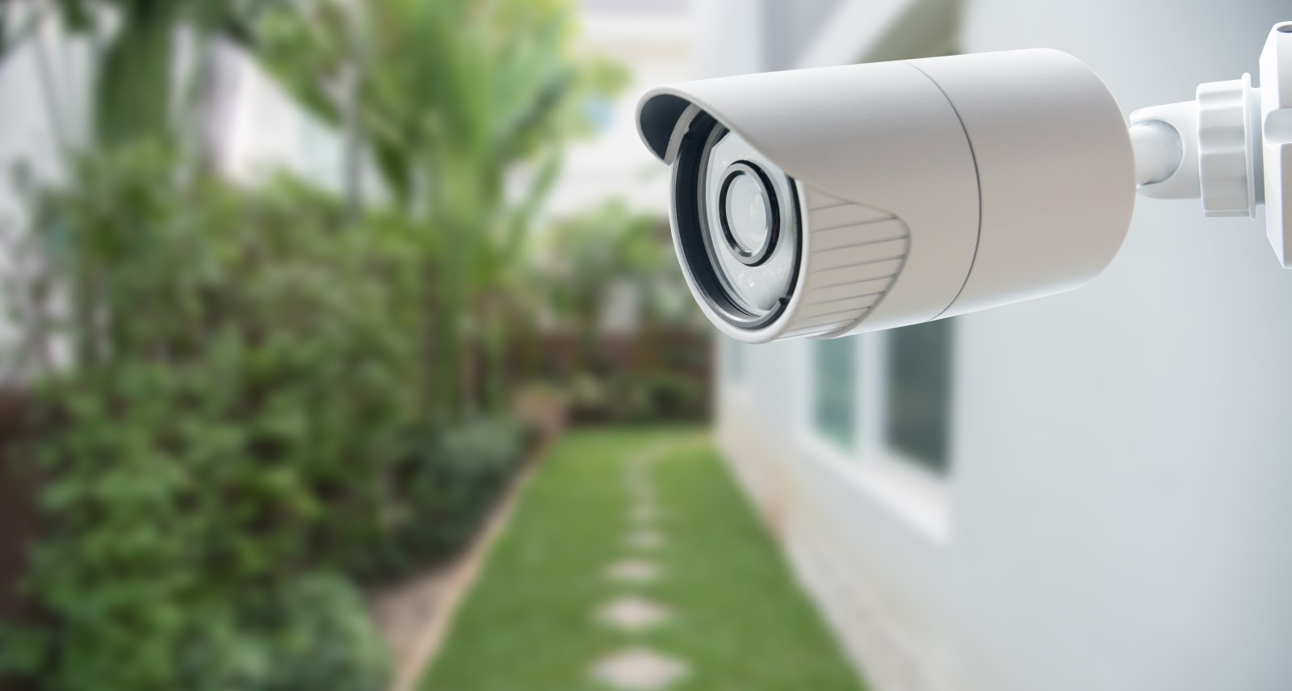
Video connectivity
USE CASES
Ultra-low power consumption
>100x area coverage
8-MHz bandwidth suitable for HD video
Better penetration through walls

Slide 41
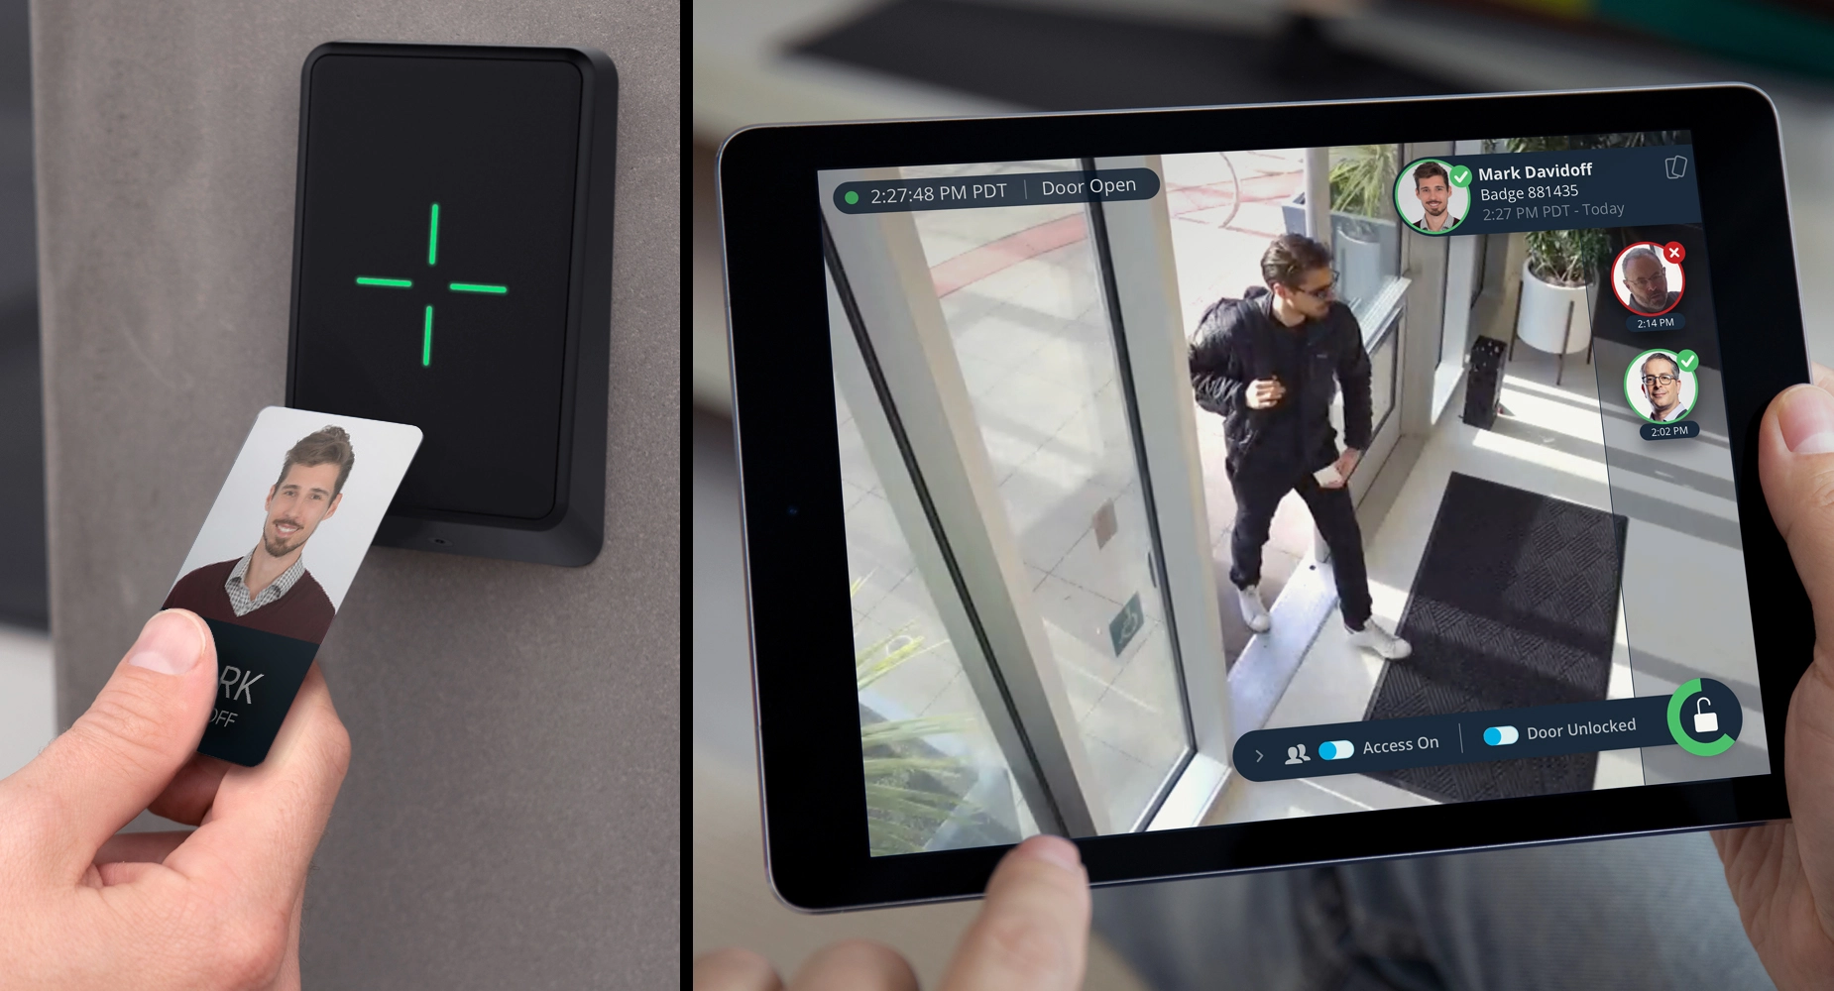
Access control
USE CASES
Whole building coverage
Simplified infrastructure
Better penetration
through walls & floors
WPA3 secure & IPv6 ready

Slide 42
Home automation
USE CASES
Indoor & outdoor reach from a single AP
Better penetration through walls & obstacles
No dependency on Wi-Fi mesh
IPv6 ready &
WPA3 secure

Slide 43
Mesh APs
USE CASES
Secondary backhaul for extended range
Out-of-band mesh configuration
Connectivity diagnostics
Wi-Fi HaLow for IoT at longer range
Notes:
Vendor name is masked as it is not public information yet

Slide 44
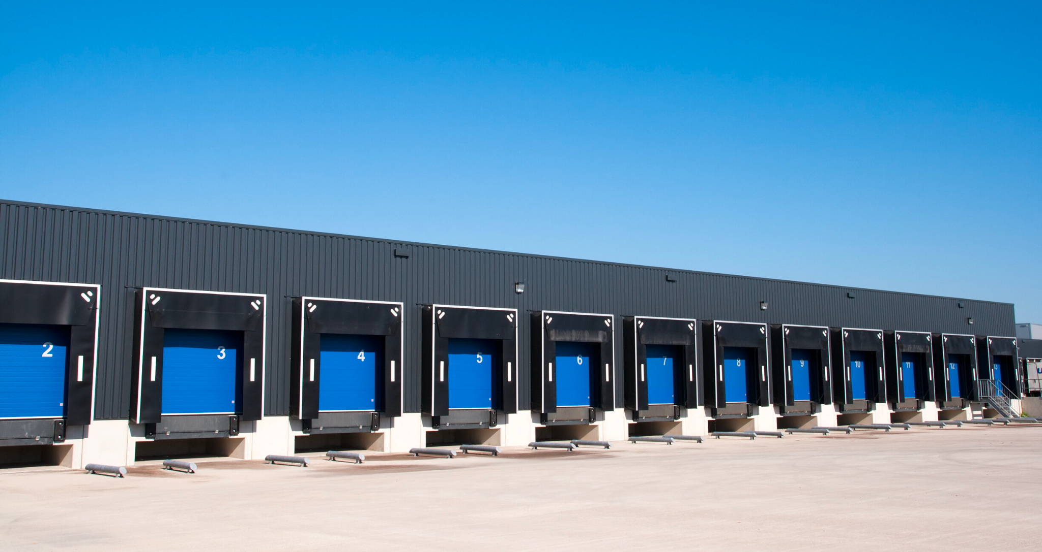
Building automation
USE CASES
Whole building coverage with single AP
Outdoor reach for yard connectivity
WPA3 secure & IPv6 ready
Address up to 8,191 STAs per AP

